Slide 1
Mutiny, Murder & Political Controversy
Robert Hadler
presentation to the
Samuel Griffith Society
Thursday, 6 May 2021

Slide 2
Observations
Australia has historically ceded control over its military to gain super-power protection in times of conflict
A mutiny in 1919 was a missed opportunity to confront and rectify a lack of control over our naval forces
Australia failed to assert its legal independence in 1931 when it was encouraged to do so by Great Britain
A military and diplomatic crisis in 1942 led to the adoption of the Statute of Westminster

Slide 4
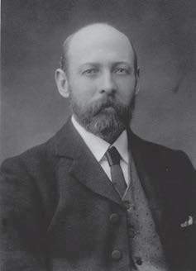
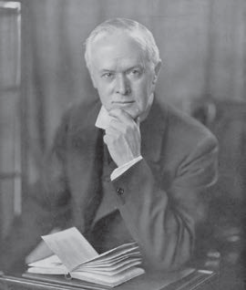
RAN transferred to RN control in 1914
Prime Minister Joseph Cook
The Swiss Studios Photograph
National Library of Australia
136285375
Governor General
Sir Ronald Munro Ferguson
Novar Collection
National Library of Australia 11450

Slide 5
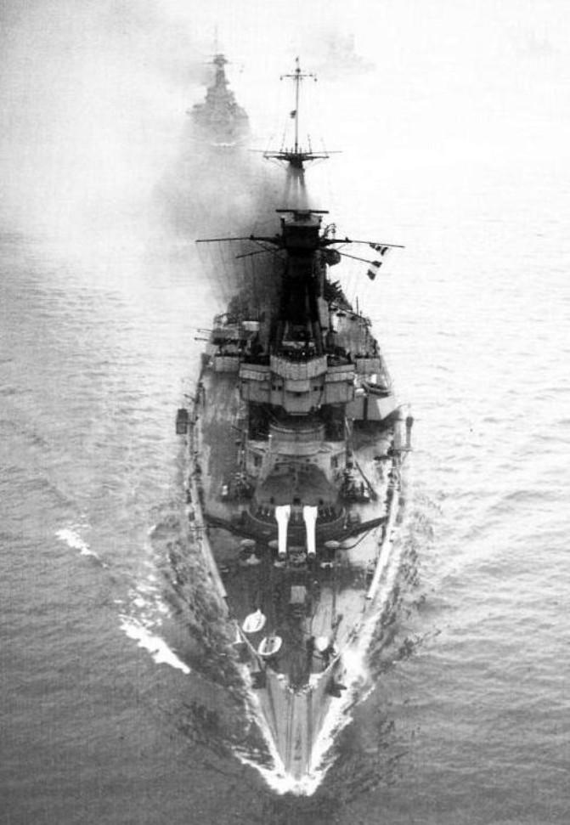
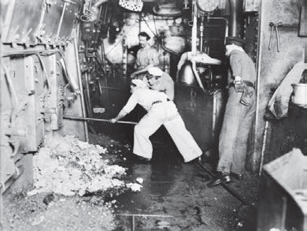
An unlucky and unhappy ship
Stokers cleaning the furnaces
Australian War Memorial EN00535
HMAS Australia I in North Sea
Australian War Memorial EN0540

Slide 6
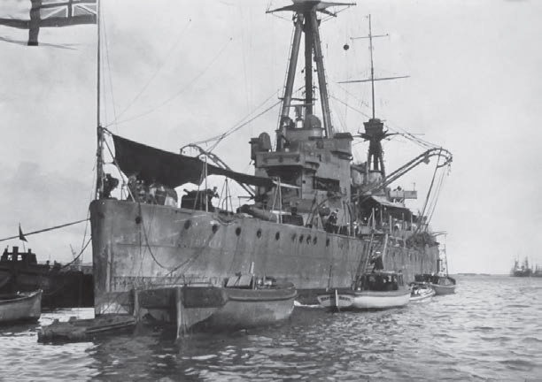
Mutiny in Fremantle - 1 June 1919
HMAS Australia I moored at Fremantle
Roy Phelan collection
Courtesy of the Australian Naval Historical Society

Slide 7
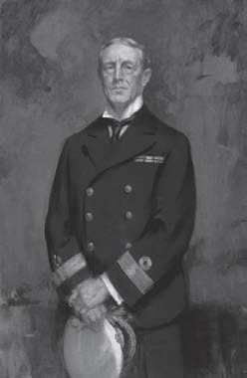
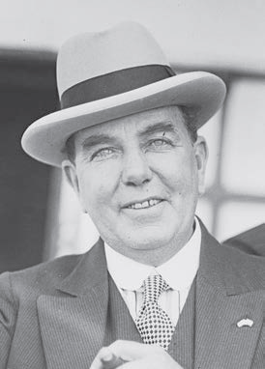
Court martial in Sydney
Commodore John Glossop
President of the Court Martial
Australian War Memorial
ART 03352
Dick Orchard, MP
‘Prisoners Friend’ at the Court Martial
Fairfax Archives
National Library of Australia 162839118

Slide 8
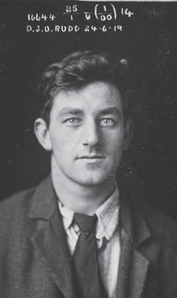
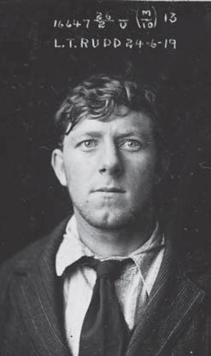
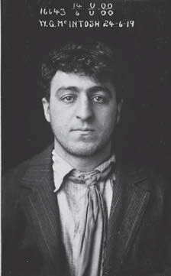
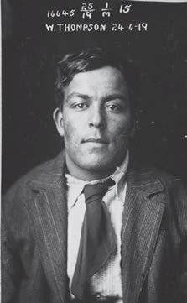
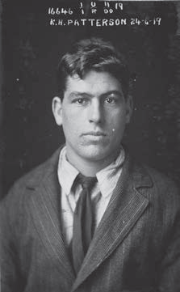
Five ring leaders sentenced to gaol
Dal Rudd
NRS2467, 3/6101/16644
Lenny Rudd
NRS2467, 3/6101/16647
Bill McIntosh
NRS2467
3/6101/16643
Pitta Thompson
NRS2467
3/6101/16645
Ken Paterson
NRS2467
3/6101/16646

Slide 9
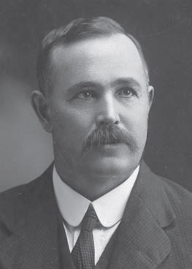
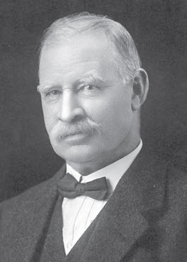
Political furore
NSW Labor Senator
Albert Gardiner
National Library of Australia
136795617
Acting Navy Minister
Alec Poynton MP
Broothorn Studios Photograph
National Library of Australia
136692261

Slide 10
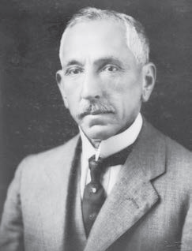
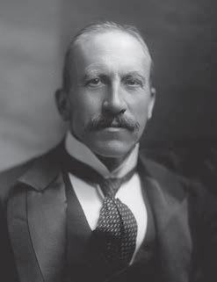
Diplomatic intervention
Prime Minister Billy Hughes
Australian War Memorial H16071
Colonial Secretary
Viscount Alfred Milner
Henry Walter Barnett Photograph
National Portrait Gallery 188577

Slide 11
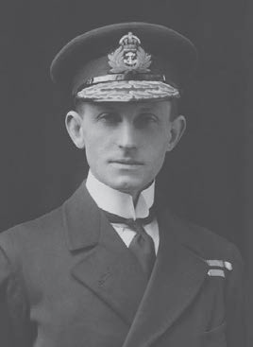
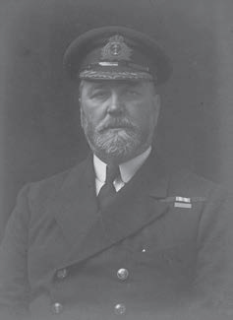
Naval resignations avoided
RAN Squadron Commander
Commodore John Dumaresq, RN
Australian War Memorial 305332
Chief of Australian Naval Staff
Rear Admiral Percy Grant, RN
Walter Stoneman Photograph
National Portrait Gallery 167922

Slide 13
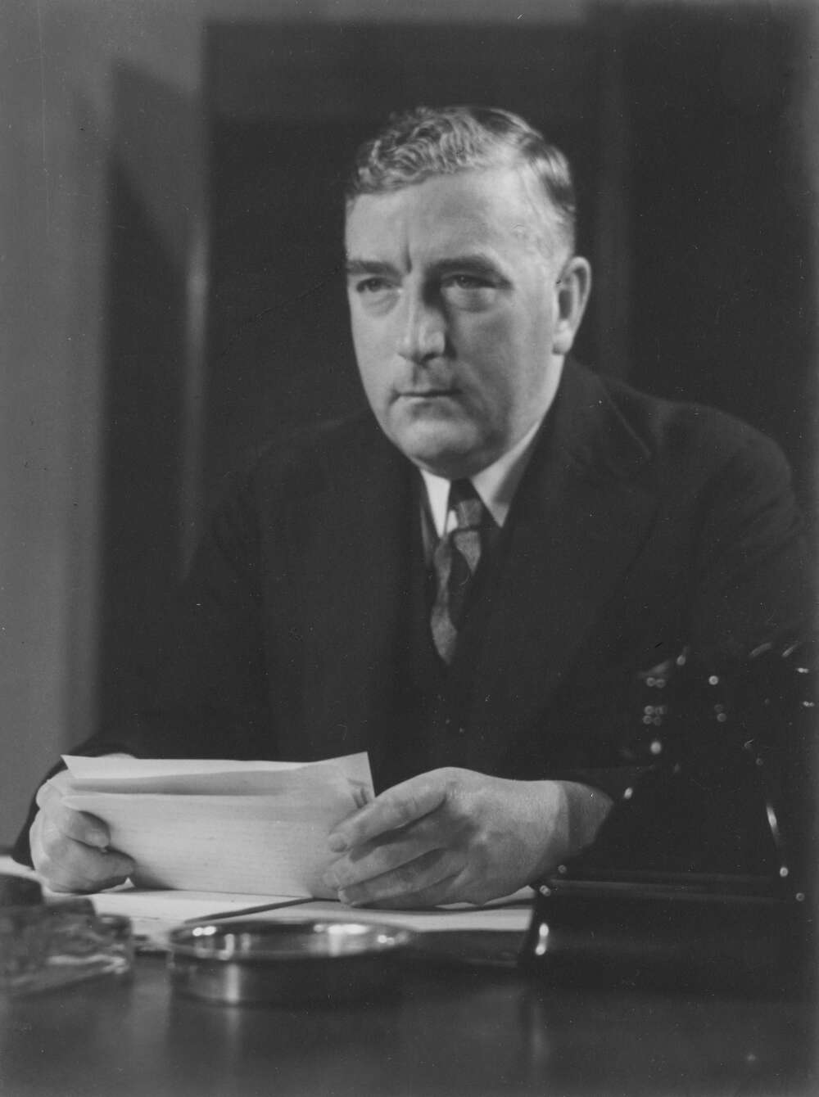
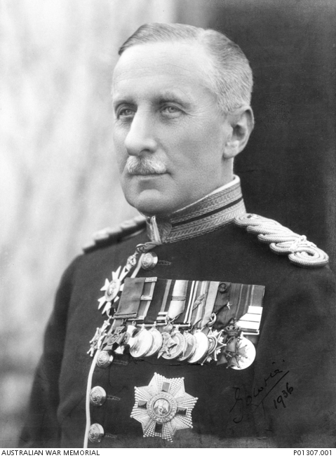
RAN ceded to RN control again in 1939
Robert Menzies
Prime Minister 1939-41
Declaration of War
National Library of Australia, 136636422
Alexander Hore-Ruthven
1st Earl of Gowrie
Governor General
Australian War Memorial Collection, P01307.001

Slide 14
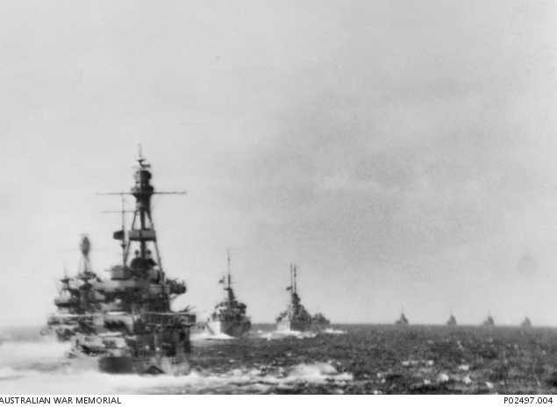
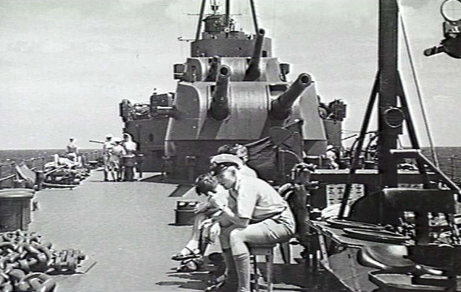
A lucky & happy ship
HMAS Australia II with Taskforce 44 into the Coral Sea, 1942
Australian War Memorial Collection, P02497.004
Seaman at 2nd degree readiness
HMAS Australia II in the Coral Sea, 1942
Australian War Memorial Collection, 305217

Slide 15
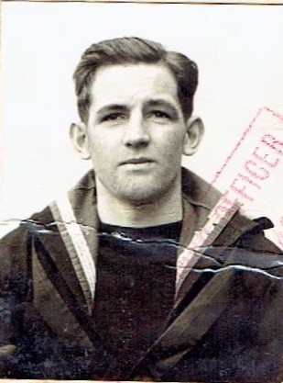
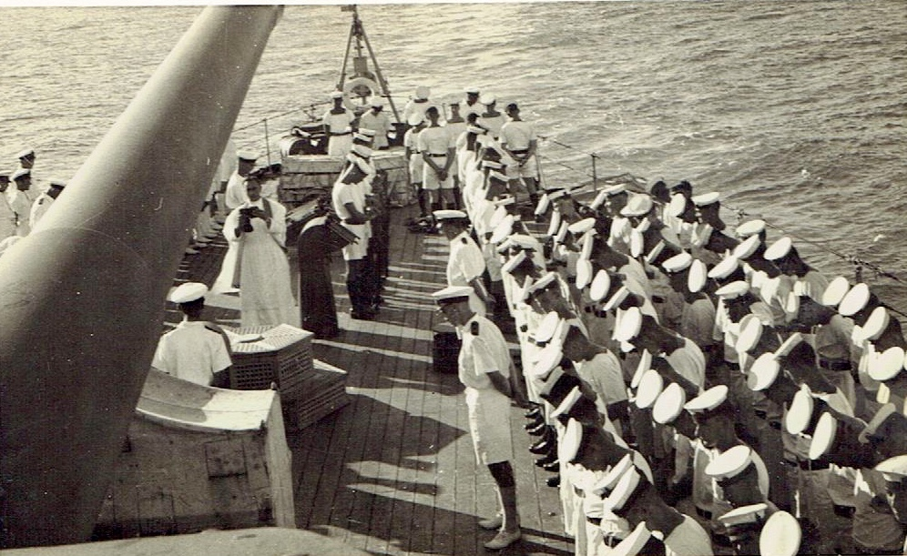
Jack Riley murdered
Burial at sea of Jack Riley, 17:00, 14 March 1942
Photograph sent to Blanche Riley by Anglican Reverend Frank Oliver
Carol Woods Collection
Jack Riley UK pass photo
Carol Woods Collection

Slide 16
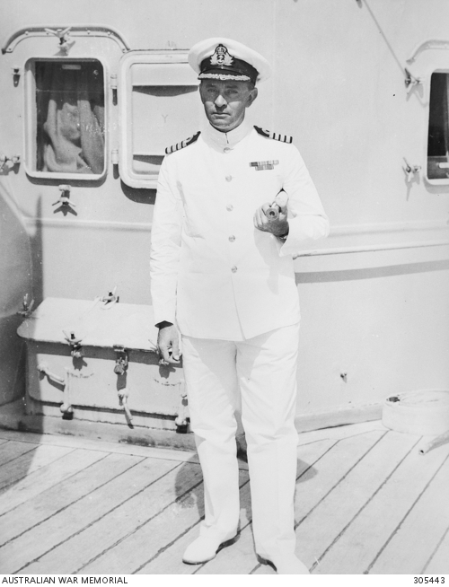
Court martial in Noumea
Captain Harold Farncomb, acted as prosecutor during the Court Martial
Australian War Memorial Collection, 305443
Paymaster Lieutenant Trevor Rapke
‘Prisoners Friend’ at the Court Martial
Jeremy Rapke Collection

Slide 17
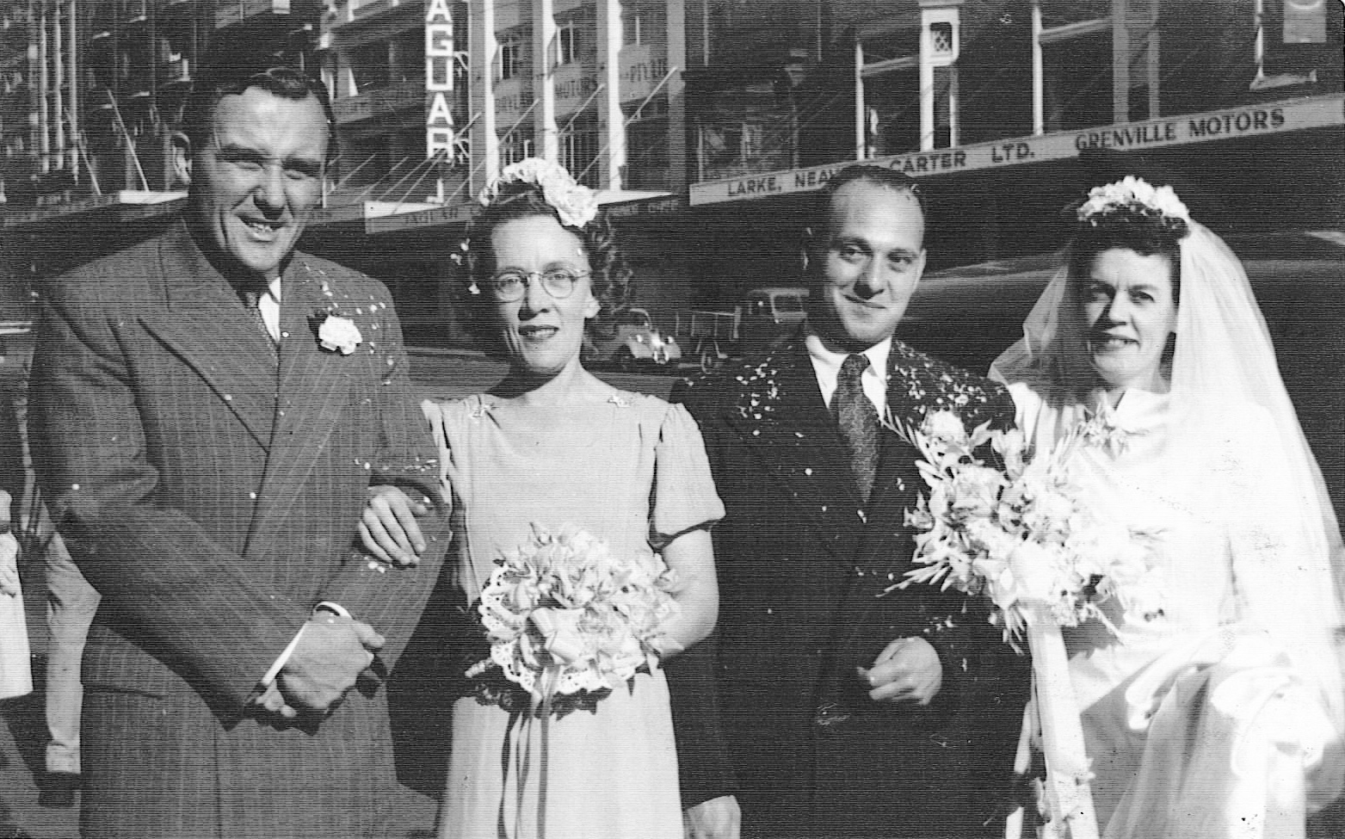
Ron Gordon & Ted Elias sentenced to death by hanging
Ted Elias marriage to Jean Harrison (on right)
with Ron Gordon and unnamed bridesmaid (on left)
Giles Yates Collection: ancestry.com.au

Slide 18
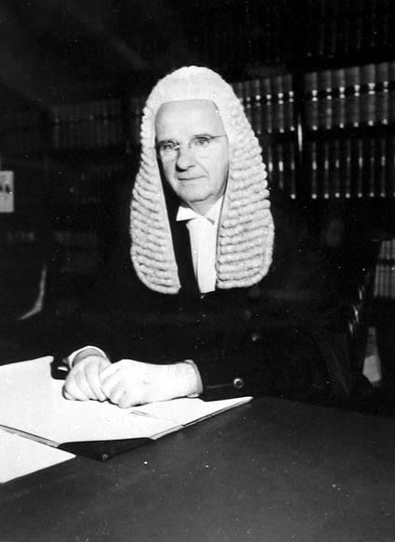
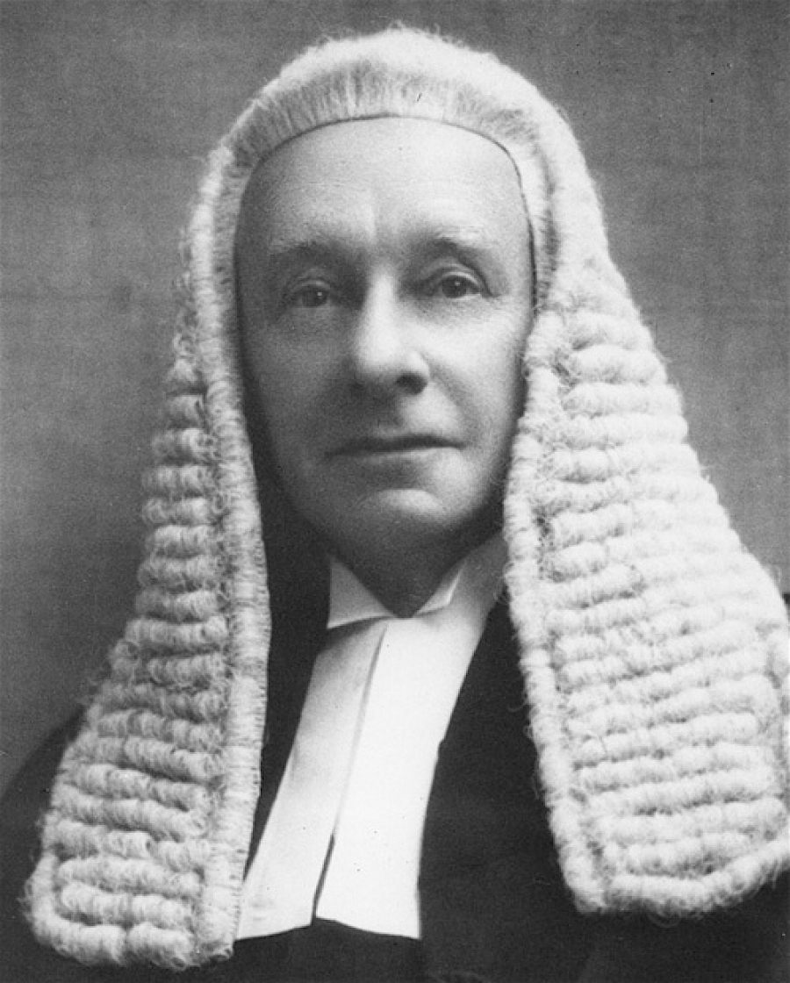
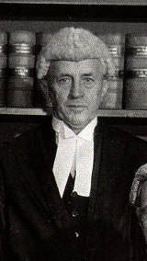
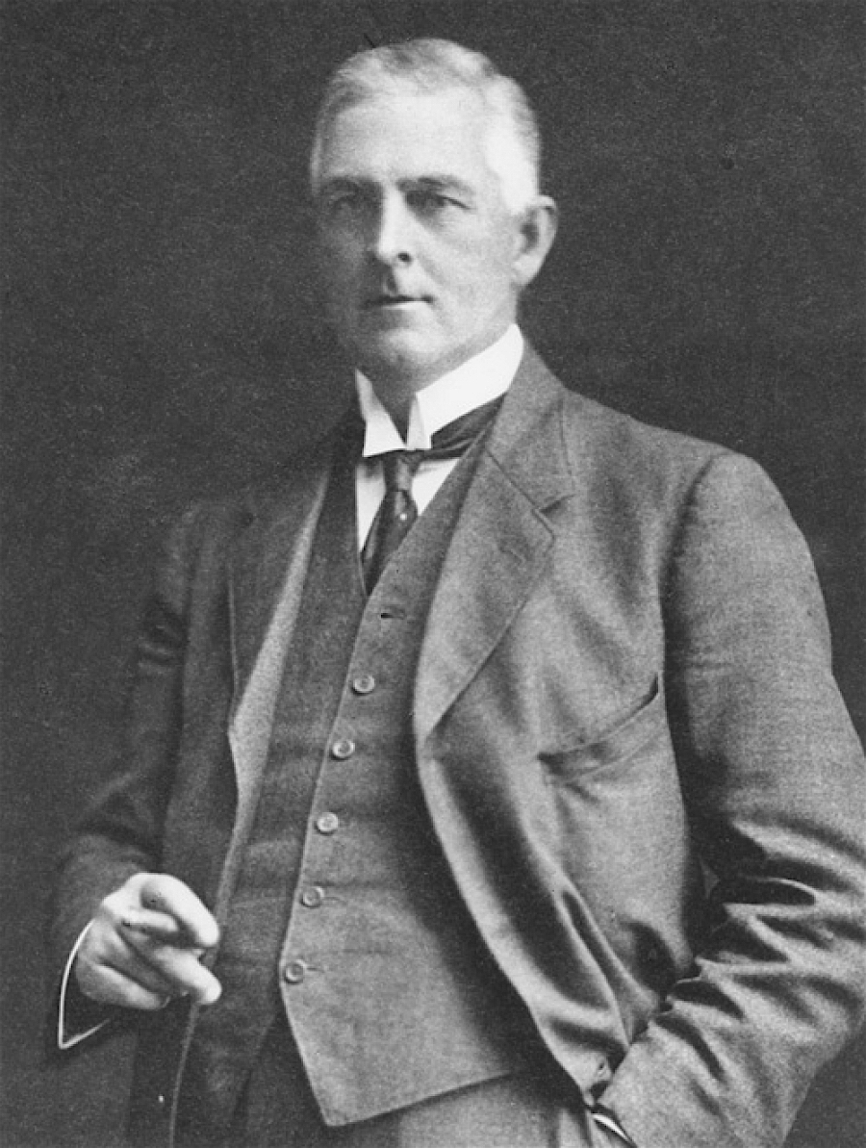
High Court appeal rejected
Sir Edward McTiernan
hcourt.gov.au
Sir George Rich, PC, KCMG, KC
hcourt.gov.au
Sir Dudley Williams
hcourt.gov.au
Sir Hayden Starke, KCMG
hcourt.gov.au

Slide 19
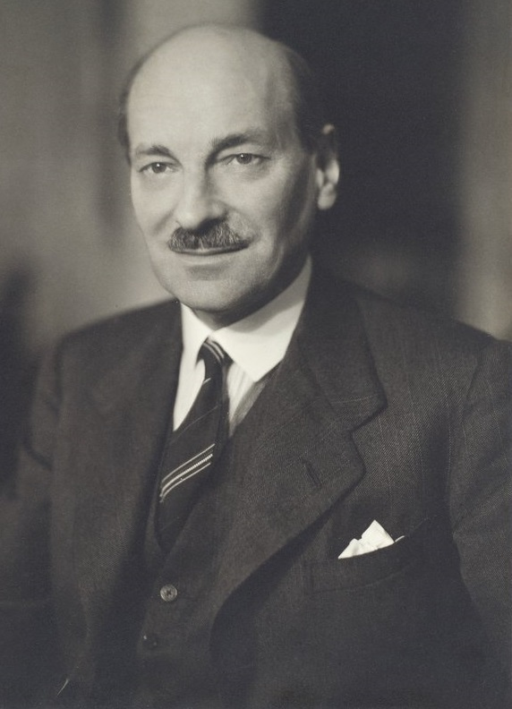
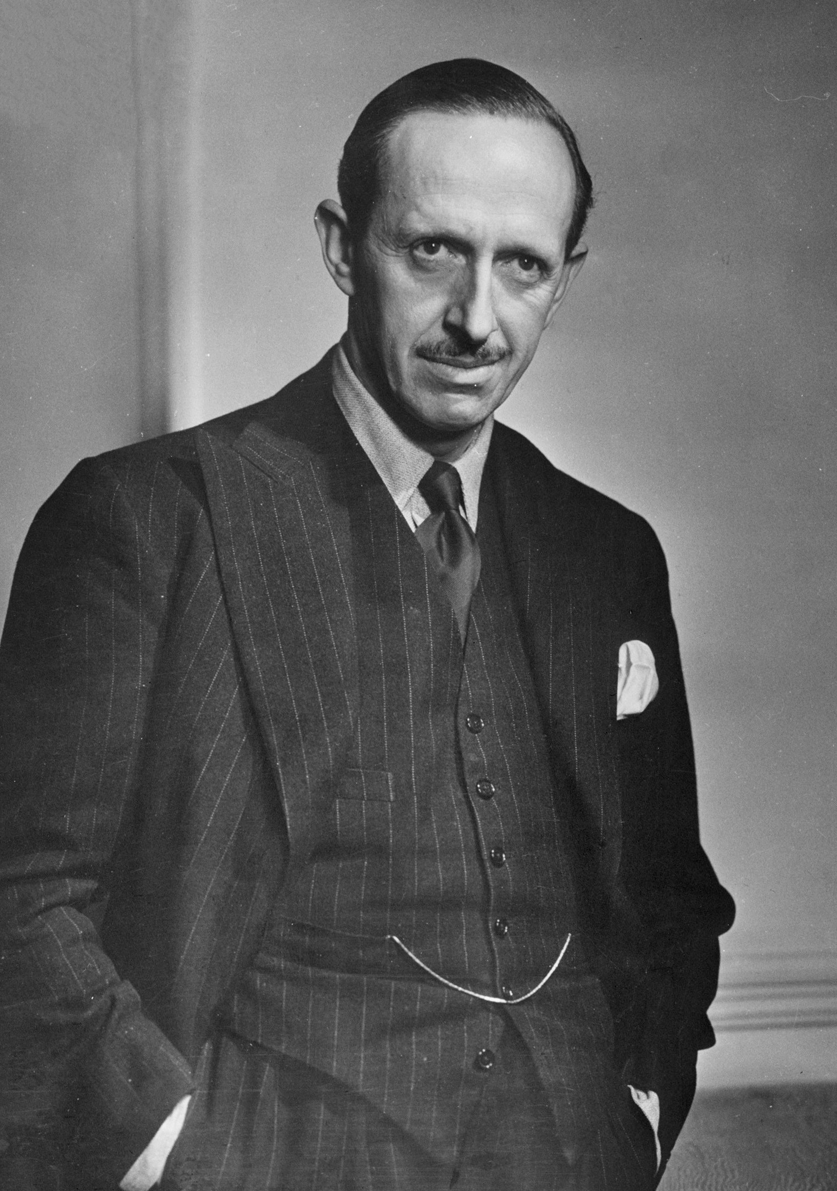
Diplomatic stand-off
Clement Atlee, Deputy Prime Minister, 1942-45 and Secretary of State for Dominion Affairs, 1942-43,
Flinders University, 31560859694
Robert Gascoyne-Cecil,
Viscount Cranborne,
Secretary of State for the Colonies
Yousuf Karsh, Dutch National Archives, 902-2081

Slide 20
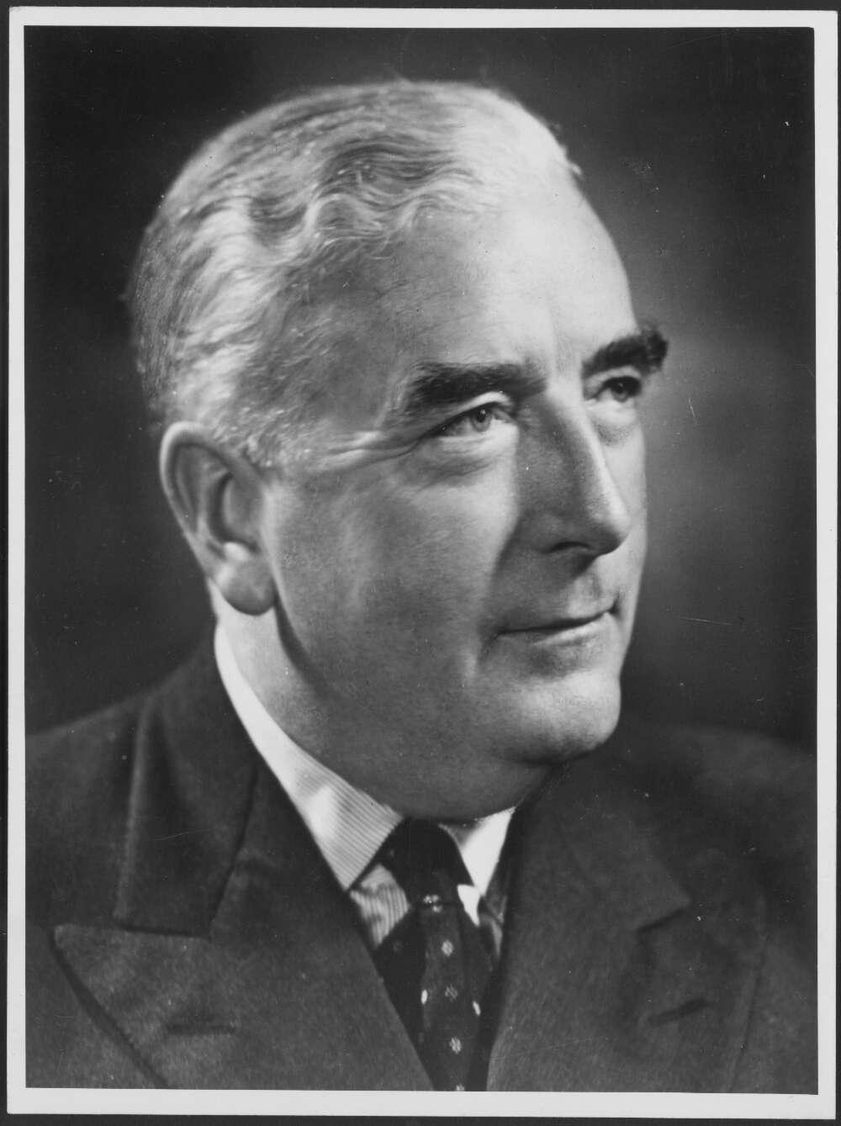
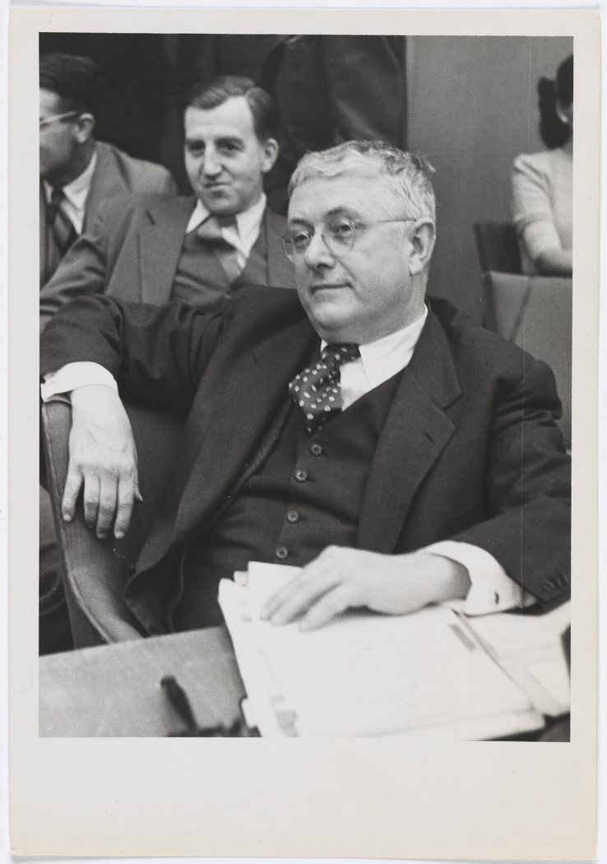
The Statute of Westminster
Opposition Leader, Robert Menzies
National Library of Australia, 136264652
Bert Evatt listening to debate
State Library of NSW, 110316141

Slide 21
Conclusions
Australia should not place our servicemen and women under the control of allied countries
Past experience shows allied countries will not be sympathetic to Australian mitigation requests
Political intervention in military matters, especially disciplinary action, poses major risks

