Slide 1
Mutiny, Murder & Political Controversy
Robert Hadler
book launch at the
National Press Club
Wednesday, 26 May 2021

Slide 2
Key Points
Australia ceded control over its navy as part of its military alliance with Great Britain in WWI and WWII
A mutiny in 1919 was a missed opportunity to confront and rectify a lack of control over our naval forces
Australia also failed to assert its legal independence in 1931 when it was encouraged to do so by Great Britain
But a murder in 1942 finally led to the adoption of the Statute of Westminster and legal independence

Slide 4
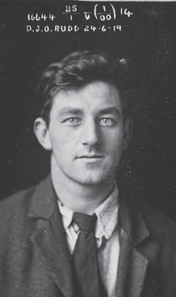
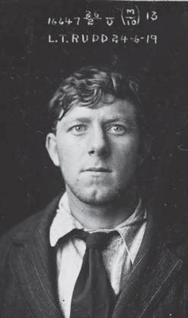
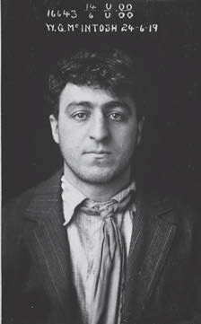
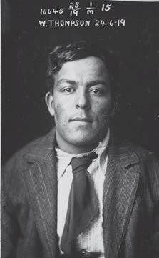
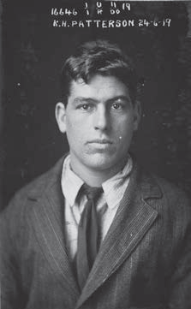
Five teenagers joined the RAN for adventure and glory
Dal Rudd
NRS2467, 3/6101/16644
Lenny Rudd
NRS2467, 3/6101/16647
Bill McIntosh
NRS2467
3/6101/16643
Pitta Thompson
NRS2467
3/6101/16645
Ken Paterson
NRS2467
3/6101/16646

Slide 5
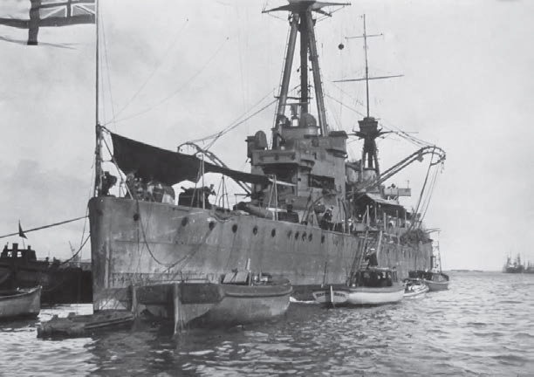
But five years of war drove them to mutiny in Fremantle on 1 June 1919
HMAS Australia I moored at Fremantle
Roy Phelan collection
Courtesy of the Australian Naval Historical Society

Slide 6
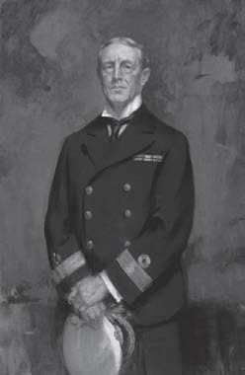
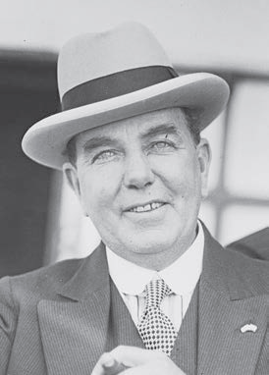
Court martial in Sydney
Commodore John Glossop
President of the Court Martial
Australian War Memorial
ART 03352
Dick Orchard, MP
‘Prisoners Friend’ at the Court Martial
Fairfax Archives
National Library of Australia 162839118

Slide 7
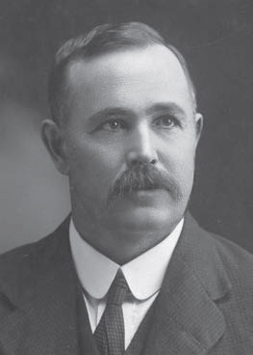
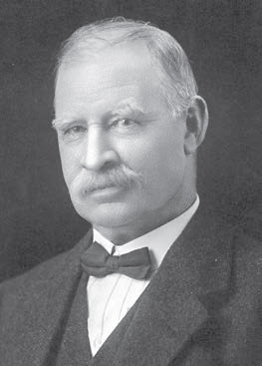
Political furore
NSW Labor Senator
Albert Gardiner
National Library of Australia
136795617
Acting Navy Minister
Alec Poynton MP
Broothorn Studios Photograph
National Library of Australia
136692261

Slide 8
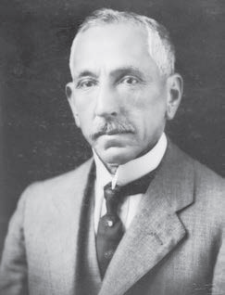
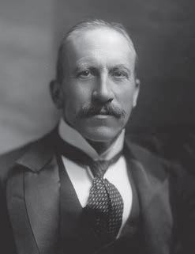
Diplomatic intervention
Prime Minister Billy Hughes
Australian War Memorial H16071
Colonial Secretary
Viscount Alfred Milner
Henry Walter Barnett Photograph
National Portrait Gallery 188577

Slide 9
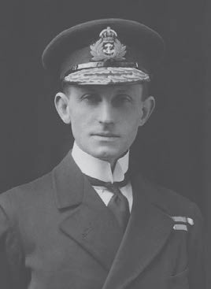
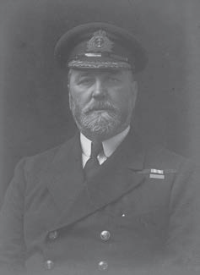
Naval resignations narrowly avoided
RAN Squadron Commander
Commodore John Dumaresq, RN
Australian War Memorial 305332
Chief of Australian Naval Staff
Rear Admiral Percy Grant, RN
Walter Stoneman Photograph
National Portrait Gallery 167922

Slide 11
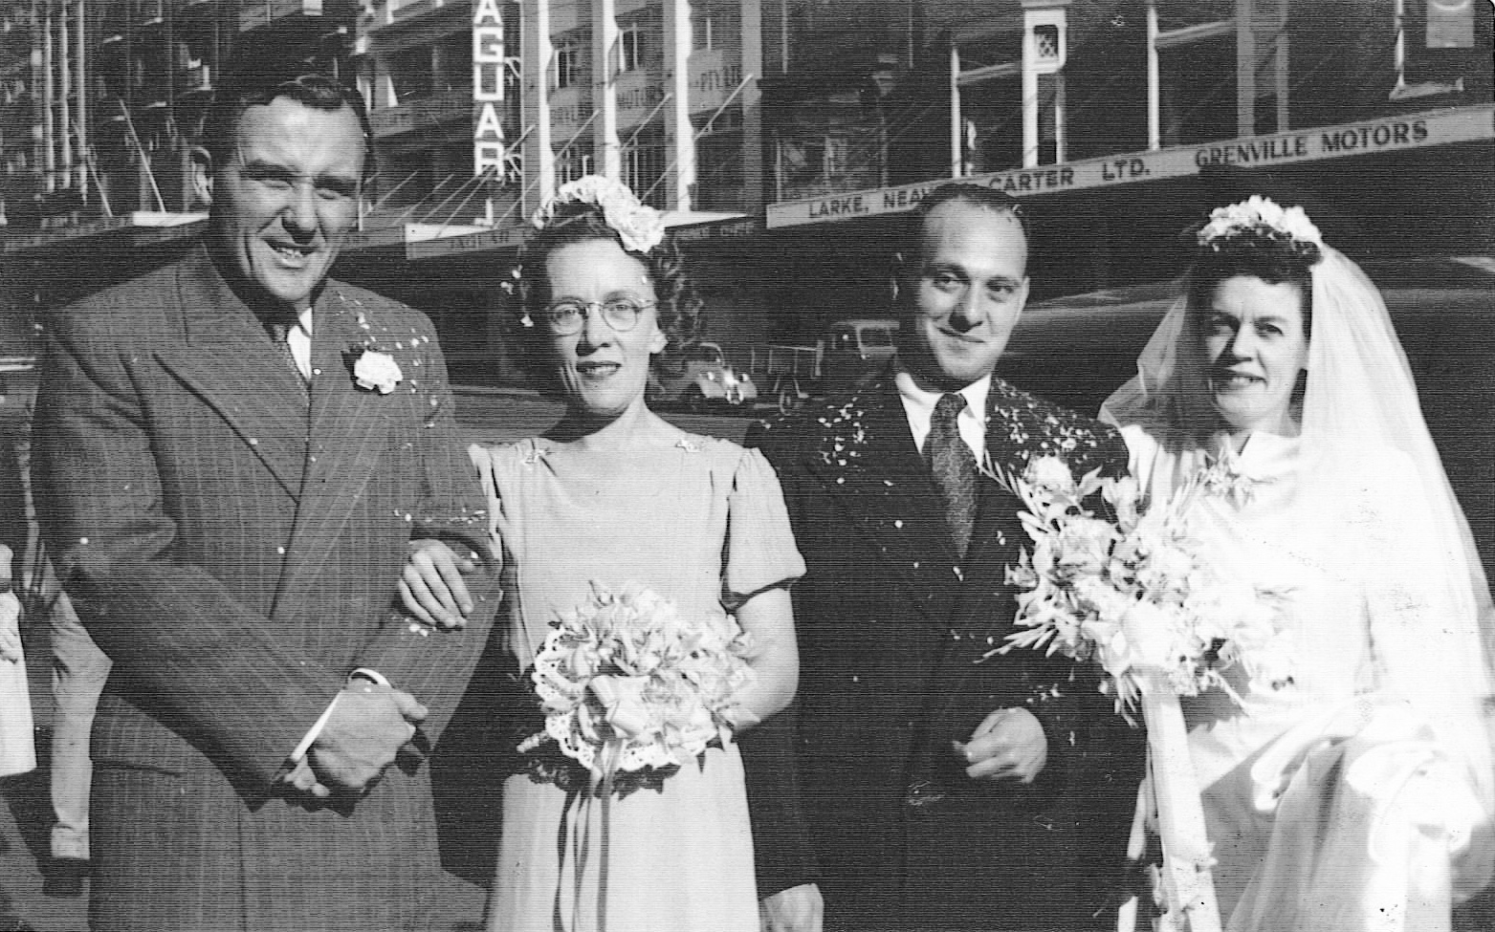
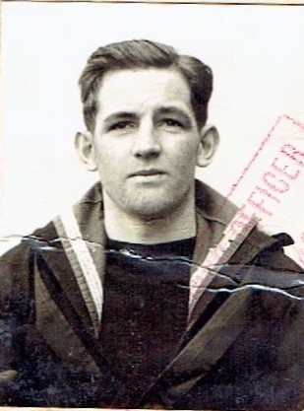
Three young sailors joined the RAN to find jobs after the Great Depression
Ted Elias marriage to Jean Harrison (on right)
with Ron Gordon and unnamed bridesmaid (on left)
Giles Yates Collection: ancestry.com.au
Jack Riley UK pass photo
Carol Woods Collection

Slide 12
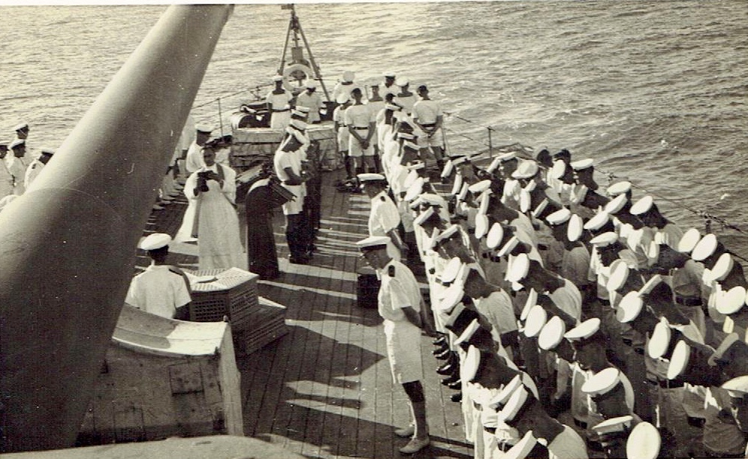
Homosexual blackmail led to murder
Burial at sea of Jack Riley, 17:00, 14 March 1942
Photograph sent to Blanche Riley by Anglican Reverend Frank Oliver
Carol Woods Collection

Slide 13
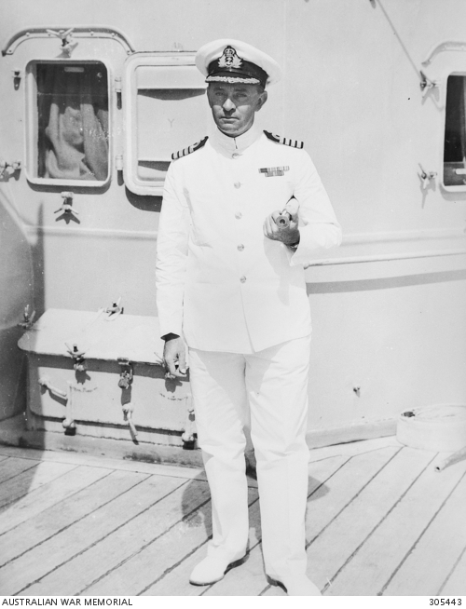
Court martial in Noumea
Captain Harold Farncomb, acted as prosecutor during the Court Martial
Australian War Memorial Collection, 305443
Paymaster Lieutenant Trevor Rapke
‘Prisoners Friend’ at the Court Martial
Jeremy Rapke Collection

Slide 14
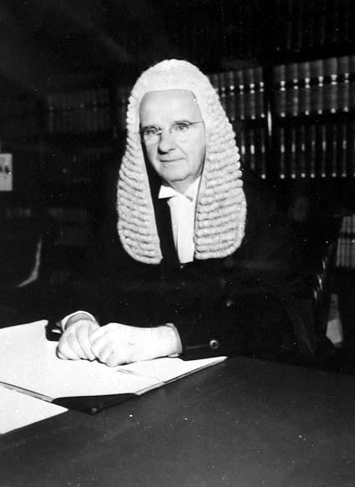
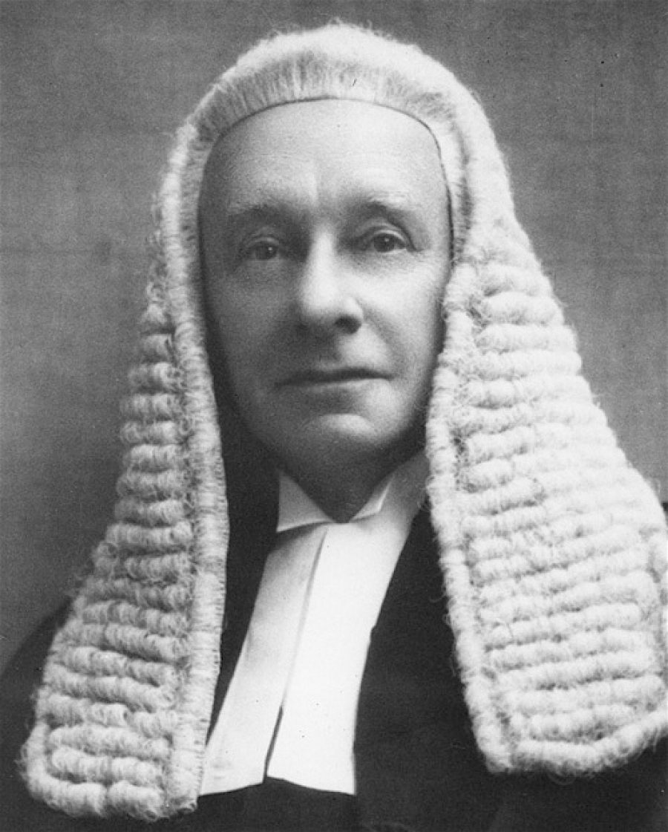
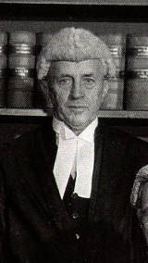
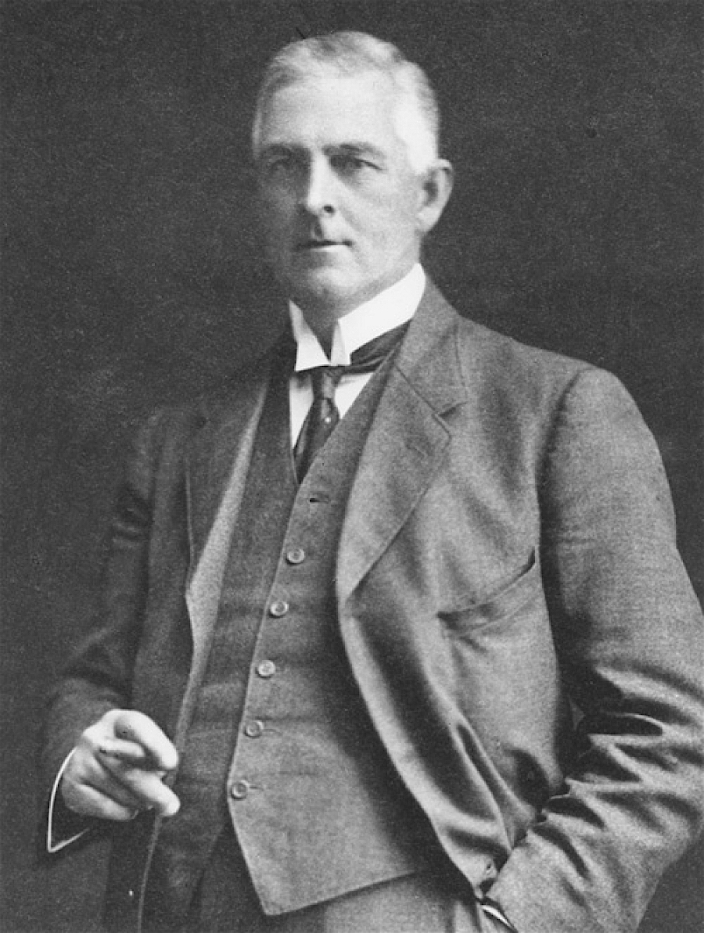
High Court appeal
Sir Edward McTiernan
hcourt.gov.au
Sir George Rich, PC, KCMG, KC
hcourt.gov.au
Sir Dudley Williams
hcourt.gov.au
Sir Hayden Starke, KCMG
hcourt.gov.au

Slide 15
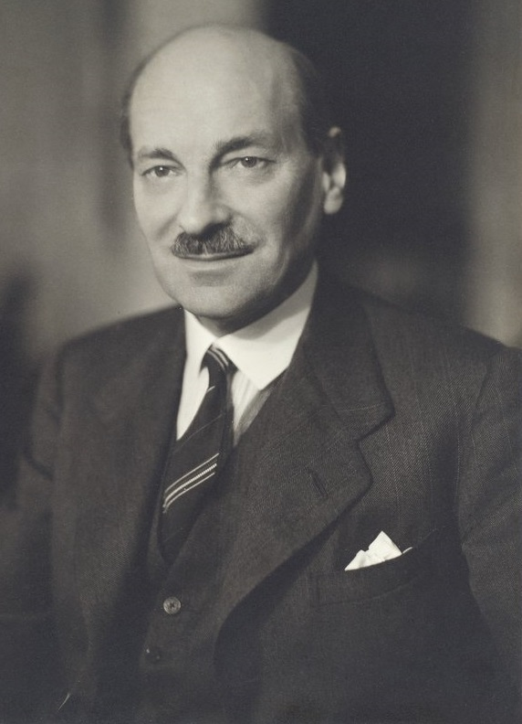
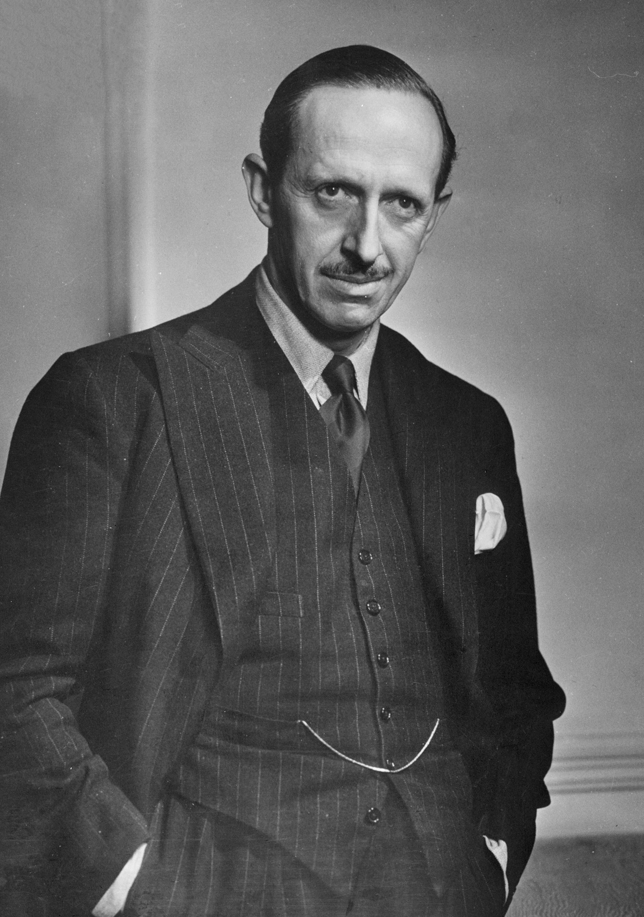
Diplomatic stand-off
Clement Atlee, Deputy Prime Minister, 1942-45 and Secretary of State for Dominion Affairs, 1942-43,
Flinders University, 31560859694
Robert Gascoyne-Cecil,
Viscount Cranborne,
Secretary of State for the Colonies
Yousuf Karsh, Dutch National Archives, 902-2081

Slide 16
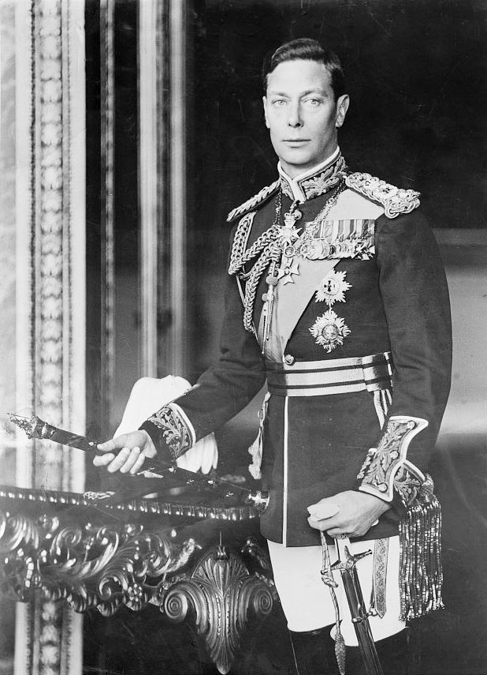
Royal clemency
H. M. King George VI of England
Matson (G Eric and Edith) Photograph collection
US Library of Congress, 04464

Slide 17
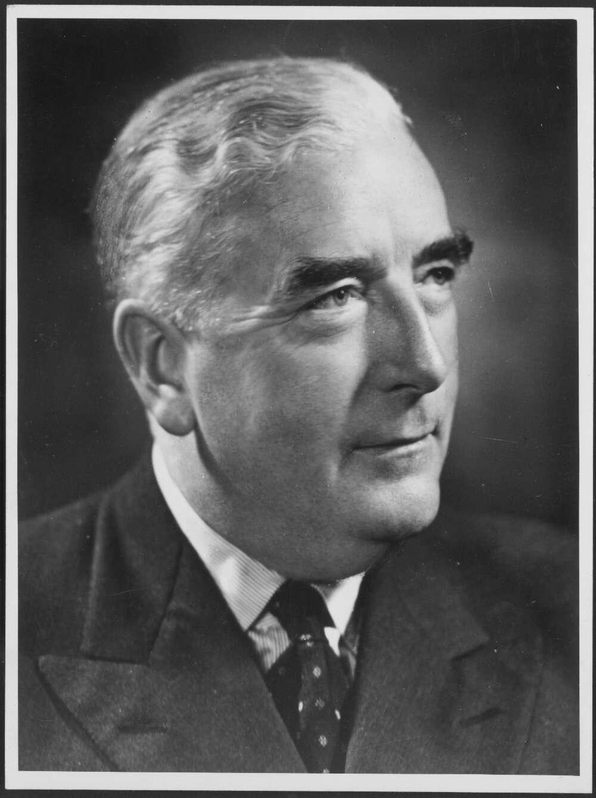
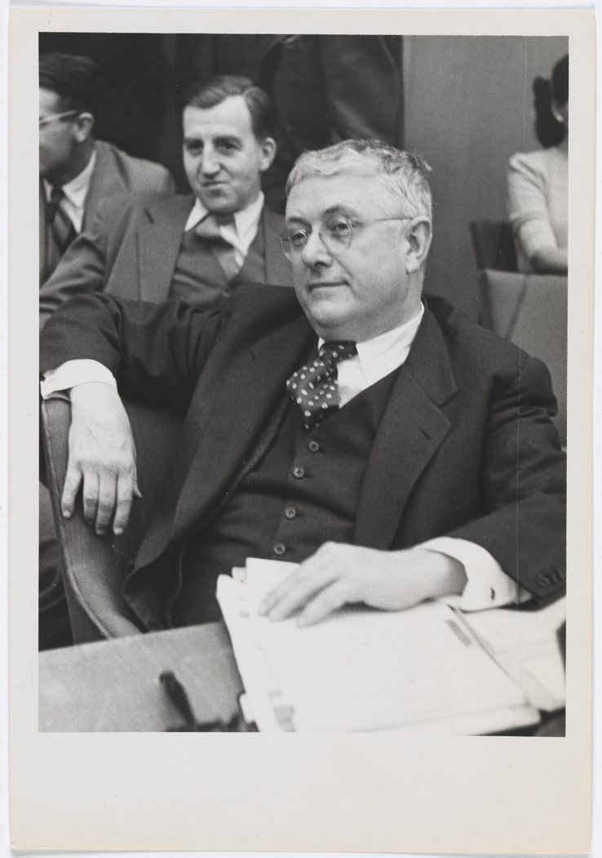
The Statute of Westminster
Opposition Leader, Robert Menzies
National Library of Australia, 136264652
Bert Evatt listening to debate
State Library of NSW, 110316141

Slide 18
Conclusions
Philosopher, George Santayana once wrote: ‘Those who forget the past are condemned to repeat it.’
There are two clear lessons from Mutineers and Dark Secrets:
Australian Governments should be very clear about the rules covering our sailors, soldiers and aircrew if they cede control over our military forces in any future conflict; and
Australian Governments should also be careful when intervening in military matters that they do not undermine the chain of command
It would be wrong to think that these are not contemporary issues:
ANZUS and the new Quad Alliance could easily involve Australia in future conflict
There have also been recent examples of political intervention for popular political purposes
It would be tragic if these lessons are learned the hard way in future.

