Slide 1
Notes:
Thank you Brent
Welcome to this zoom presentation today about my new book, Dark Secrets – as the heading states – it is one of the most controversial events in Australian history.
Most of this story occurs in the dark days of the war against the Japanese in 1942 but it is a long, complex and emotional story.
The story actually starts decades earlier, just as the First World War is ending…

Slide 2
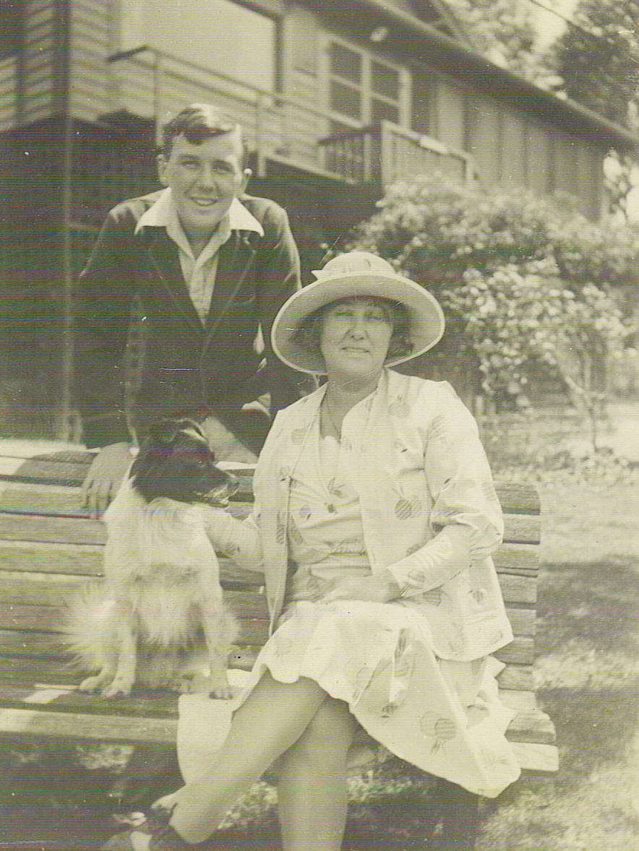
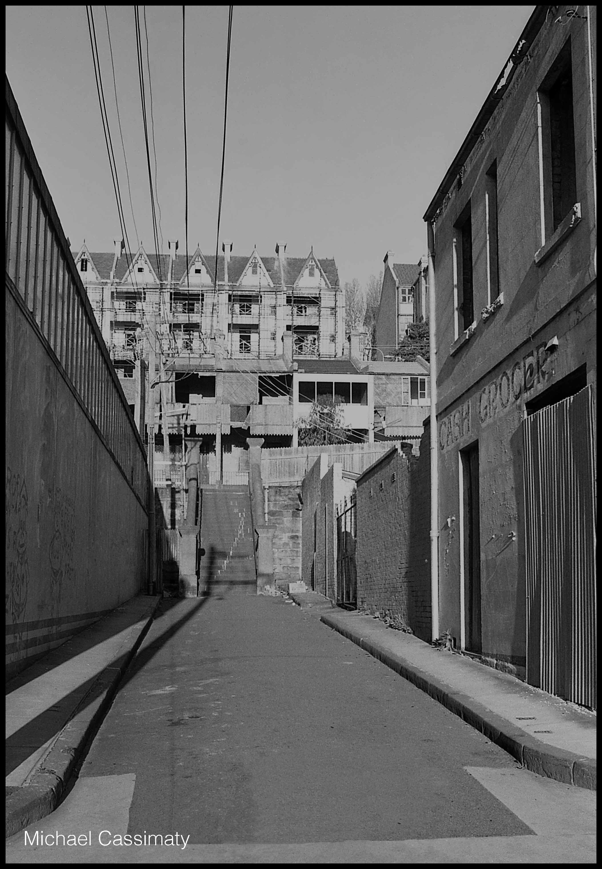
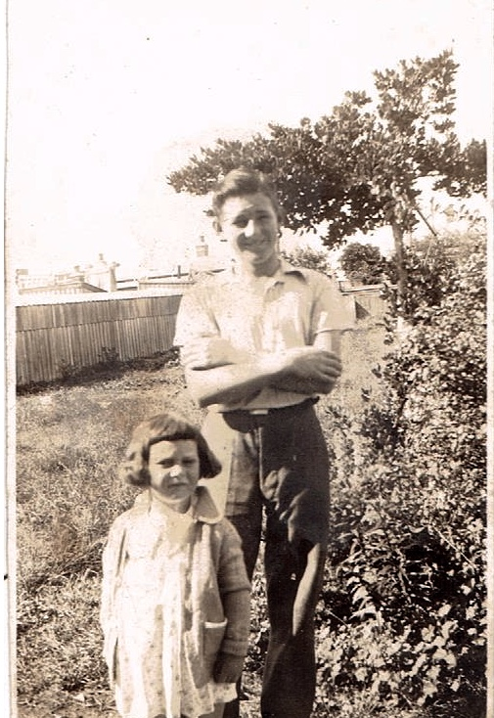
Fate brings three boys together…
Ron Gordon in Copnor
Giles Yates collection, ancestry.com.au
Ted Elias in Sydney
Wikimedia Commons
Royal Australian Historical Society, 30685319846
Jack Riley in Bellerive
Carol Woods Collection
Notes:
Between 1918 and 1922, three boys were born on the opposite ends of the world in very different circumstances:
Ron Gordon was born in Copnor on the Island of Portsmouth to a Royal Navy Chief Petty Officer, Albert and his wife, Mary.
He was inseparable from his older brother Frank after they moved to Australia in 1927
But Frank was homesick and joined the RAN and then transferred to the Fleet Air Arm in the Royal Navy as soon as he was old enough
Tragedy struck soon after when Mary and Albert both died of influenza in 1934
Ron was left an orphan and decided to follow in his father’s and brother’s footsteps and join the RAN in 1936.
Ted Elias was born in the inner suburbs of Sydney to a labourer, Alfred and his wife Christina
Unfortunately Alfred died when Ted was only 2 ½ and Christina was left a single working mother
Ted grew up in the slums of Sydney during the gang wars of the 1920s and the Great Depression in the 1930s
It did not take him long to seek job security in the RAN in 1936.
Jack Riley was born in the idylic rural setting of Bellerive in 1922 to a carpenter, Victor and his wife, Blanche
The family moved to Sydney in 1930 to start a new life and a daughter, Judith was born
But dreams of a new life in Sydney were killed off by the Great Depression and the family moved back to Bellerive
The visit of HMAS Hobart to Tasmania in 1938 subsequently sparked Jack’s interest in the Navy and he joined the RAN at the age of 16 in June 1939.

Slide 3
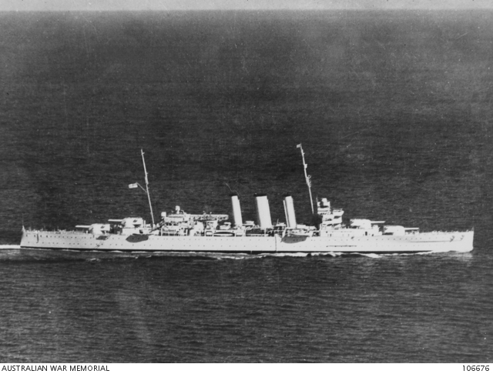
on HMAS Australia in 1939
Australian War Memorial Collection, 106676
Notes:
Fate brought these three young men together in the RAN flagship, HMAS Australia, in September 1939.
Australia had only just been re-commissioned after its first refit since 1928.
It was our biggest and best warship:
It was just over 10,000 tons (equal to 250, 40 ton semi trailers)
19,000 tons
It was very fast, with a top speed of 31.5 knots (55 KPH)
25 knots
And it was also very powerful, with 8 x 8 inch (or 200 millimeters) guns and 8 x 4 inch guns.
8 x 12 inch (305 millimeters) and 14 x 4 inch guns

Slide 4
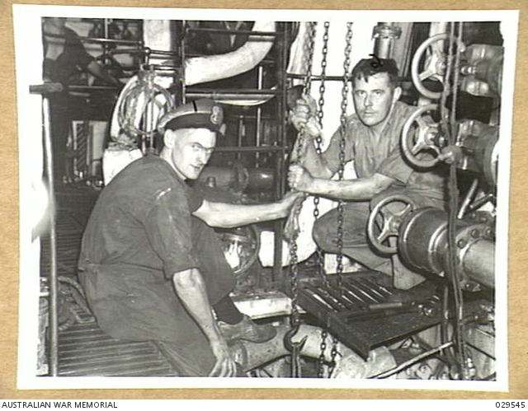
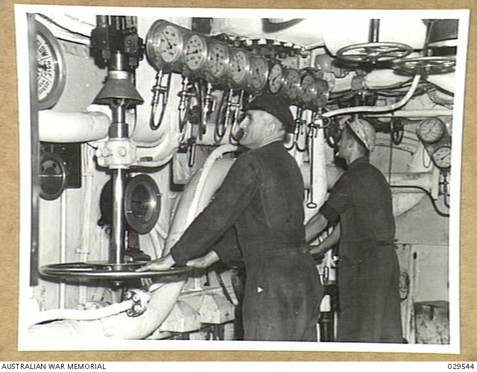
They all become stokers in the engine room of HMAS Australia
Engineers repairing a lubrication pump, HMAS Australia
Australian War Memorial Collection, 029545
The engine room, HMAS Australia
Australian War Memorial Collection, 029544
Notes:
The three stokers had a much better life than their predecessors when warships were coal powered.
The first HMAS Australia in WWI used a ton of coal per mile and could only sail 3,000 miles before it had to re-coal which was a very dirty and sometimes dangerous job.
Warships were fitted with oil burning furnaces in the 1920s and 30s but the furnaces, especially in the tropics, often pushed the temperature in the boiler room above 120 degrees fahrenheit (or 49 degrees celcius).

Slide 5
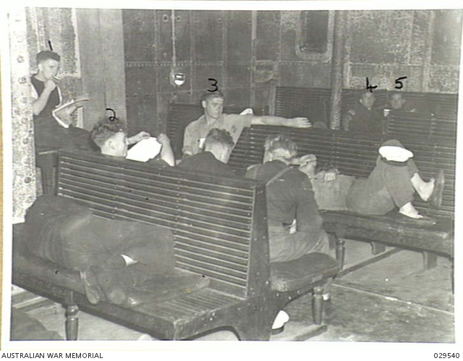
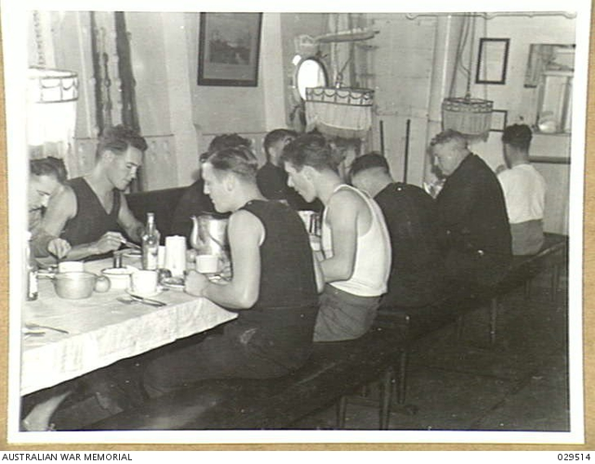
Daily life on HMAS Australia was always crowded
Artisan’s Mess Deck
HMAS Australia
Australian War Memorial Collection, 029540
Seaman’s recreation room
HMAS Australia
Australian War Memorial Collection, 029540
Notes:
Stokers also lived cheek by jowl in the engine rooms and the mess decks where they also hung their hammocks.
There were more than 850 crew in the warship and it was only 214 yards long (about 190 meters or a little longer than the MCG at 171 meters).
In these cramped, hot and sweaty conditions, petty differences could easily flare into confrontation if the sailors were not closely managed!

Slide 6
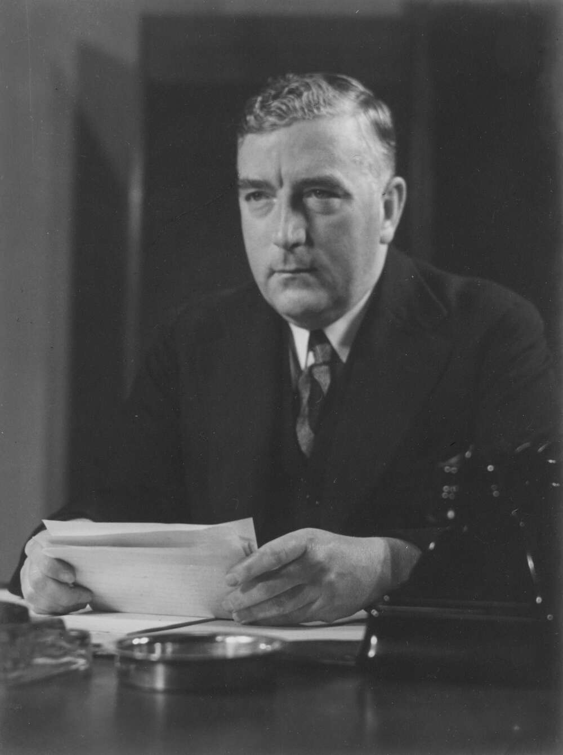
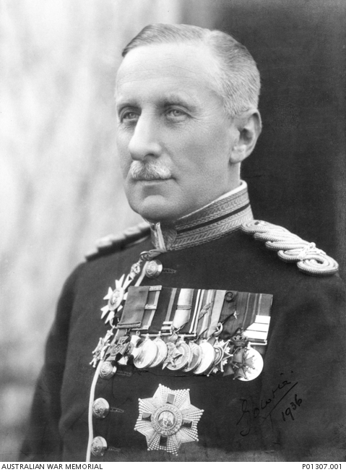
The RAN was placed under Royal Navy control in November 1939
Robert Menzies
Prime Minister 1939-41
Declaration of War
National Library of Australia, 136636422
Alexander Hore-Ruthven
1st Earl of Gowrie
Governor General
Australian War Memorial Collection, P01307.001
Notes:
HMAS Australia, and all other RAN warships were placed under the control of the Royal Navy by the Governor General in 1939.
This had an immediate impact for RAN sailors as they were placed under Admiralty orders to sail for war in far away oceans.
It also had unforeseen consequences for RAN sailors.
If they breached discipline they would be sentenced under British military law and this would be much more severe than Australian regulations.
More of this later…

Slide 7
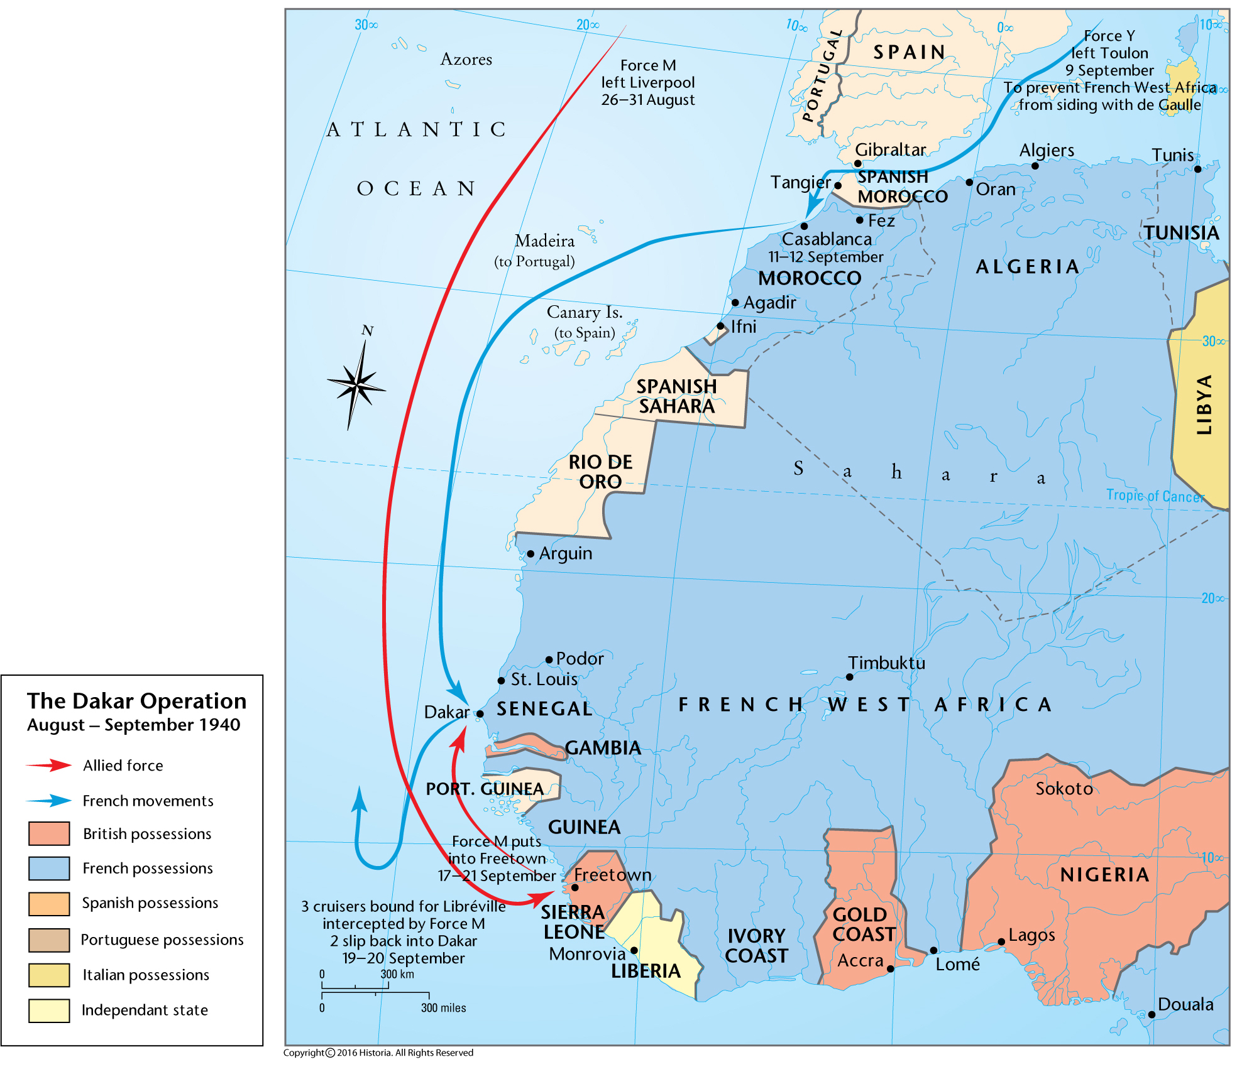
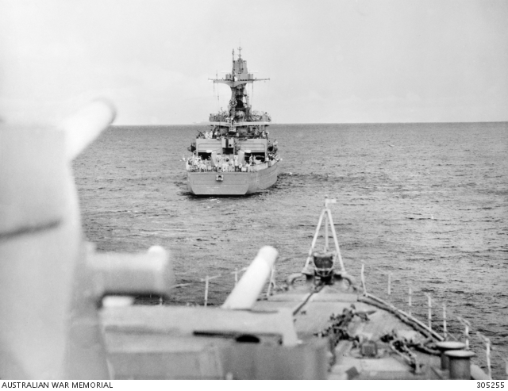
Dakar: the first angry shots of the war against the Vichy French August 1940
HMAS Australia escorts the Vichy French cruiser Gloire
to Casablanca
Australian War Memorial Collection, 305255
The Dakar Operation,
The Map Archive, Ax00277
Notes:
After boring convoy duty in the Indian Ocean, HMAS Australia was ordered by the Admiralty to Africa to help the Free French liberate Senegal.
In its first action of the war, the flagship forced the Vichy French cruiser Gloire to agree to parole in Casablanca for the rest of the war.
At this stage, HMAS Australia was a happy and a lucky ship – during the chase, it narrowly avoided colliding with the French cruiser and Vichy French aircraft dropped their bombs way off target afterwards.

Slide 8
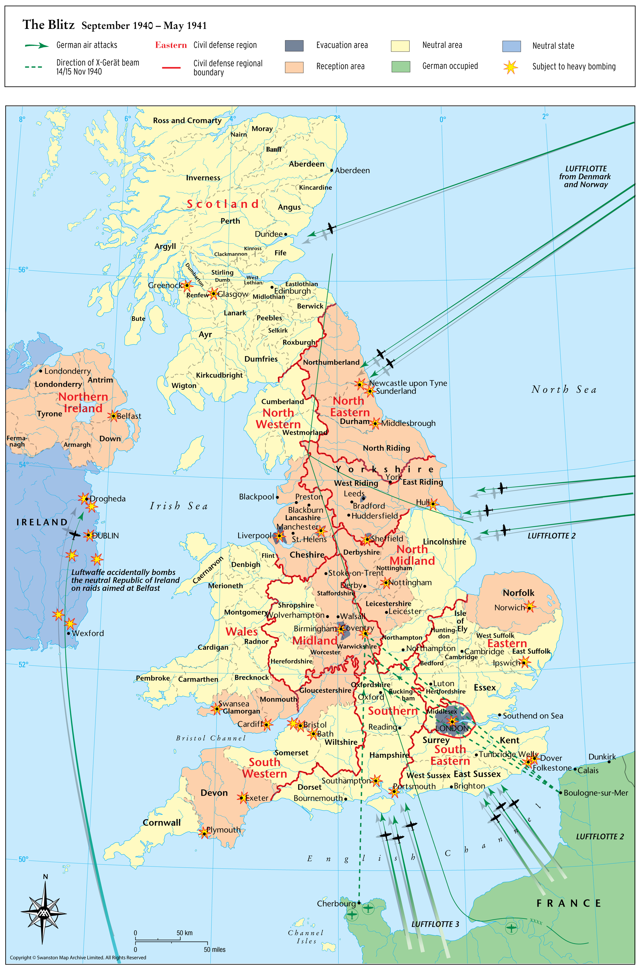
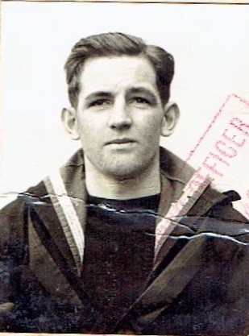
HMAS Australia patrolled the Atlantic and the Indian Ocean
The Blitz September 1940-May 1941
The Map Archive, Ax00843
Jack Riley UK pass photo
Carol Woods Collection
Notes:
After this first flush of success, the Admiralty ordered HMAS Australia to Britain to refit.
While it was in dry dock, the flagship had another lucky escape when a 1000 ton German aerial torpedo hit the ship but failed to explode.
The Admiralty then ordered the flagship back to West Africa to help with the blockade of Dakar.
During a bombardment of Vichy French ships in Dakar, the flagship was damaged by shellfire but no one was hurt – another lucky escape.
The flagship then sailed to the Indian Ocean to unsuccessfully hunt for a Vichy French convoy and then German Raiders in the great southern ocean.

Slide 9
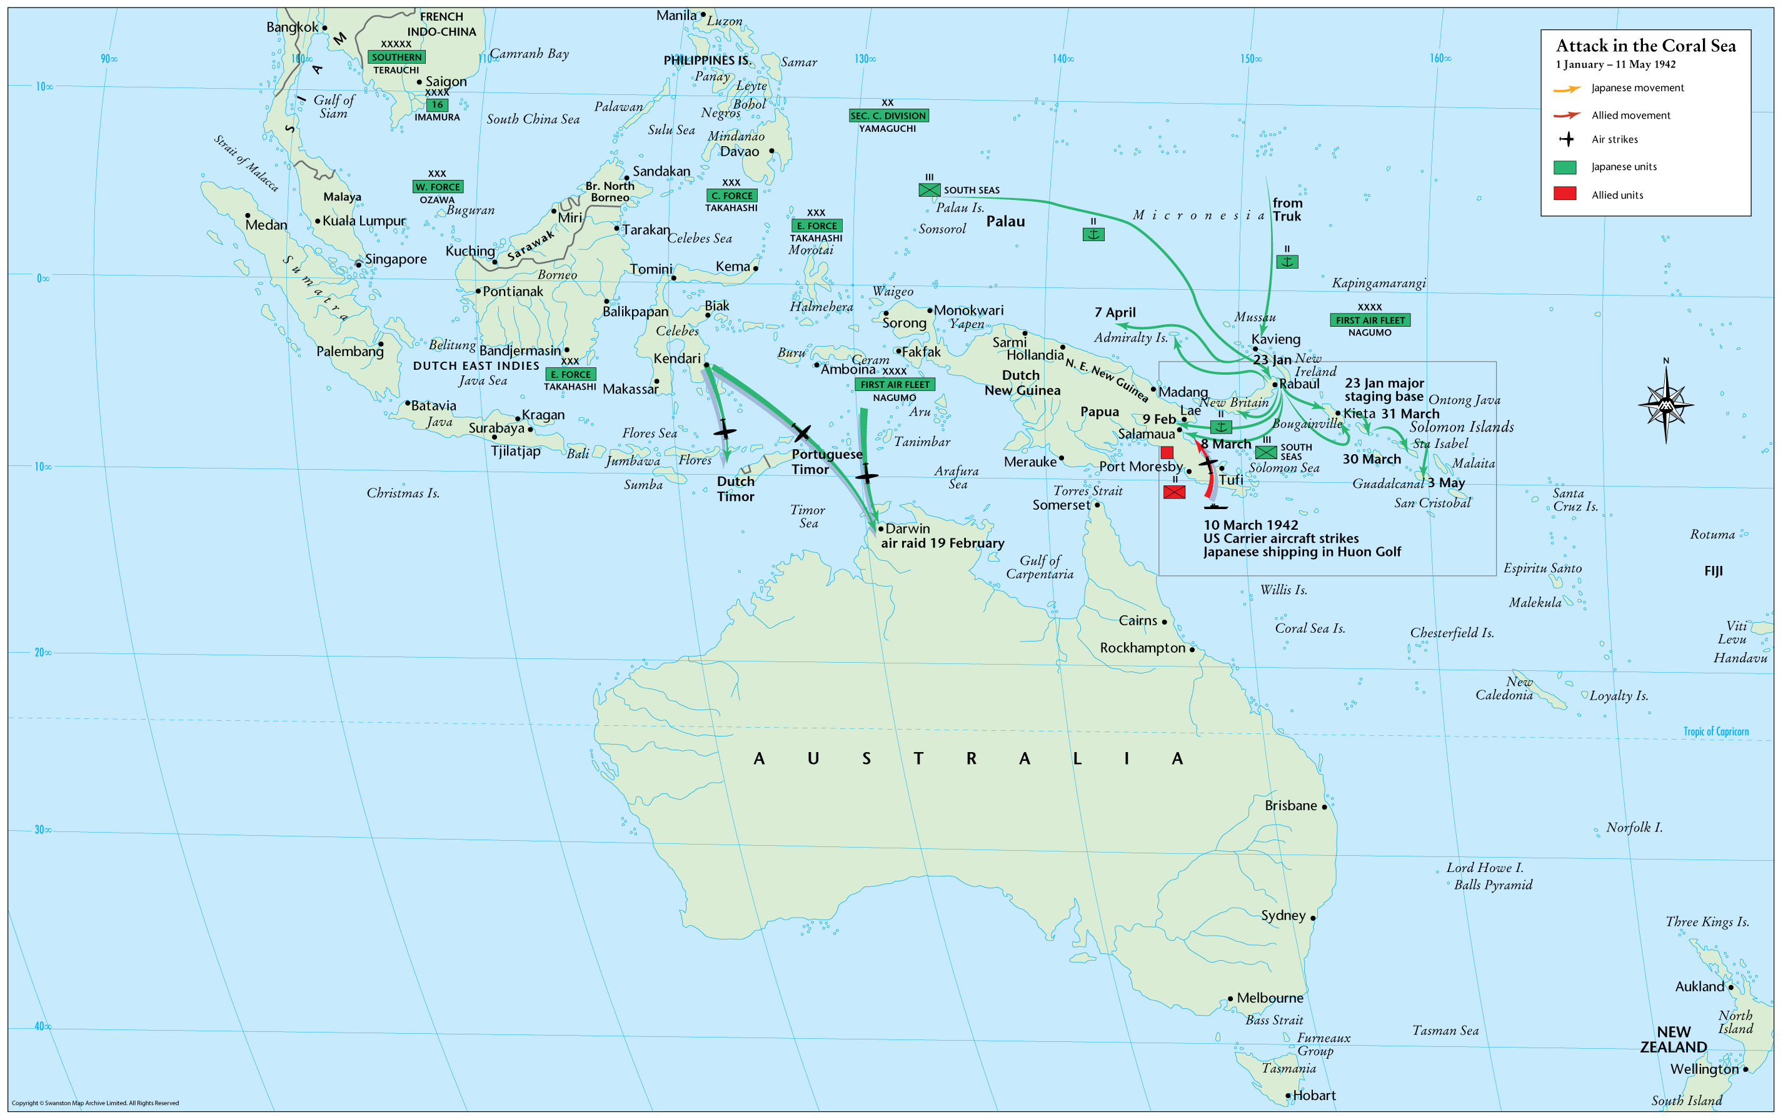
The Japanese advance forced HMAS Australia back home in Dec 41
Attack in the Coral Sea, 1942
The Map Archive, Ax00314
Notes:
Then in December 1941, the Admiralty ordered HMAS Australia to the Australian Station as the Japanese advanced down the Asian archipelago.
The RAN urgently needed reinforcements after the loss of the cruisers Sydney and Perth and the destroyers Parramatta and Yarra.
The RAN only had Australia, its sister ship, HMAS Canberra and the light cruiser Hobart to defend the entire continent!
And the Japanese were closing in fast in much bigger numbers.

Slide 10
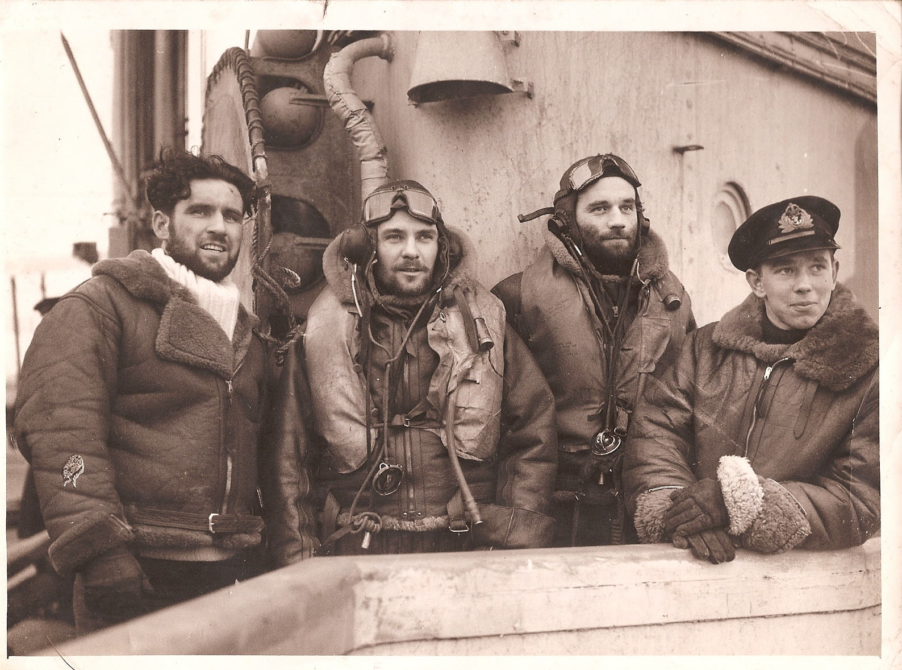
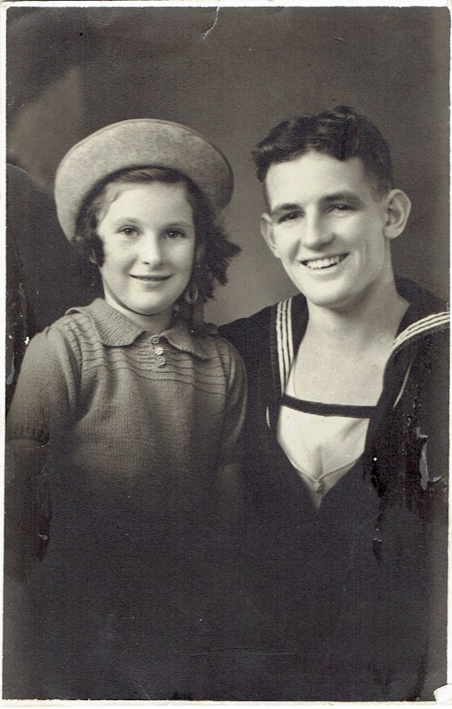
Frank Gordon was killed in action and Jack Riley went home on sick leave
Frank Gordon (second from left) joined the Fleet Air Arm and was killed on patrol from HMS Victorious while searching for the German battleship, Tirpitz
Giles Yates Collection, ancestry.com.au
Jack and Judith Riley while on sick leave in Bellerive in 1942
Carol Woods Collection
Notes:
Shortly afterwards, Ron Gordon was shocked to hear that his older brother Frank was MIA, presumed dead in the North Sea.
Ron now had lost all of his family. He turned to his close friend Ted for support.
However, Ted was also struggling with his own family issues. His mother had married again to a drifter, Peter Byrne and Ted suddenly felt very alone.
Jack was happy to be home on leave in Bellerive but he was sick and suffering from damaged eye sight after an accident involving an open furnace door. He did not was to go back to the war.
The three sailors were suffering from loss, anger and pain.
This was a bad combination of emotions to take back to war.

Slide 11
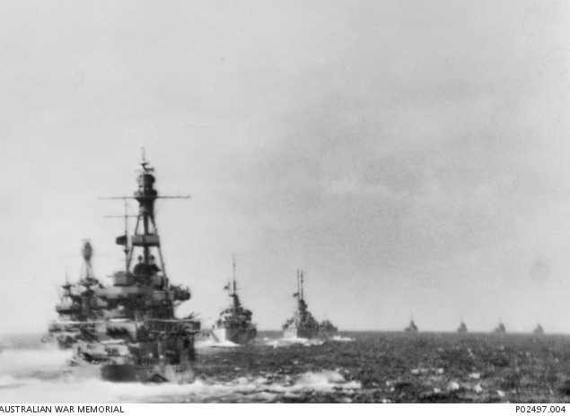
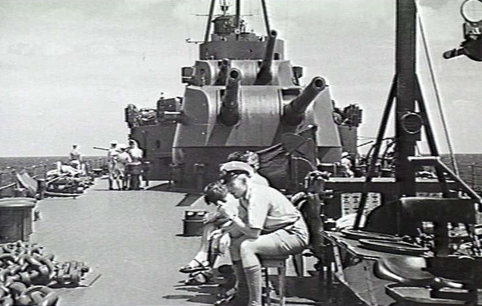
In early 1942, HMAS Australia led Taskforce 44 into the Coral Sea
HMAS Australia with Taskforce 44 into the Coral Sea, 1942
Australian War Memorial Collection, P02497.004
Seaman at 2nd degree readiness on HMAS Australia in the Coral Sea, 1942
Australian War Memorial Collection, 305217
Notes:
In January 1942, HMAS Australia led Task Force 44, including Hobart and the USS Chicago to the Coral Sea.
They were to rendevous with a US carrier task force and block a Japanese invasion of New Guinea.
Tensions were high and emotions were raw.

Slide 12
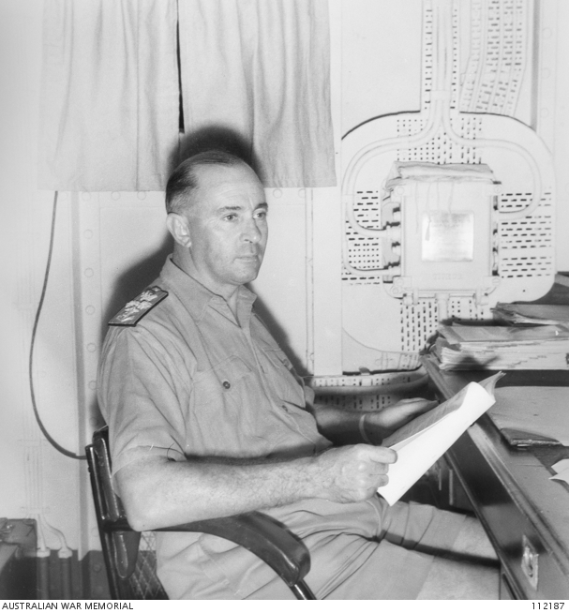
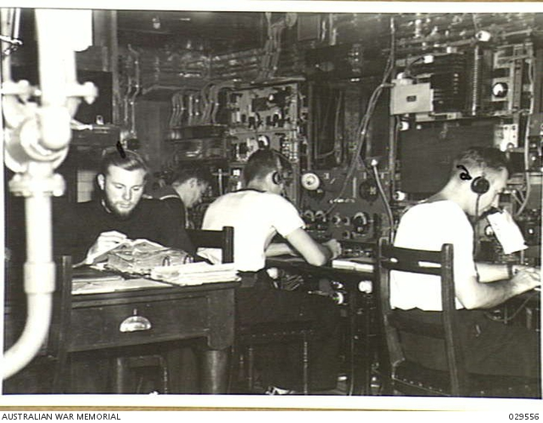
The night of the attack on Jack Riley Thursday, 12 March 1942
Captain Harold Farncomb
in his day cabin
Australian War Memorial Collection, 112187
Wireless Room on HMAS Australia
Australian War Memorial Collection, 029556
Notes:
Thursday 12 March 1942 seemed quiet at first.
The flagship Captain, Harold Farncomb, was in his cabin writing reports.
Sailors in the wireless room listened for news of the Japanese invasion fleet.
The crew were at 2nd degree readiness, relaxing at their posts at black-out on a very balmy evening.

Slide 13
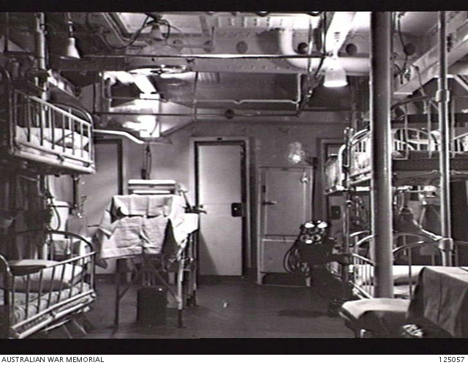
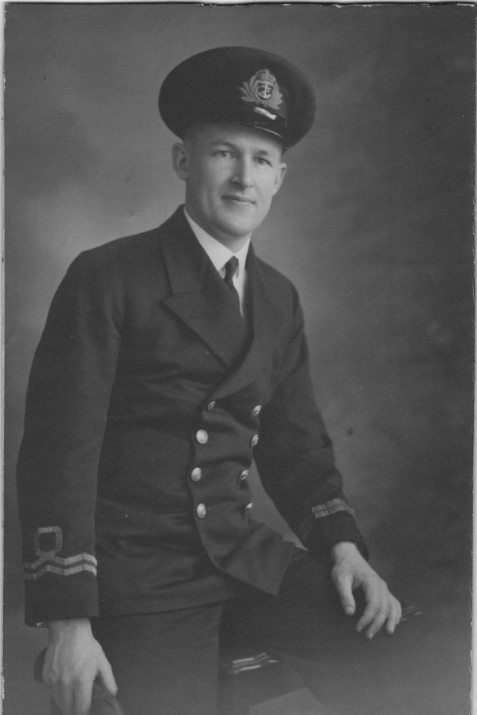
Malcolm Stening strives to save Riley Jack on Friday, 13 March 1942
Operating table in the sick bay
Australian war Memorial Collection, 125057
Surgeon Lieutenant, Malcolm Stening
Obituary, Sydney Morning Herald, 9 March 2015, Rod Lyons
Notes:
Ron Gordon, Ted Elias and Jack Riley were alone on the deck.
Suddenly, Ron Gordon and Ted Elias attacked Jack Riley.
In a moment of madness, Ron Gordon and Ted Elias brutally stabbed Jack Riley 14 times and tried to throw him overboard.
But after hearing the commotion, shipmates arrived before they could complete the cover up.
Jack Riley was taken below and before he passed out he told the ship’s surgeon Malcolm Stening that Gordon and Elias had attacked him…because he had accused them of being homosexual.

Slide 14
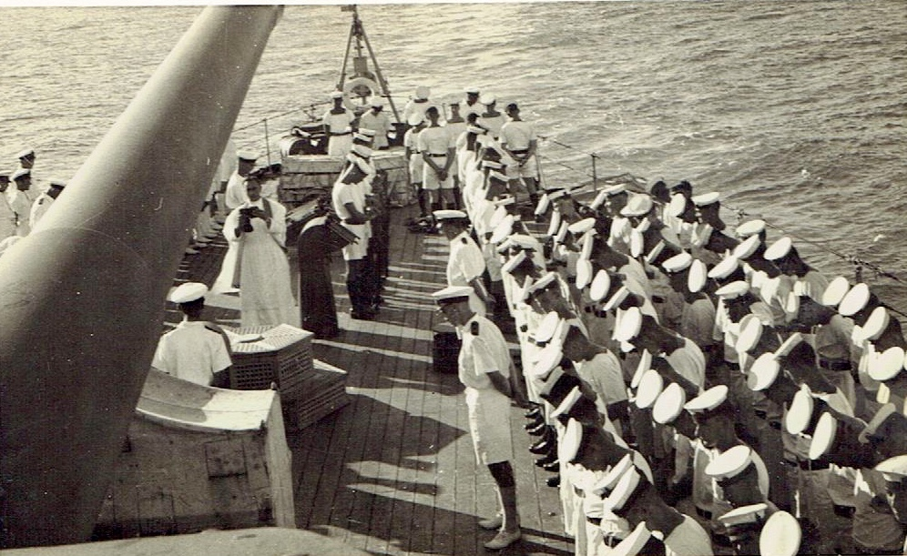
Jack Riley’s burial at sea Saturday, 14 March 1942
Burial at sea of Jack Riley, 17:00, 14 March 1942
Photograph sent to Blanche Riley by Anglican Reverend Frank Oliver, Carol Woods Collection
Notes:
Jack Riley clung to life for over 24 hours before peritonitis eventually killed him.
He was buried at sea at 17:00 hours on Saturday evening.
Ron Gordon and Ted Elias claimed two other sailors had attacked Jack Riley in the dark that night but they were charged with murder.

Slide 15
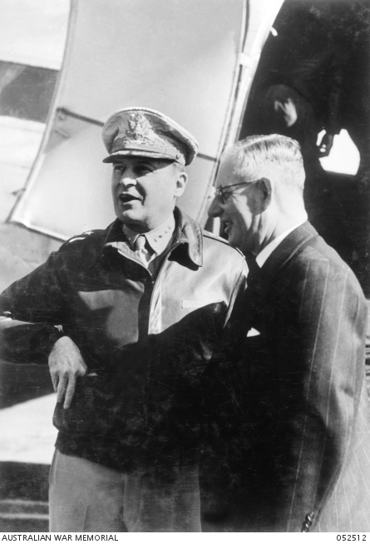
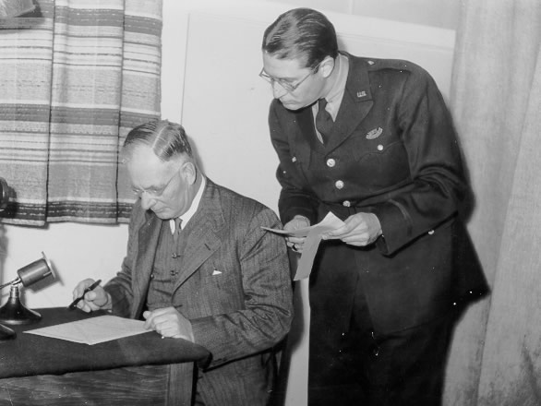
Australia turned to America to stop a Japanese invasion
Prime Minister, John Curtin broadcast to Americans, 14 March 1942
JCPML00617/65/31, Records of Lloyd Ross,
National Library of Australia, MS 3939, Series 11, Folder 65
John Curtin and General Douglas McArthur
Australian War Memorial, 052512
Notes:
As Jack Riley was being buried at sea, Labor PM, John Curtin was appealing to Americans to help stem the tide against the Japanese.
He decided to make a pact with US General, Douglas MacArthur to wage a combined war against the Japanese.
It was a pivotal moment when Australia swung from the Mother Country towards a new ally in the United States.

Slide 16
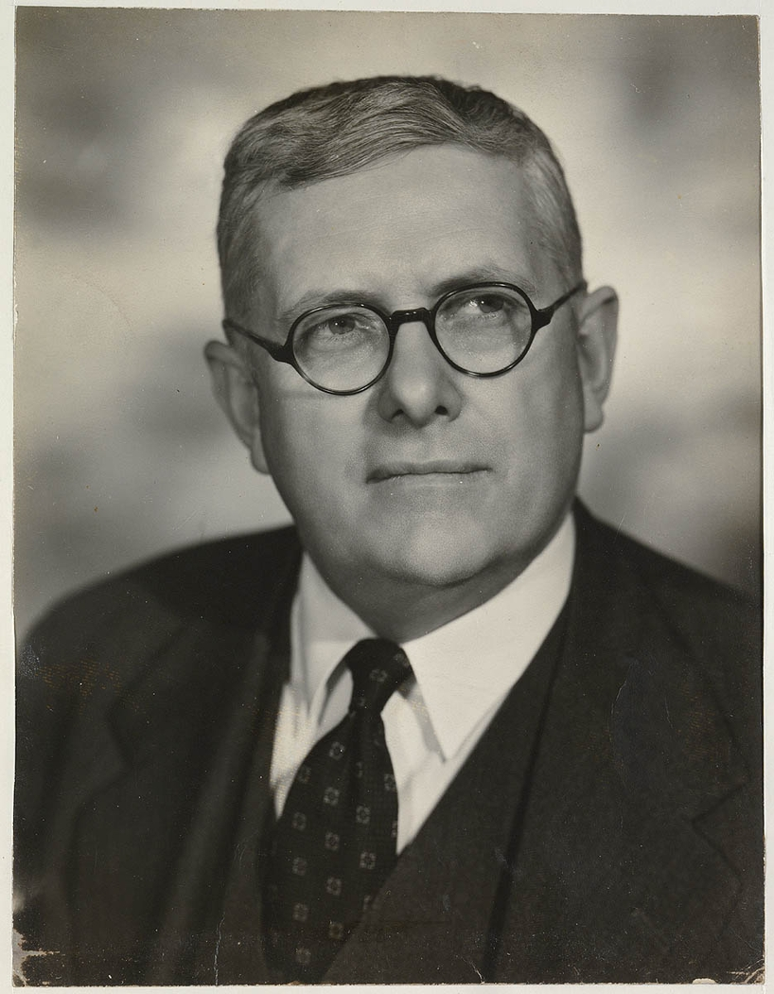
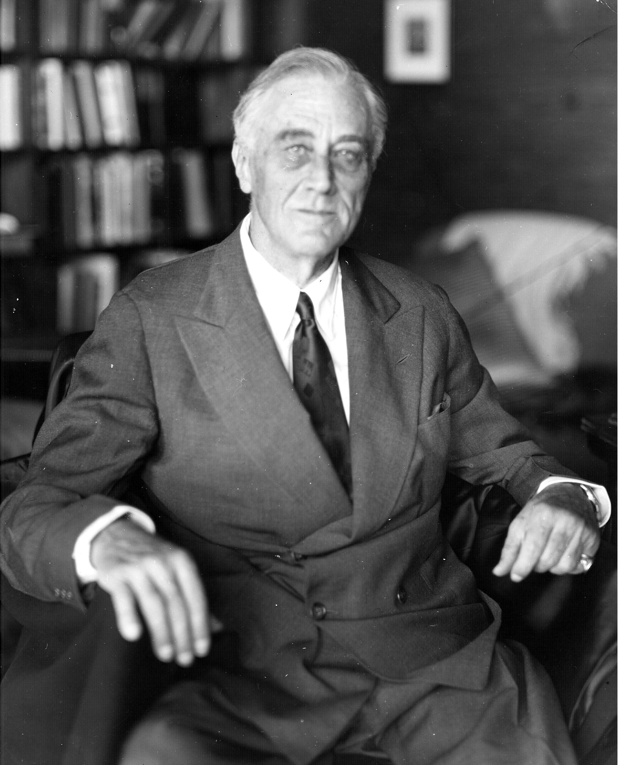
Bert Evatt flew to the US to meet President Franklin Roosevelt
Herbert ‘Bert’ Evatt
Minister for External Affairs and Attorney General
Mitchell Library, State Library of NSW, PXA 1837/1943-1951
US President, Franklin, D Roosevelt
Wikipedia
PFDR Presidential Library & Museum
FDR-April-11-1945
Notes:
Curtin asked his External Affairs Minister and AG, Bert Evatt to fly to the US to lobby President Roosevelt for planes, troops and ships to fight the Japanese.
Evatt borrowed MacArthur’s Catalina flying boat to travel to the US.
He flew over the Coal Sea at the same time that Jack Riley was being buried at sea.
He did not know it then but British PM, Winston Churchill and Franklin Roosevelt had already agreed on a Germany First strategy.

Slide 17
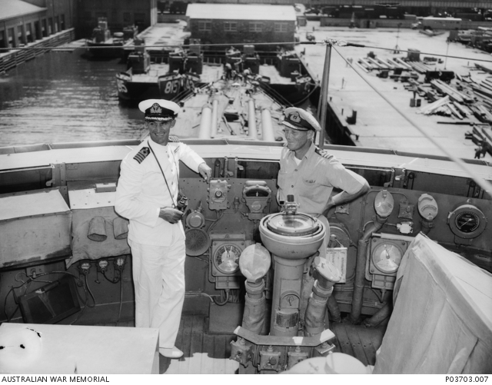
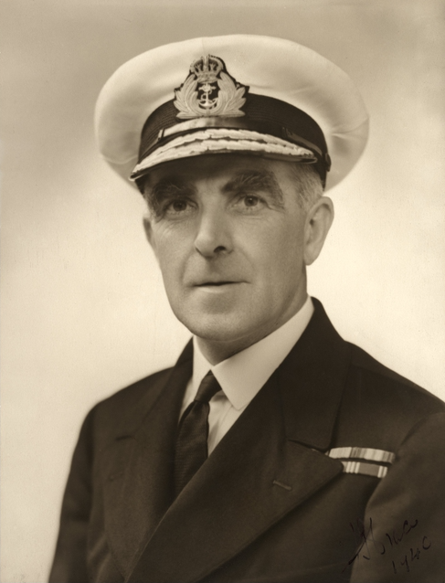
‘Third degree’ investigation finds a ‘nest of immorality’ on HMAS Australia
Commander John ‘Black Jack’ Armstrong, Executive Officer of HMAS Australia
(on left) who undertook the
murder investigation
Australian War Memorial Collection, P03703.007
Rear Admiral John ‘Jack’ Crace, Squadron Commander on HMAS Australia
Australian War Memorial, 305285
Notes:
After the burial at sea, the flagship EO, Black Jack Armstrong began a third degree interrogation of the crew.
He found that Ron Gordon and Ted Elias, and others, were part of a homosexual group, and the two sailors had killed Jack Riley to hide their sexual activities.
In his report on the murder, Squadron Commander, Rear Admiral Jack Crace, told the Navy Board in Melbourne there was a ‘large nest of immorality’ on the flagship.

Slide 18
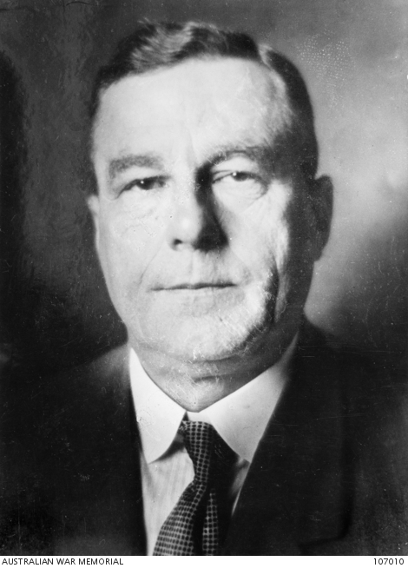
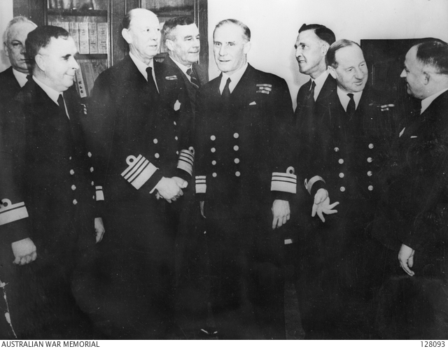
The Navy Board approves court martial
George Macandie
Secretary to the
Naval Board
Australian War Memorial Collection, 107010
The Australian Commonwealth Naval Board
Australian War Memorial Collection, 128093
Notes:
The Navy Board in Melbourne were shocked by the reports and agreed that there should be a quick court martial in Noumea.
They wanted the flagship free as quickly as possible to take part in any defence against a Japanese invasion.
A civil court case would take months and occupy many of the ships officers and crew and the Navy Board simply could not sanction that diversion from the fight against the Japanese.

Slide 19
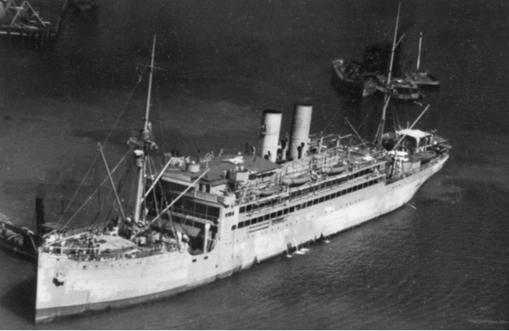
Trevor Rapke ordered from Darwin to Noumea to defend Gordon and Elias
HMAS Merkur
Australian War Memorial Collection, 301049
Paymaster Lieutenant, Trevor Rapke
Jeremy Rapke Collection
Notes:
The Navy Board decided that pre-war criminal lawyer, Trevor Rapke, serving in Darwin, should be the sailor’s defence lawyer or the prisoners friend.
They assumed he would be able to get to Noumea quickly!
But he actually had to fly from Darwin to Adelaide, then take a train to Sydney before he could catch the former merchant ship HMAS Merkur to Noumea.
He arrived in Noumea on April Fools day, just before Easter 1942.

Slide 20
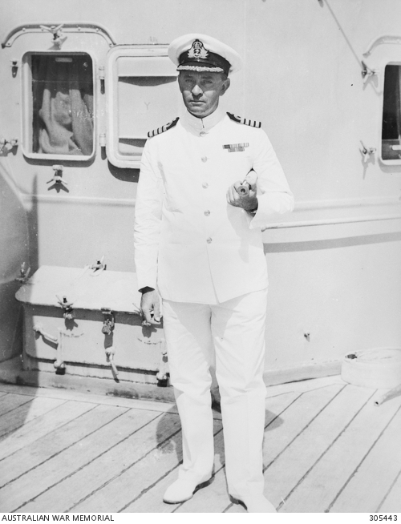
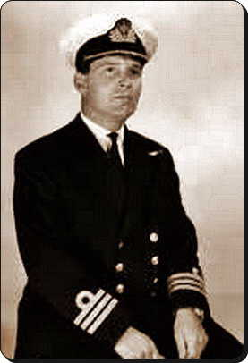
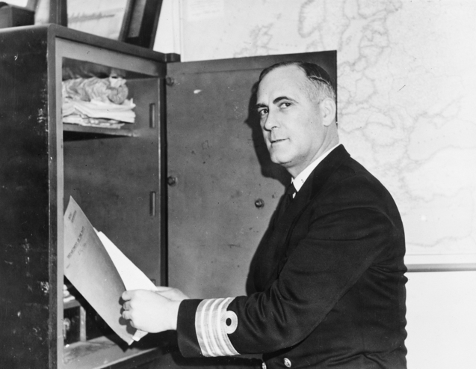
The Court Martial verdict: the death penalty for Gordon and Elias
Captain Harold Farncomb, acted as prosecutor during the Court Martial
Australian War Memorial Collection, 305443
Paymaster Commander, Patrick Perry, secretary to Rear Admiral Crace, was appointed Deputy Judge Advocate to advise the Panel
Australian War Memorial Collection, 017727
Royal Navy Captain
Robert Bevan of HMNZS Leander, served as President of the Court Martial panel
Unithistories.com
Notes:
The court martial was always going to be a challenge.
As the murder occurred at night, there were no direct eye witness accounts, no murder weapon was found and the Navy did not want to hand the Japanese propoganda by referring to the alleged homosexual motive!
Harold Farncomb simply told the Panel of junior officers he personally believed that Ron Gordon and Ted Elias were guilty.
After five days, the Panel found Ron Gordon and Ted Elias guilty as charged based solely on circumstantial evidence.
Trevot Rapke immediately claimed there had been a miscarraige of justice and wanted to lodge an appeal but there was no appeal under British military law!

Slide 21
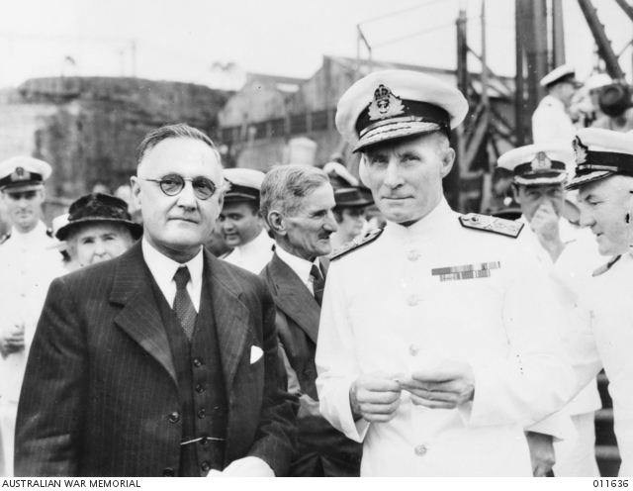
Navy Minister, Norman Makin stays the death penalty
Navy Minister, Norman Makin, 1941-46, and Vice-Admiral Sir Guy Royle, Chief of Australian Naval Staff, 1941-45
Australian War Memorial Collection, 011636
Notes:
The death sentence placed the new Labor Government in a difficult position.
The new Navy Minister, Norman Makin, wanted to support the Navy but his Government was opposed to capital punishment.
As a result, Makin ordered the death penalty be put on hold until the Government could find a way out of the mess.

Slide 22
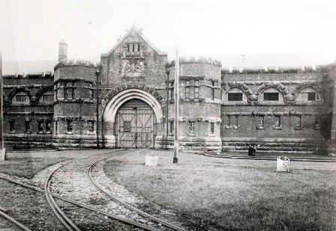
Gordon and Riley returned to Australia and held in Long Bay Penitentiary
Long Bay Penitentiary
Wikipedia Commons
Randwick Library Local Studies Collection, H00/H00030
Notes:
HMAS Australia was ordered back to Sydney to offload Ron Gordon and Ted Elias at Long Bay Penitentiary.
The formal excuse was that the flagship needed to replace worn turbine shafts but Australia was quickly back at sea.
Even though Trevor Rapke had clashed with the Captain, during the court martial, Harold Farncomb asked him to stay on the flagship as his secretary.
The sweetener was that Harold Farncomb would argue for clemency for Ron Gordon and Ted Elias.

Slide 23
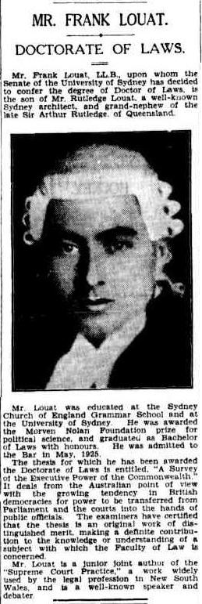
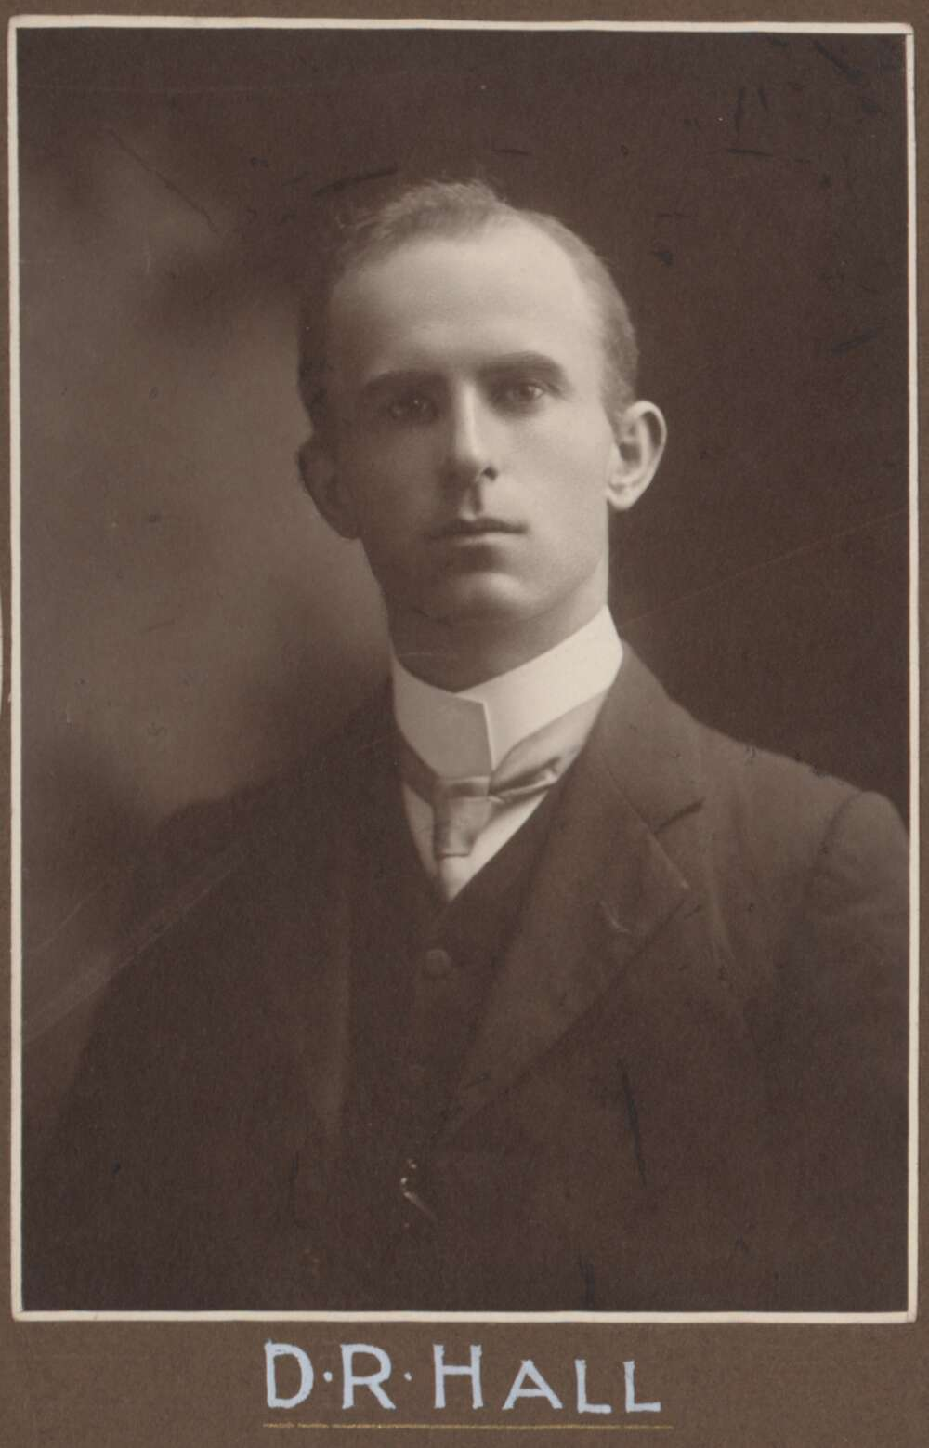
Legal experts came to the aid of Ron Gordon and Ted Elias
Dr Frank Luoat
President of the Constitutional Association of NSW
Trove: Sydney Morning Herald, Page 17, Thursday, 4 May 1933
David Hall, former Attorney General of NSW
and Federal MP
National Library of Australia
T Humphrey & Co., PIC/6459/13 LOC B221
Notes:
While the flagship was in Sydney, Trevor Rapke had arranged for two legal experts to help Ron Gordon and Ted Elias.
A constitutional lawyer, Dr Frank Louat and a former NSW AG, David Hall, agreed to lodge a High Court appeal.
It was a long shot but a worthy delaying tactic to give the Government time to stop the death sentence.

Slide 24
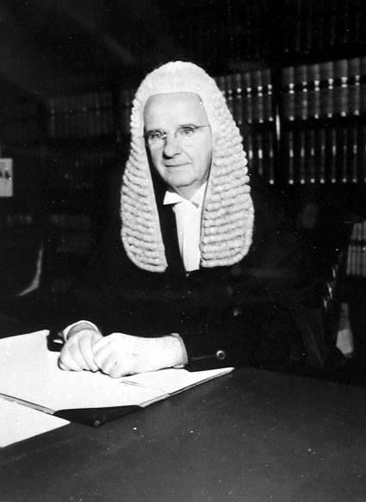
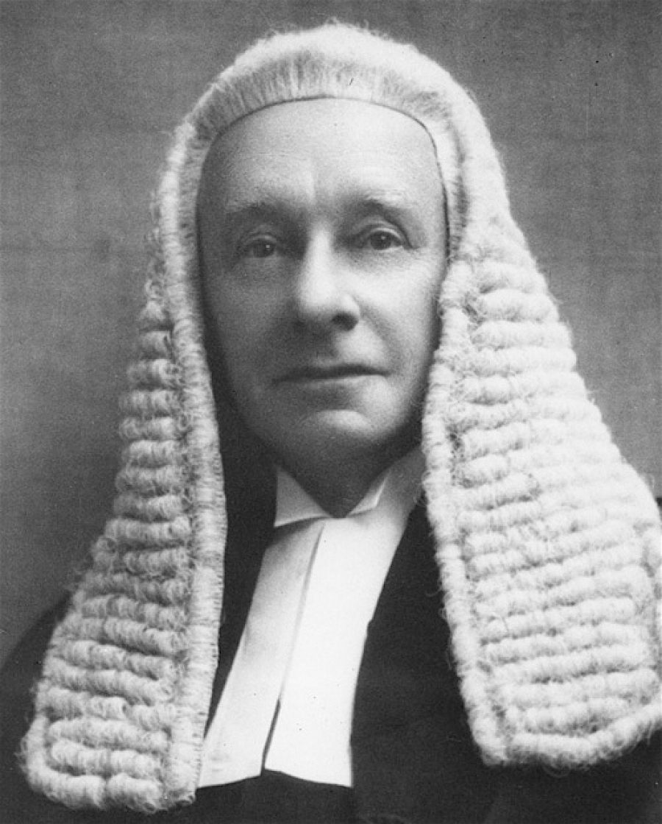
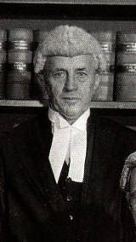
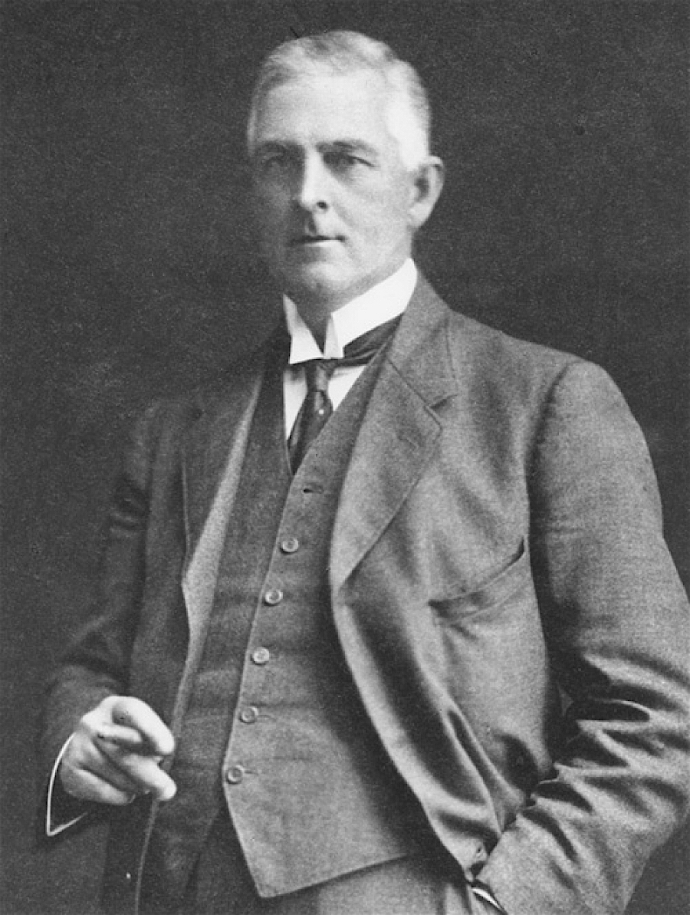
The High Court Appeal 4 May 1942
Sir Edward McTiernan
High Court of Australia
Sir George Rich, PC, KCMG, KC
High Court of Australia
Sir Dudley Williams
High Court of Australia
Sir Hayden Starke, KCMG
High Court of Australia
Notes:
Four High Court justices heard the case – it only took a morning.
The arguments were clear cut:
either British law applied and the sentences were valid; or
there had been a miscarraige of justice and the two sailors should be freed
Unfortunately, the justices would take over two months to formally write a detailed decision.

Slide 25
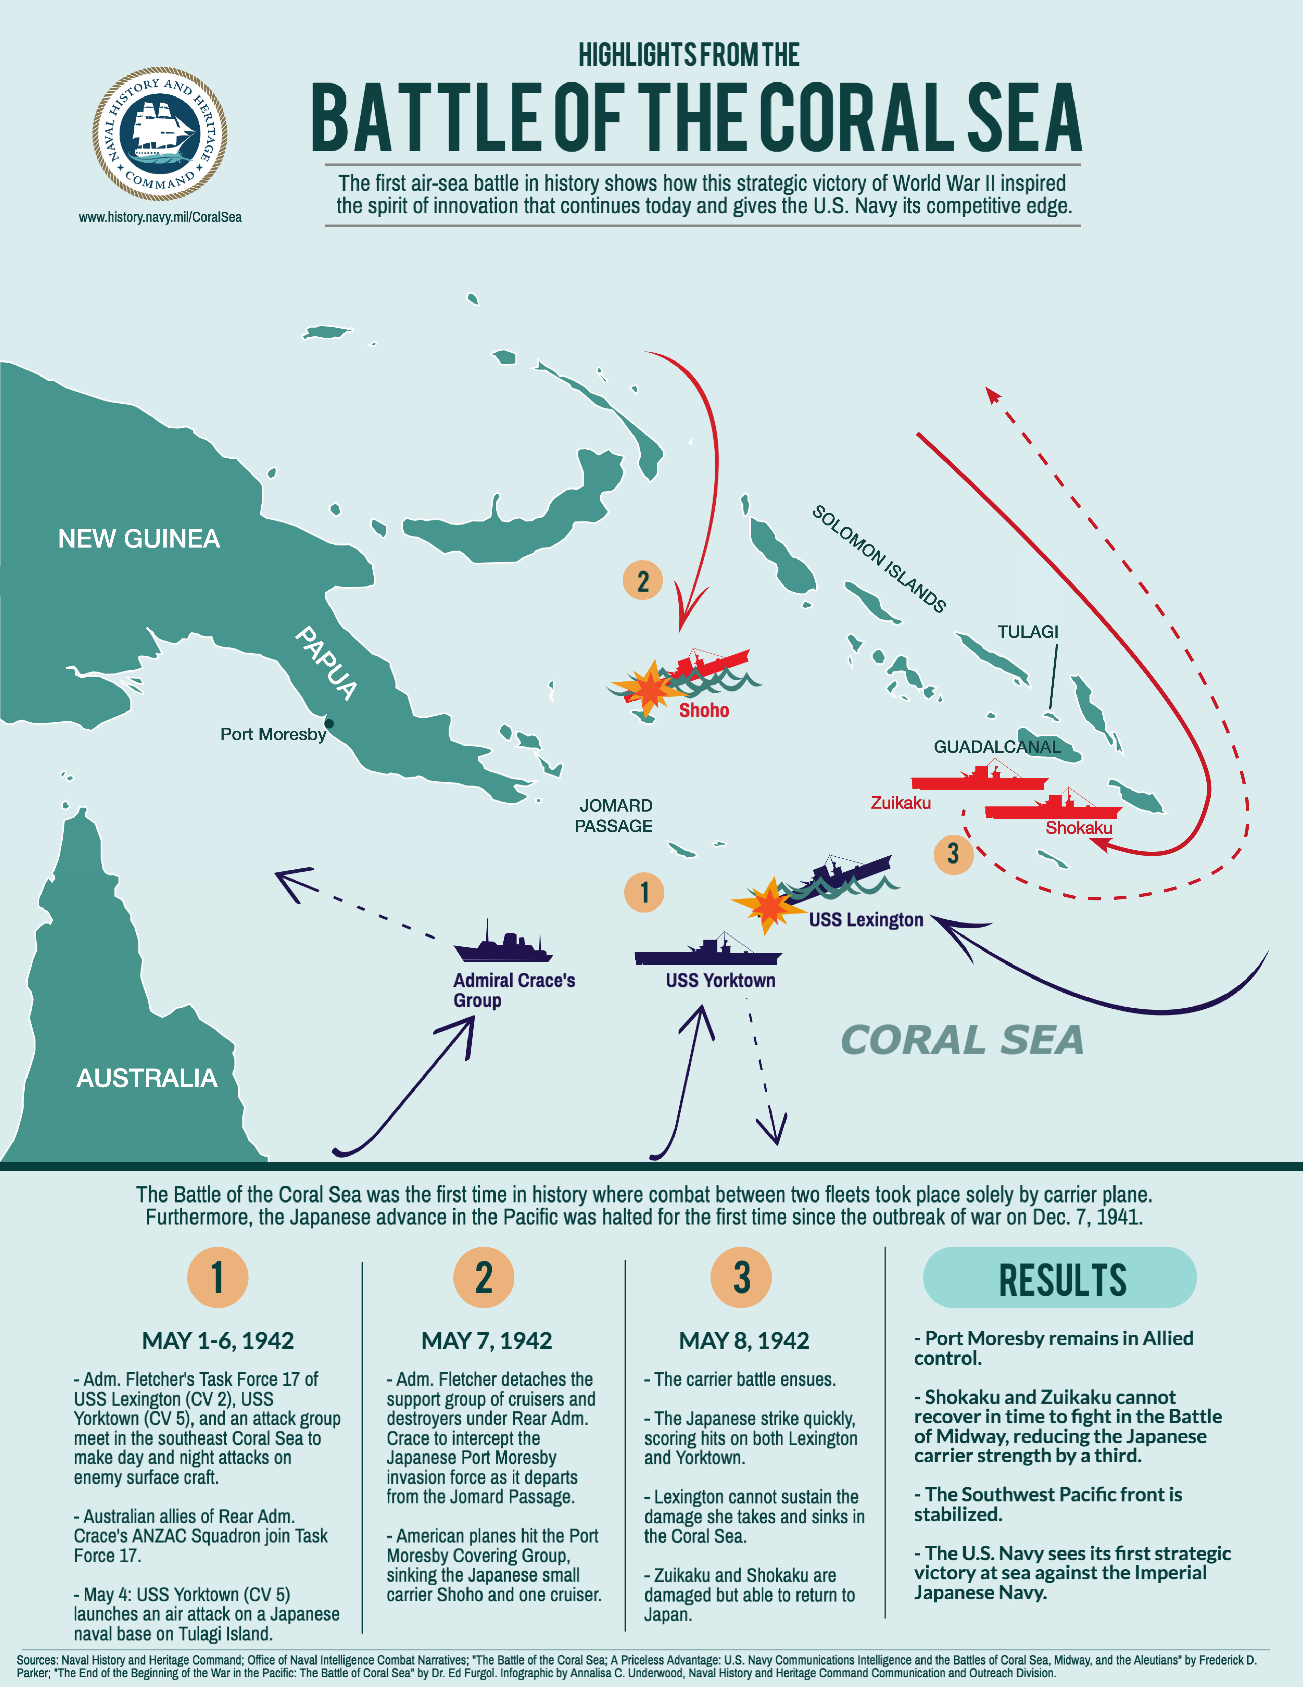
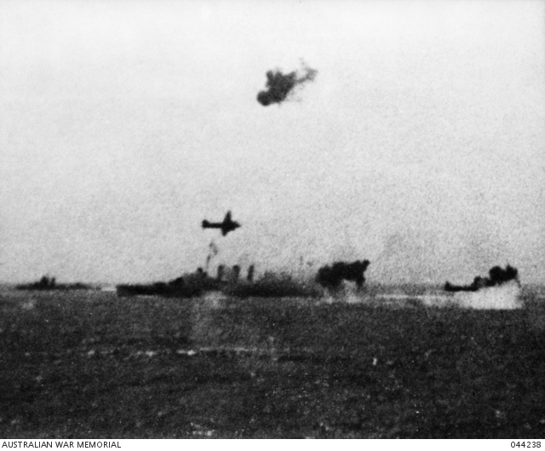
Battle of the Coral Sea, May 1942 HMAS Australia survives Japanese attack
Battle of the Coral Sea, May 1942
Archives Centre, Naval History and Heritage Command, Washington DC
HMAS Australia being bombed by Japanese planes in the Battle of the Coral Sea
Australian War Memorial Collections, 044238
Notes:
Meanwhile, the flagship was about to face a concerted Japanese attack in the Battle of the Coral Sea.
The flagship was heavily bombed but narrowly avoided being sunk at the hands of Japanese bombers and both Harold Farncomb and Trevor Rapke survived the battle.
Importantly, Task Force 44 had blocked the Japanese invasion of New Guinea in the west.
In the east, the US Navy and Japanese lost one carrier each in a very intense battle.
Technically it was a draw but the Allies claimed victory because the Japanese withdrew.

Slide 26
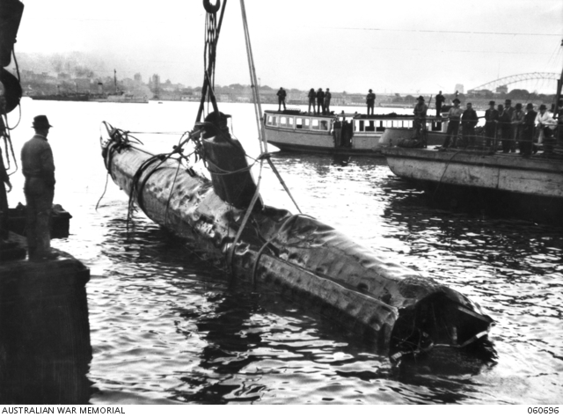
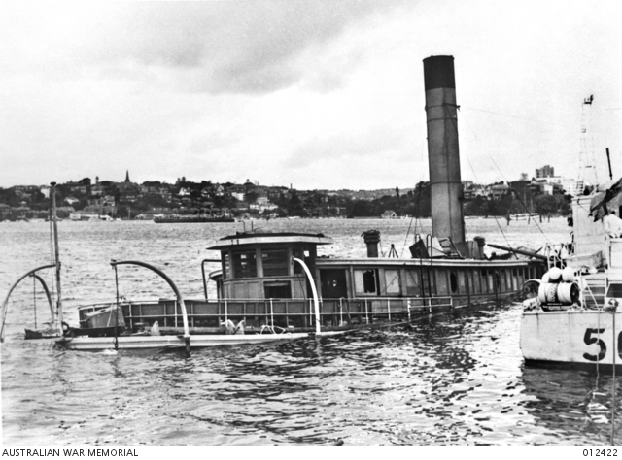
Daring Japanese submarine attack in Sydney Harbour, 31 May 1942
Japanese Midget Submarine sunk in Sydney Harbour
Australian War Memorial Collections, 060696
RAN accommodation ship, HMAS Kuttabul, damaged in Japanese midget submarine attack
Australian War Memorial Collections, 012422
Notes:
While both sides were licking their wounds, the Japanese decided to make a surprise attack on Sydney.
In late May 1942, several Japanese midget submarines penetrated Sydney Harbour and created chaos.
Torpedoes just missed USS Chicago but managed to sink the former ferry, HMAS Kuttabul.
Unfortunately, 21 Australian and British sailors died when Kuttabul was sunk.
As an aside, Ron Gordon and Ted Elias had their kit stored on Kuttabul after the went to gaol and it went to the bottom of the harbour.
As a result, they lost all their personal belongings.

Slide 27
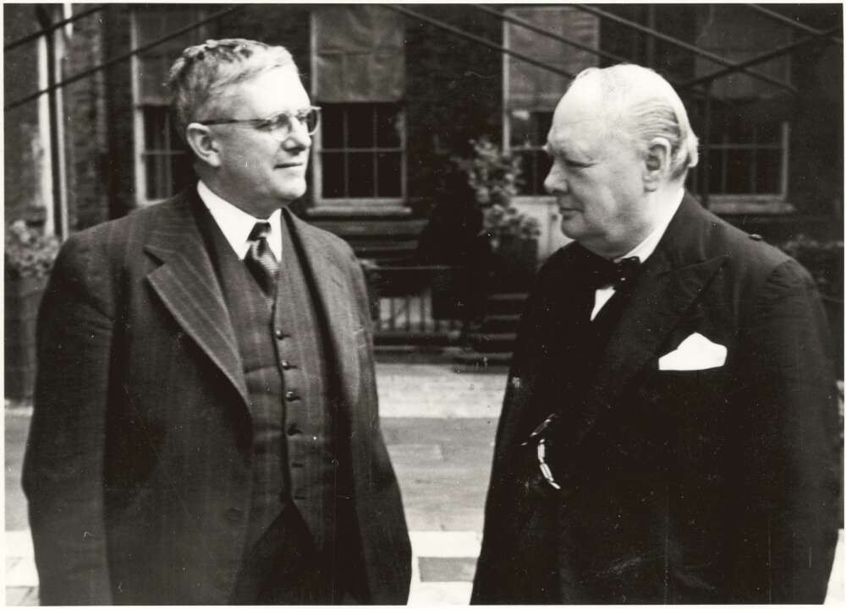
Bert Evatt went from the US to the UK to meet Winston Churchill
Bert Evatt meets Winston Churchill, 1942
National Library of Australia, 137175784
Notes:
While the war raged in the Pacific, Bert Evatt flew from the US to Britain to lobby Winston Churchill.
Curtin and Churchill had been at loggerheads over the recall of Australian troops from the Middle East.
Evatt’s job was to sooth the waters and get some planes to help in the defence of Australia.
Churchill only promised a squadron of Spitfires and it would take nearly year before they arrived.
Evatt came back to Australia in late June empty handed to face the High Court decision.

Slide 28
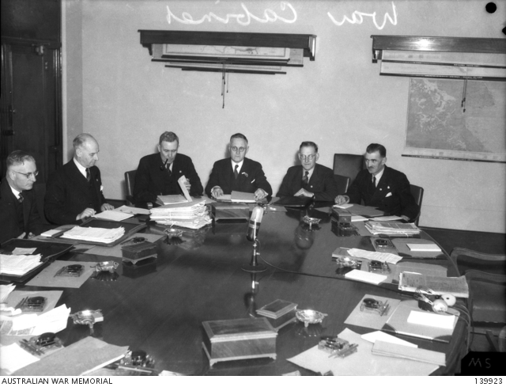
Cabinet briefed on High Court decision
John Curtin, Australian Prime Minister 1941-45 (on left) at a War Cabinet meeting in Victoria Barracks, Melbourne
Australian War Memorial Collections, 139923
Notes:
The High Court finally handed down its decision on 8 July 1942.
All four High Court justices rejected the lawyers appeal.
They held that British military law applied after the Governor General’s transfer order in 1939 and the death sentence was confirmed.
Evatt briefed Cabinet the same day.
Cabinet put him in charge of finding a face saving solution.

Slide 29
Bert Evatt orders his advisers to find a solution
Allan Dalziel (on right), chief of staff to Bert Evatt
Fairfax Media Archives, FXT107139
Sir George Shaw Knowles
Solicitor General, 1932-46
Office of the Parliamentary Counsel
Notes:
Evatt immediately ordered his two senior advisers to find a way out of the mess.
His chief of staff was Allan Dalziel.
His departmental head was Sir George Knowles.
They worked on a range of options.
The first option was to ask the British to change their rules to avoid the death sentence.

Slide 30
A diplomatic stand-off with Whitehall
Clement Atlee, Deputy Prime Minister, 1942-45 and Secretary of State for Dominion Affairs, 1942-43,
Wikimedia Commons
Flinders University, 31560859694
Robert Gascoyne-Cecil,
Viscount Cranborne,
Secretary of State for the Colonies
Wikimedia Commons
Yousuf Karsh, Dutch National Archives, 902-2081
Notes:
However, the British were simply not prepared to change the rules to help two murderers.
An Australian exemption would create a nightmare for the Royal Navy which had multiple nationalities serving in their warships.
They countered that the Australian Government needed to change its own legislation.
This forced Dalziel and Knowles to look at alternatives.

Slide 31
King George VI commutes the death sentences to life imprisonment
H. M. King George VI of England
Wikimedia Commons
Matson (G Eric and Edith) Photograph collection
US Library of Congress, 04464
Notes:
In the and, the legal advice was clear.
The only quick and clean way to avoid the death sentence was to seek Royal Clemency.
The Labor Government was initially reluctant to go cap in hand to the King but it had no choice.
Fortunately, King George VI was sympathetic – he wanted to keep Australia in the Empire and was pleased to help.
So on 11 August 1942, George VI commuted the death sentences of Ron Gordon and Ted Elias to life imprisonment.

Slide 32
Ron Gordon and Ted Elias transferred to Goulburn Reformatory
Goulburn Reformatory
Archives Office of NSW
Notes:
Both Ron Gordon and Ted Elias were obviously extremely relieved to hear about Royal Clemency.
The sting in the tail though was that they were transferred to the old colonial prison at Goulburn for the rest of their lives!
Their lawyers, family and friends were not prepared to accept this.
They still believed there had been a miscarraige of justice.

Slide 33
HMAS Australia survives the Battle of Savo Island, August 1942
HMAS Canberra sinking after the Battle of Savo Island Australian War Memorial Collection, 137295
The Battle of Savo Island
Archives Centre, Naval History and Heritage Command, Washington, DC
Notes:
While the legal and diplomatic battle played out between Melbourne, Canberra and London…
HMAS Australia was involved in the first allied offensive against the Japanese in the Pacific.
A combined Australian and US fleet landed an invasion force of 11,000 US Marines on Gaudacanal.
While the land offensive initially went smoothly, the Japanese struck back in a surprise night attack and sunk the Canberra and several US cruisers.
Once again, Australia was lucky to miss the action.

Slide 34
Evatt’s gamble – adopting the Statute of Westminster, October 1942
Opposition Leader, Robert Menzies
National Library of Australia, 136264652
Bert Evatt listening to debate
State Library of NSW, 110316141
Notes:
In Canberra, Evatt was so furious about the lack of Australian control over its own ships they he decided to adopt the Statute of Westminster.
This was a huge gamble, as the Conservative Opposition, which had the numbers in the Senate, had refused to adopt this legislation before or during the war.
It was only after a secret briefing of Parliament about what had happened on the flagship that Evatt was able to get the numbers to adopt the legislation.
This meant, for the first time, that Australia was legally independent of Great Britain.

Slide 35
Allied counter-attacks in New Guinea 1942-1943
New Guinea August-September 1943
The Map Archive, Ax00348
Notes:
While Evatt was playing politics in Canberra, the allies stopped a Japanese attack over the Kokoda Track and launched a counter-offensive.
However, HMAS Australia was ordered to stay behind the Great Barrier Reef.
On the flagship, the sea inside the Reef was disparagingly known as the Cabbage Patch and they called themselves Curtin’s Koalas.
They did not know it but they were being kept in reserve for a future offensive.
It was at this point that Trevor Rapke retired and Harold Farncomb was ordered to Britain to train on aircraft carriers.
Trevor Rapke had been in the front line for 366 days and was suffering from battle stress and a severe case of dermetitous.
But he remained determined to help Ron Gordon and Ted Elias.

Slide 36
Christina Byrnes starts her campaign to free Ted and Ron
Mrs Christina Byrnes, mother of Ted Elias
Trove: The Daily Telegraph, Page 2, Thursday, 23 July 1942
Mervyn Finlay with magistrate and future NSW Premier and Governor General, William McKell
National Library of Australia, 157582036
Notes:
As the war dragged on, and Ron Gordon and Ted Elias remained locked up in Goulburn, the prisoner’s family and friends decided to escalate their campaign to free the two men.
Elias’s mother, Christina Bryne engaged a Sydney criminal lawyer, Mervyn Finlay and he wrote letters for her to send to a wide range of opinion leaders to get support.
Finlay also arranged for media coverage to influence public opinion and put pressure on the Government to free the two prisoners

Slide 37
Senior clergyman campaign to free Ron Gordon and Ted Elias
The Anglican Bishop of Goulburn, Dr Ernest Burgmann
Anglican Diocese of Canberra and Goulburn
Catholic Cardinal of Sydney
Norman Gilroy
Find a Grave, Eman Bonnici
Notes:
The campaign to engage key opinion leaders paid off.
The Anglican Bishop of Goulburn, Ernest Burgmann, kicknamede the Bushman Bishop, and the Catholic Cardinal in Sydney, Norman Gilroy both lobbied Evatt to do more to release the men.
Burgmann was a close personal friend of Evatt and Dalziel and he was able to influence them.

Slide 38
Maxwell Inquiry in February 1944 recommends lesser gaol terms
Justice Allan Maxwell Snr (on right)
Justice Alan Maxwell Jnr (on left)
Fairfax Media Archives, G12001904AA
Percy Spender, KC
Minister for the Navy, 1940
Australian War Memorial Collection, C24162
Notes:
To end the lobbying, Evatt decided to hold a secret judicial inquiry into the case.
He appointed NSW Supreme Court justice, Allan Maxwell to review the evidence.
Harold Farncomb and Trevor Rapke both attended. Former Navy Minister, Percy Spender, helped to defend the sailors.
After a five day hearing in Sydney, Maxwell decided that:
The men were guilty as charged
However, Harold Farncomb’s personal comments about the men’s guilt were inappropriate; and
Mitigating circumstances should have been considered.
Maxwell recommended reduced sentences but did not specify what they should be.

Slide 39
Battle between Navy and Attorney Generals delays prisoners release
Alfred Nankervis, Secretary of the Department of the Navy
Australian War Memorial Collection, 107011
Sir George Shaw Knowles,
Secretary of the
Attorney Generals Department
Office of the Parliamentary Counsel
Notes:
The lack of clarity in the Maxwell ruling fuelled a long lasting legal battle.
The Ags Department in Canberra wanted to free the sailors as early as possible.
But the Navy Office in Melbourne was determined to keep them in gaol as long as possible.
They argued for years over the technical legal details about how the Maxwell ruling should be implemented.
Sir George Knowles eventually retired and became Australia’s High Commissioner in South Africa.
Evatt also lost interest in the case and focused on his new project at the end of the war – the United Nations.
In their absence, Alfred Nankervis, the secretary of the Navy Office continued to argue against early release.

Slide 40
Judge Rainbow and Sir Kenneth Bailey achieve legal breakthrough in 1949
Judge Alfred Rainbow,
President,
Prisoner’s Aid Association
Lynn Rainbow Collection
Sir Kenneth Bailey,
Secretary,
Attorney General’s Department
1946-64
National Library of Australia, 137110965
Notes:
It was not until 1949 – seven years after the murder - that a breakthrough occurred in the legal battle.
Judge Alfred Rainbow, President of the Prisoners Aid Association in NSW found that the Maxwell ruling had been misrepresented.
The Ags Department initially thought that good behaviour reductions in the men’s sentences would not apply.
But Rainbow confirmed with Maxwell that this was not his intention and the men should have had the benefit of good behaviour.
The new head of the AGs Department, Sir Keith Bailey, confirmed this was the case and advised the Navy Office.
The Navy Office finally agreed that the men could be released and they walked free from Goulburn gaol in September 1950.

Slide 41
Ted Elias (AKA Ellis) married one week after leaving gaol in September 1950
Ted Elias marriage to Jean Harrison (on right)
with Ron Gordon and unnamed bridesmaid (on left)
Giles Yates Collection: ancestry.com.au
Notes:
Only one week later in Sydney, Ted Elias married a pre-war girlfriend, Jean Harrison.
He also changed his name to Ted Ellis and joined a secret community organisation, the Independent Order of Oddfellows to help build a new life
He eventually passed away in 1988 at the age of 70.
Ron Gordon also married, twice, and also lived a long and happy life.
He eventually passed away in 1994 at the age of 76.
There is little doubt that Ron Gordon and Ted Elias murdered Jack Riley.
The bottom line is, they did the crime and they served their time.
However, their post-war marraiges raise some doubts about the motive for the crime
This leaves us to speculate about the homosexual motive and to debate the legal and political fallout.

Slide 42
Notes:
I would now be pleased to answer any questions.

