Slide 2
This story starts in Bellerive
Bellerive, 1930
Libraries Tasmania, Richard C Harvey, NS1029/1/10

Slide 3
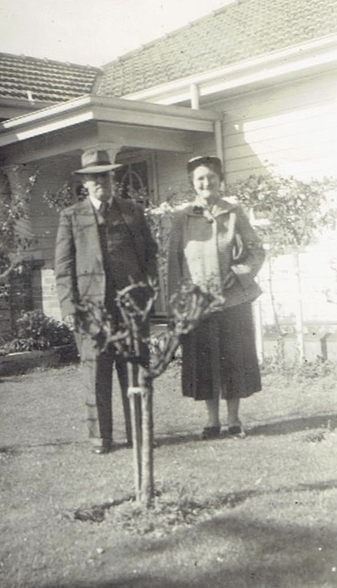
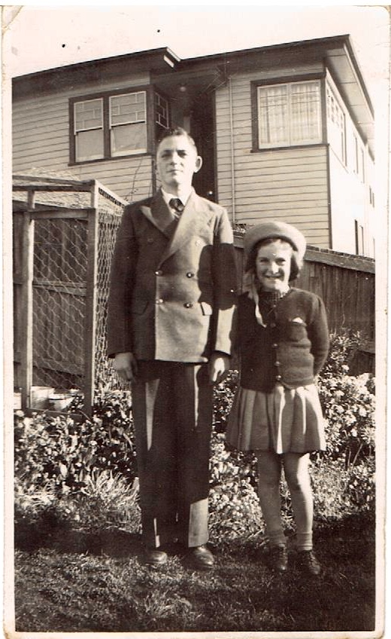
The Riley’s lived at 3 Douglas Street
Victor & Blanche Riley
Carol Woods Collection
Jack & Judith Riley
Carol Woods Collection

Slide 4
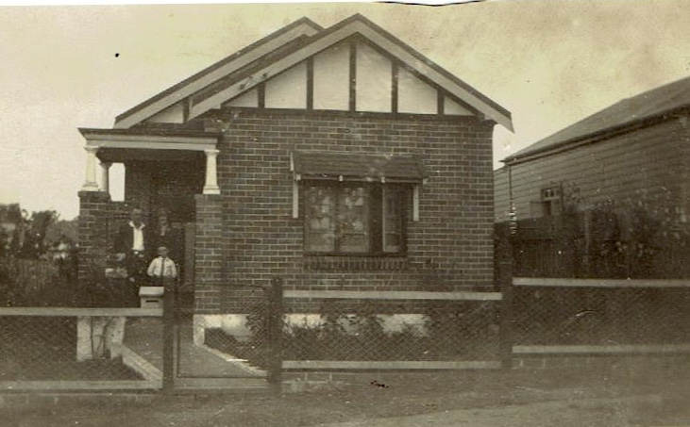
The family temporarily moved to Sydney in the late 1920s
Riley home in Lakemba,
Sydney, 1930
Carol Woods Collection

Slide 5
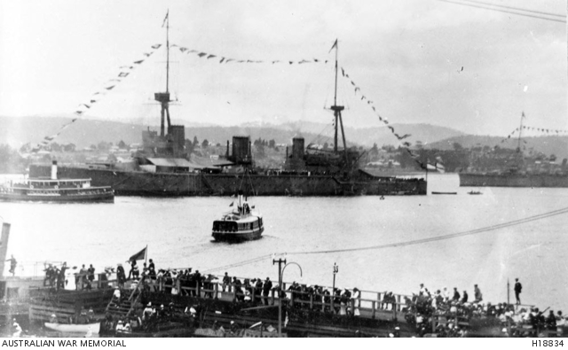
Jack fell in love with the Navy during Hobart Regatta visits

Slide 6
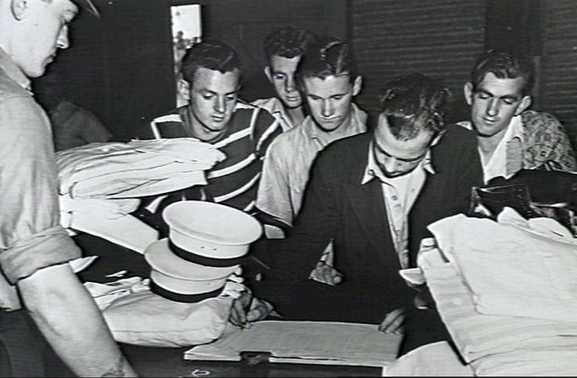
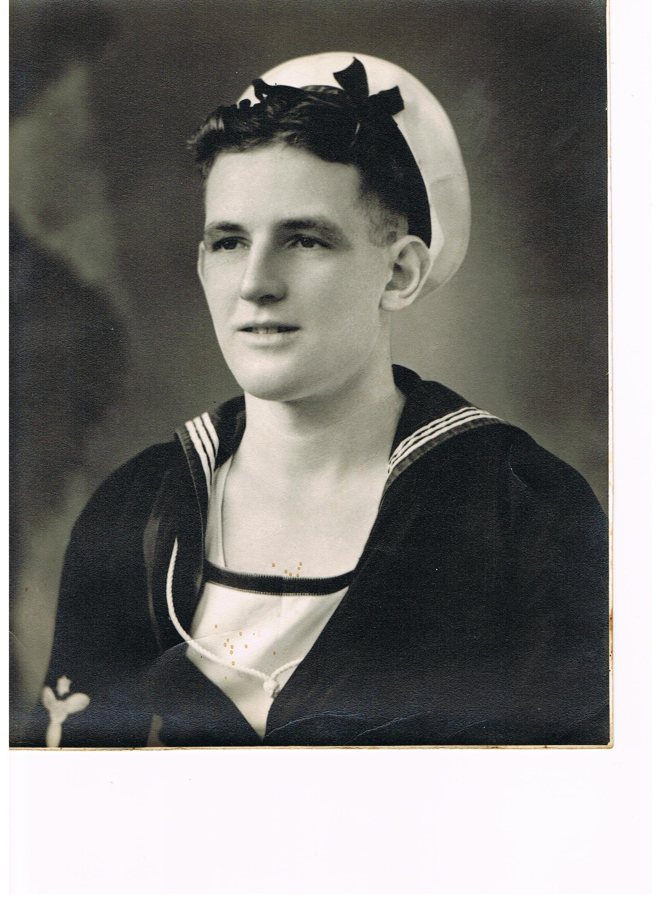
Jack Riley enlisted in 1939
Recruits at HMAS Cerberus
Australian War Memorial Collection, 306273
Jack Riley in RAN Uniform
Carol Woods Collection

Slide 7
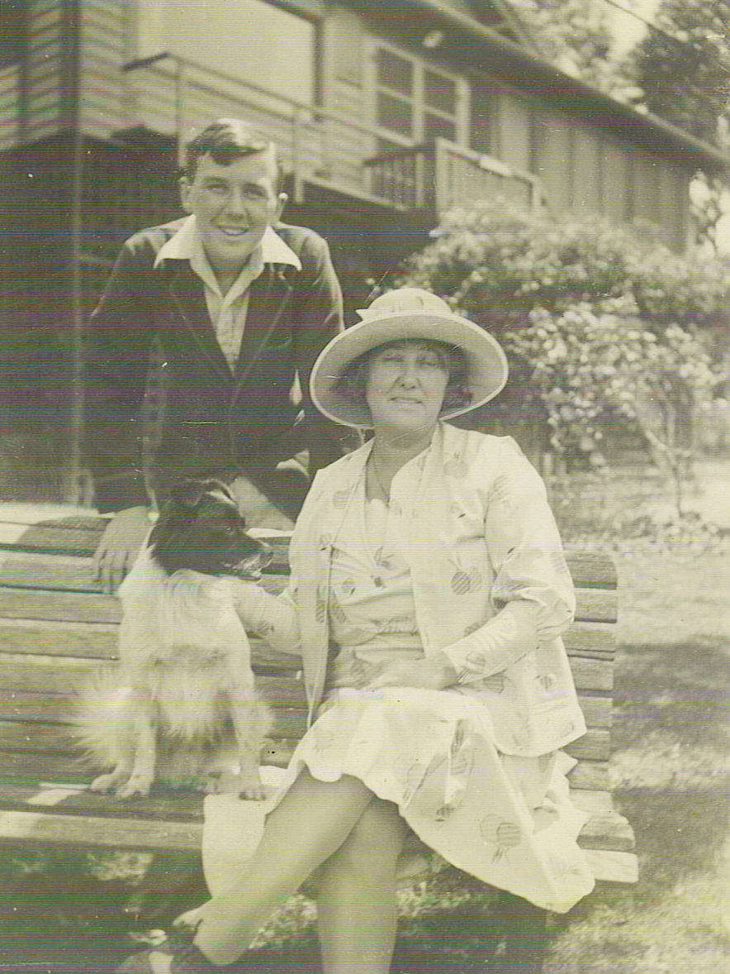
Ron Gordon was born in Copnor, Portsmouth in 1918
Copnor Bridge Post Office, 1920s
Portsmouthandsouthsea.co.uk
A young Ron Gordon
Giles Yates collection, ancestry.com.au

Slide 8
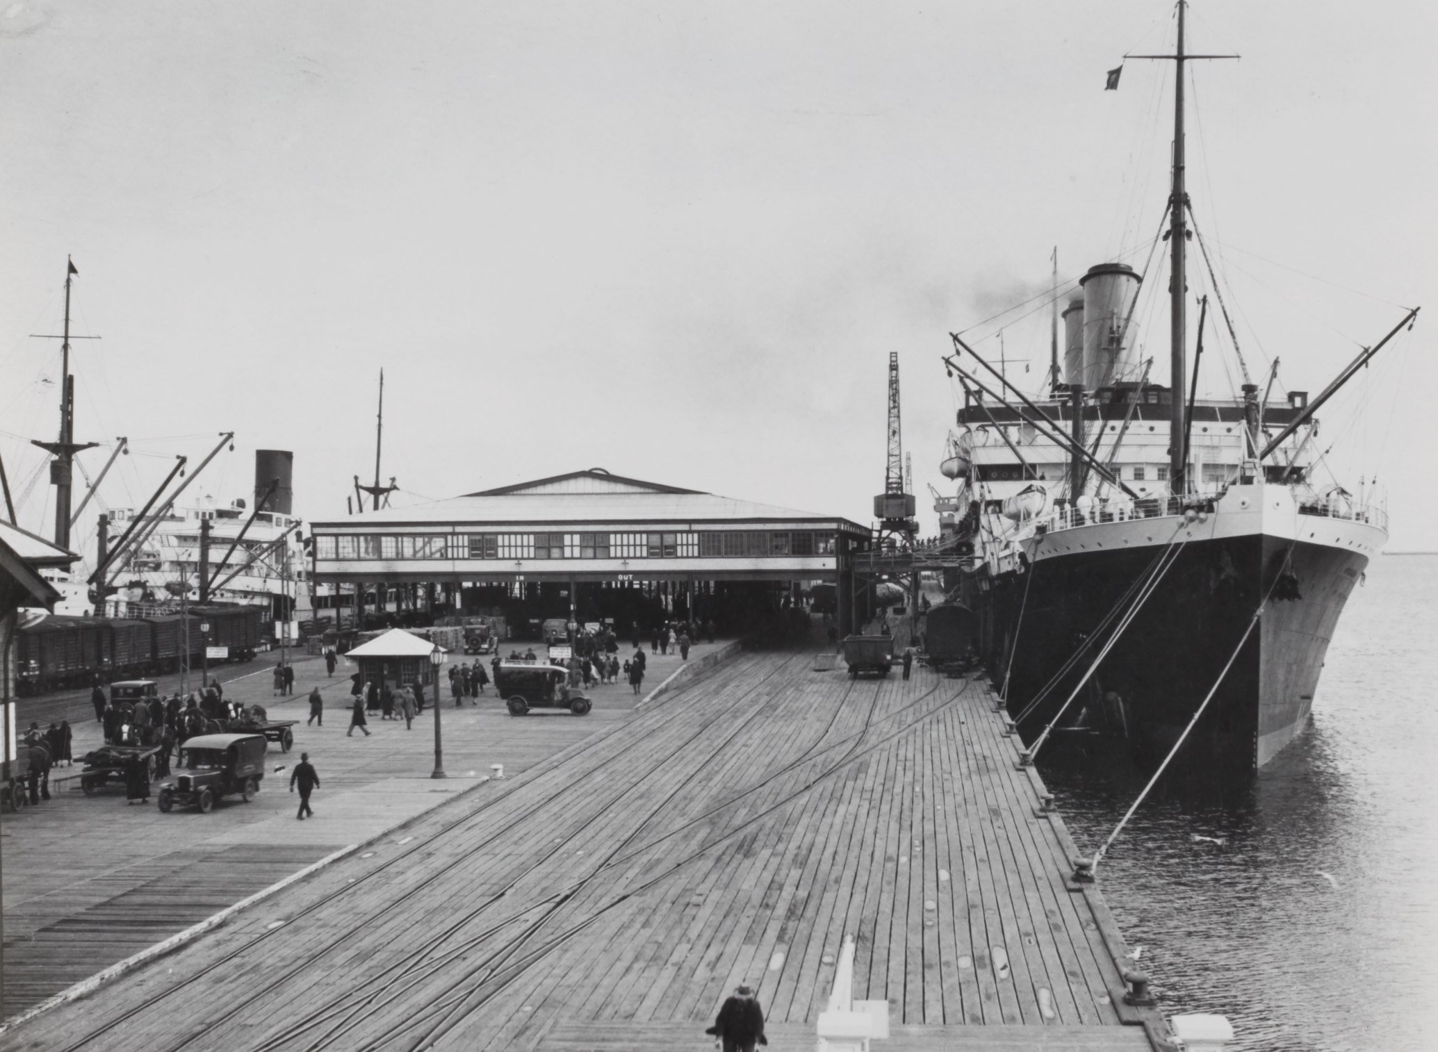
Ron Gordon and his family sailed to Australia on SS Borda in 1927
SS Borda
State Library of South Australia, PRG2801/1/113
Station Pier in Melbourne, 1920-39
Museum Victoria Collection, 1767151

Slide 9
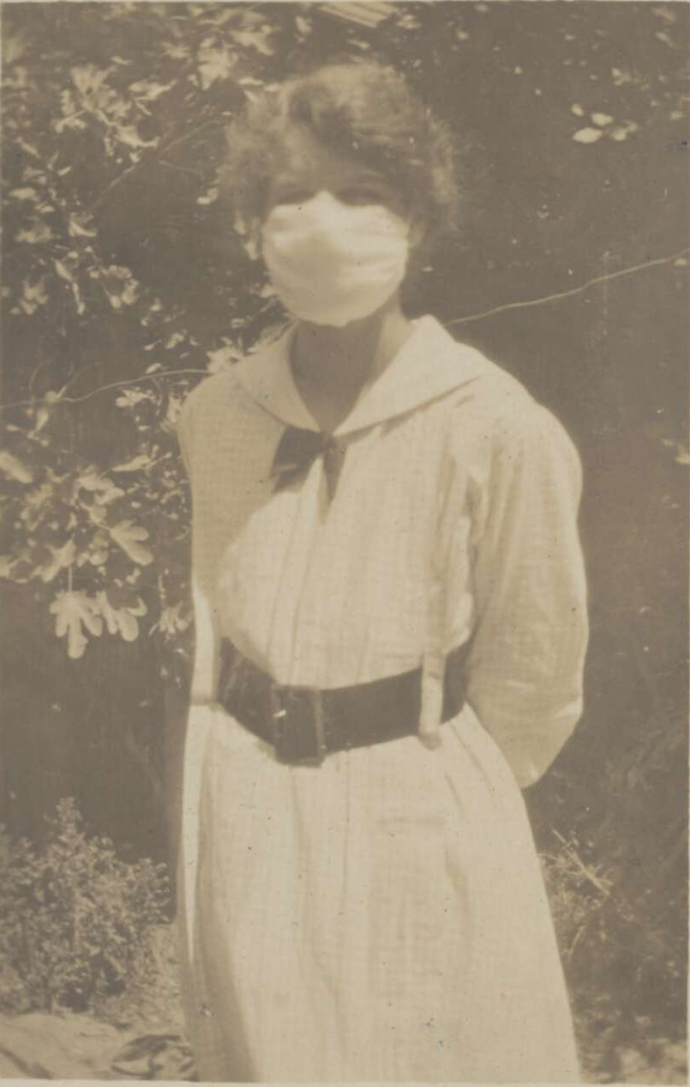
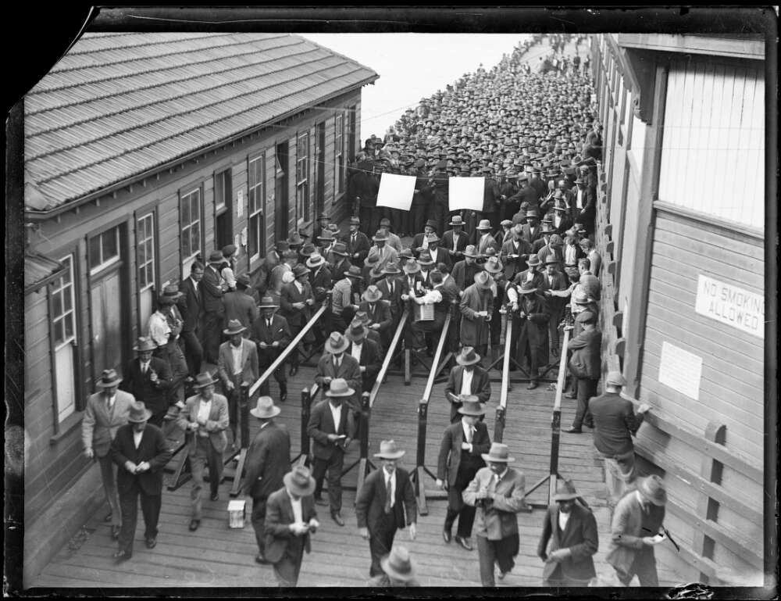
The Depression and influenza outbreak devastated the Gordon family
Dole queue at Circular Quay, 1931
National Library of Australia, 6247551
Masks worn in flu epidemic
National Library of Australia
Robert Campbell, 3919207

Slide 10
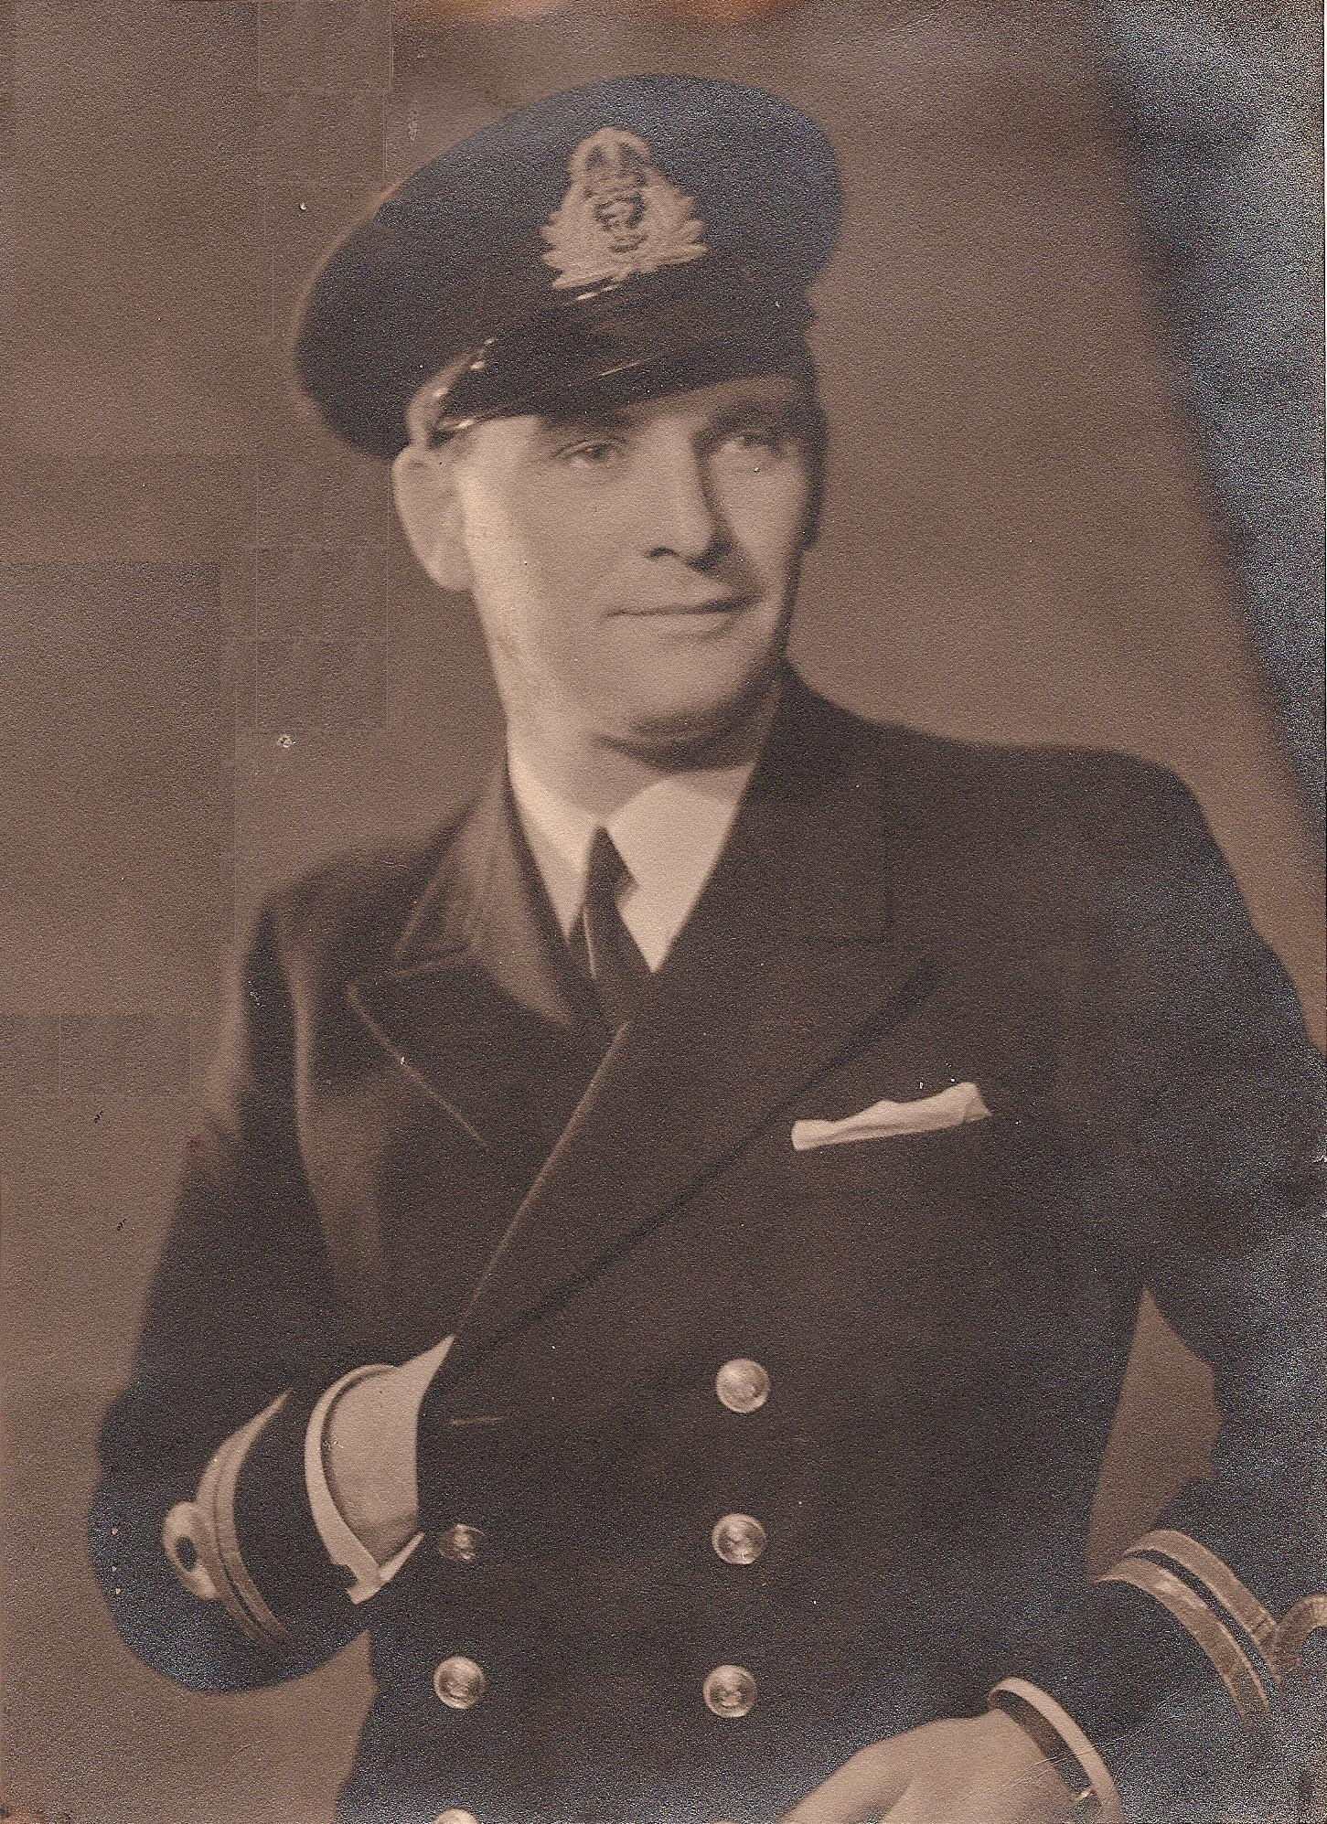
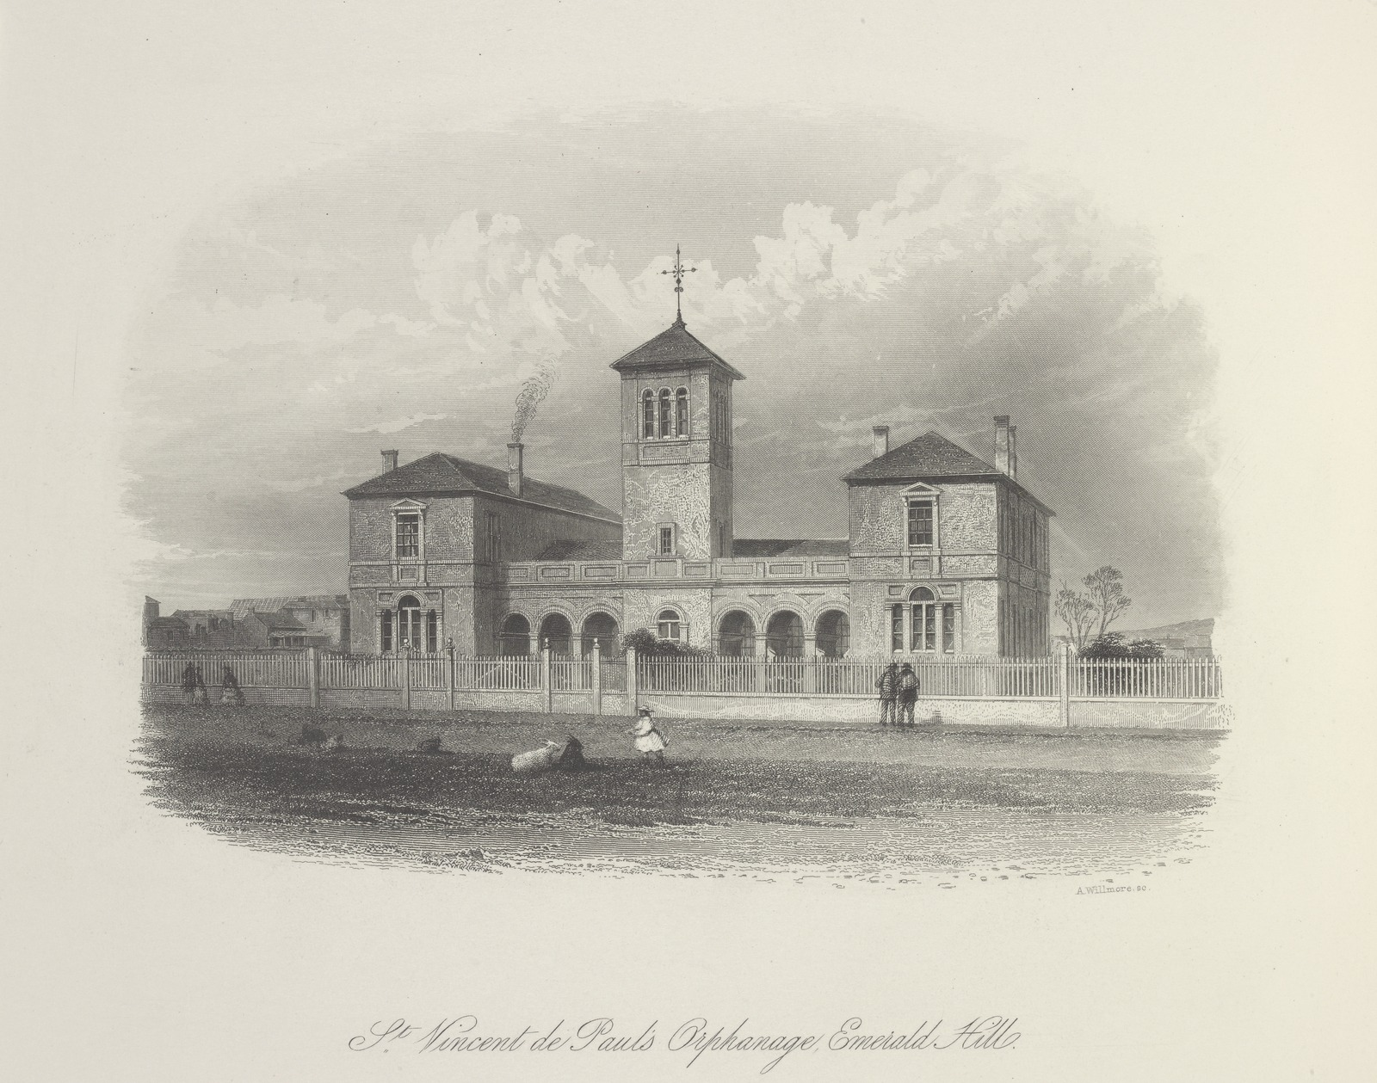
The Gordon brothers went separate ways
Frank Gordon in RAN Uniform
Giles Yates Collection, ancestry.com.au
Ron Gordon was sent to
St Vincent De Paul Boys Orphanage, Emerald Hill
State Library of Victoria, Arthur Wilmore, 1862

Slide 11
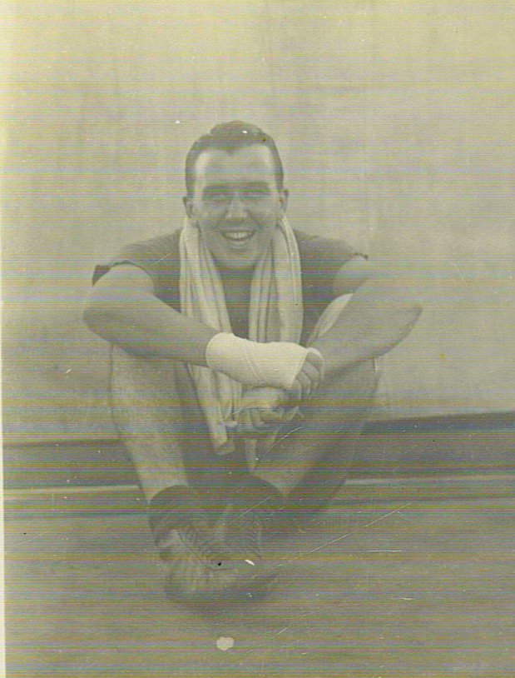
Ron Gordon followed Frank into the RAN at HMAS Cerberus in 1936
Midshipmen Parade at HMAS Cerberus
Australian War Memorial Collection, 306168
Ron Gordon – boxing enthusiast
Giles Yates Collection, ancestry.com.au

Slide 12
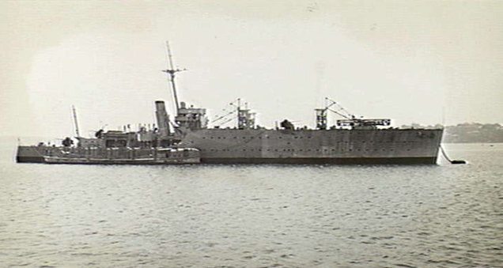
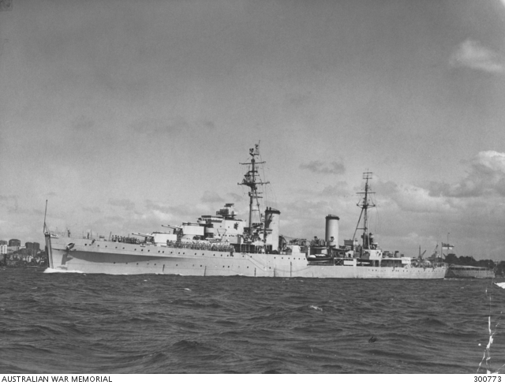
Ron Gordon served on HMAS Albatross and Hobart in 1938
Seaplane carrier, HMAS Albatross
Australian War Memorial Collection, 300119
Light cruiser, HMAS Hobart
Australian War Memorial Collection, 300773

Slide 13
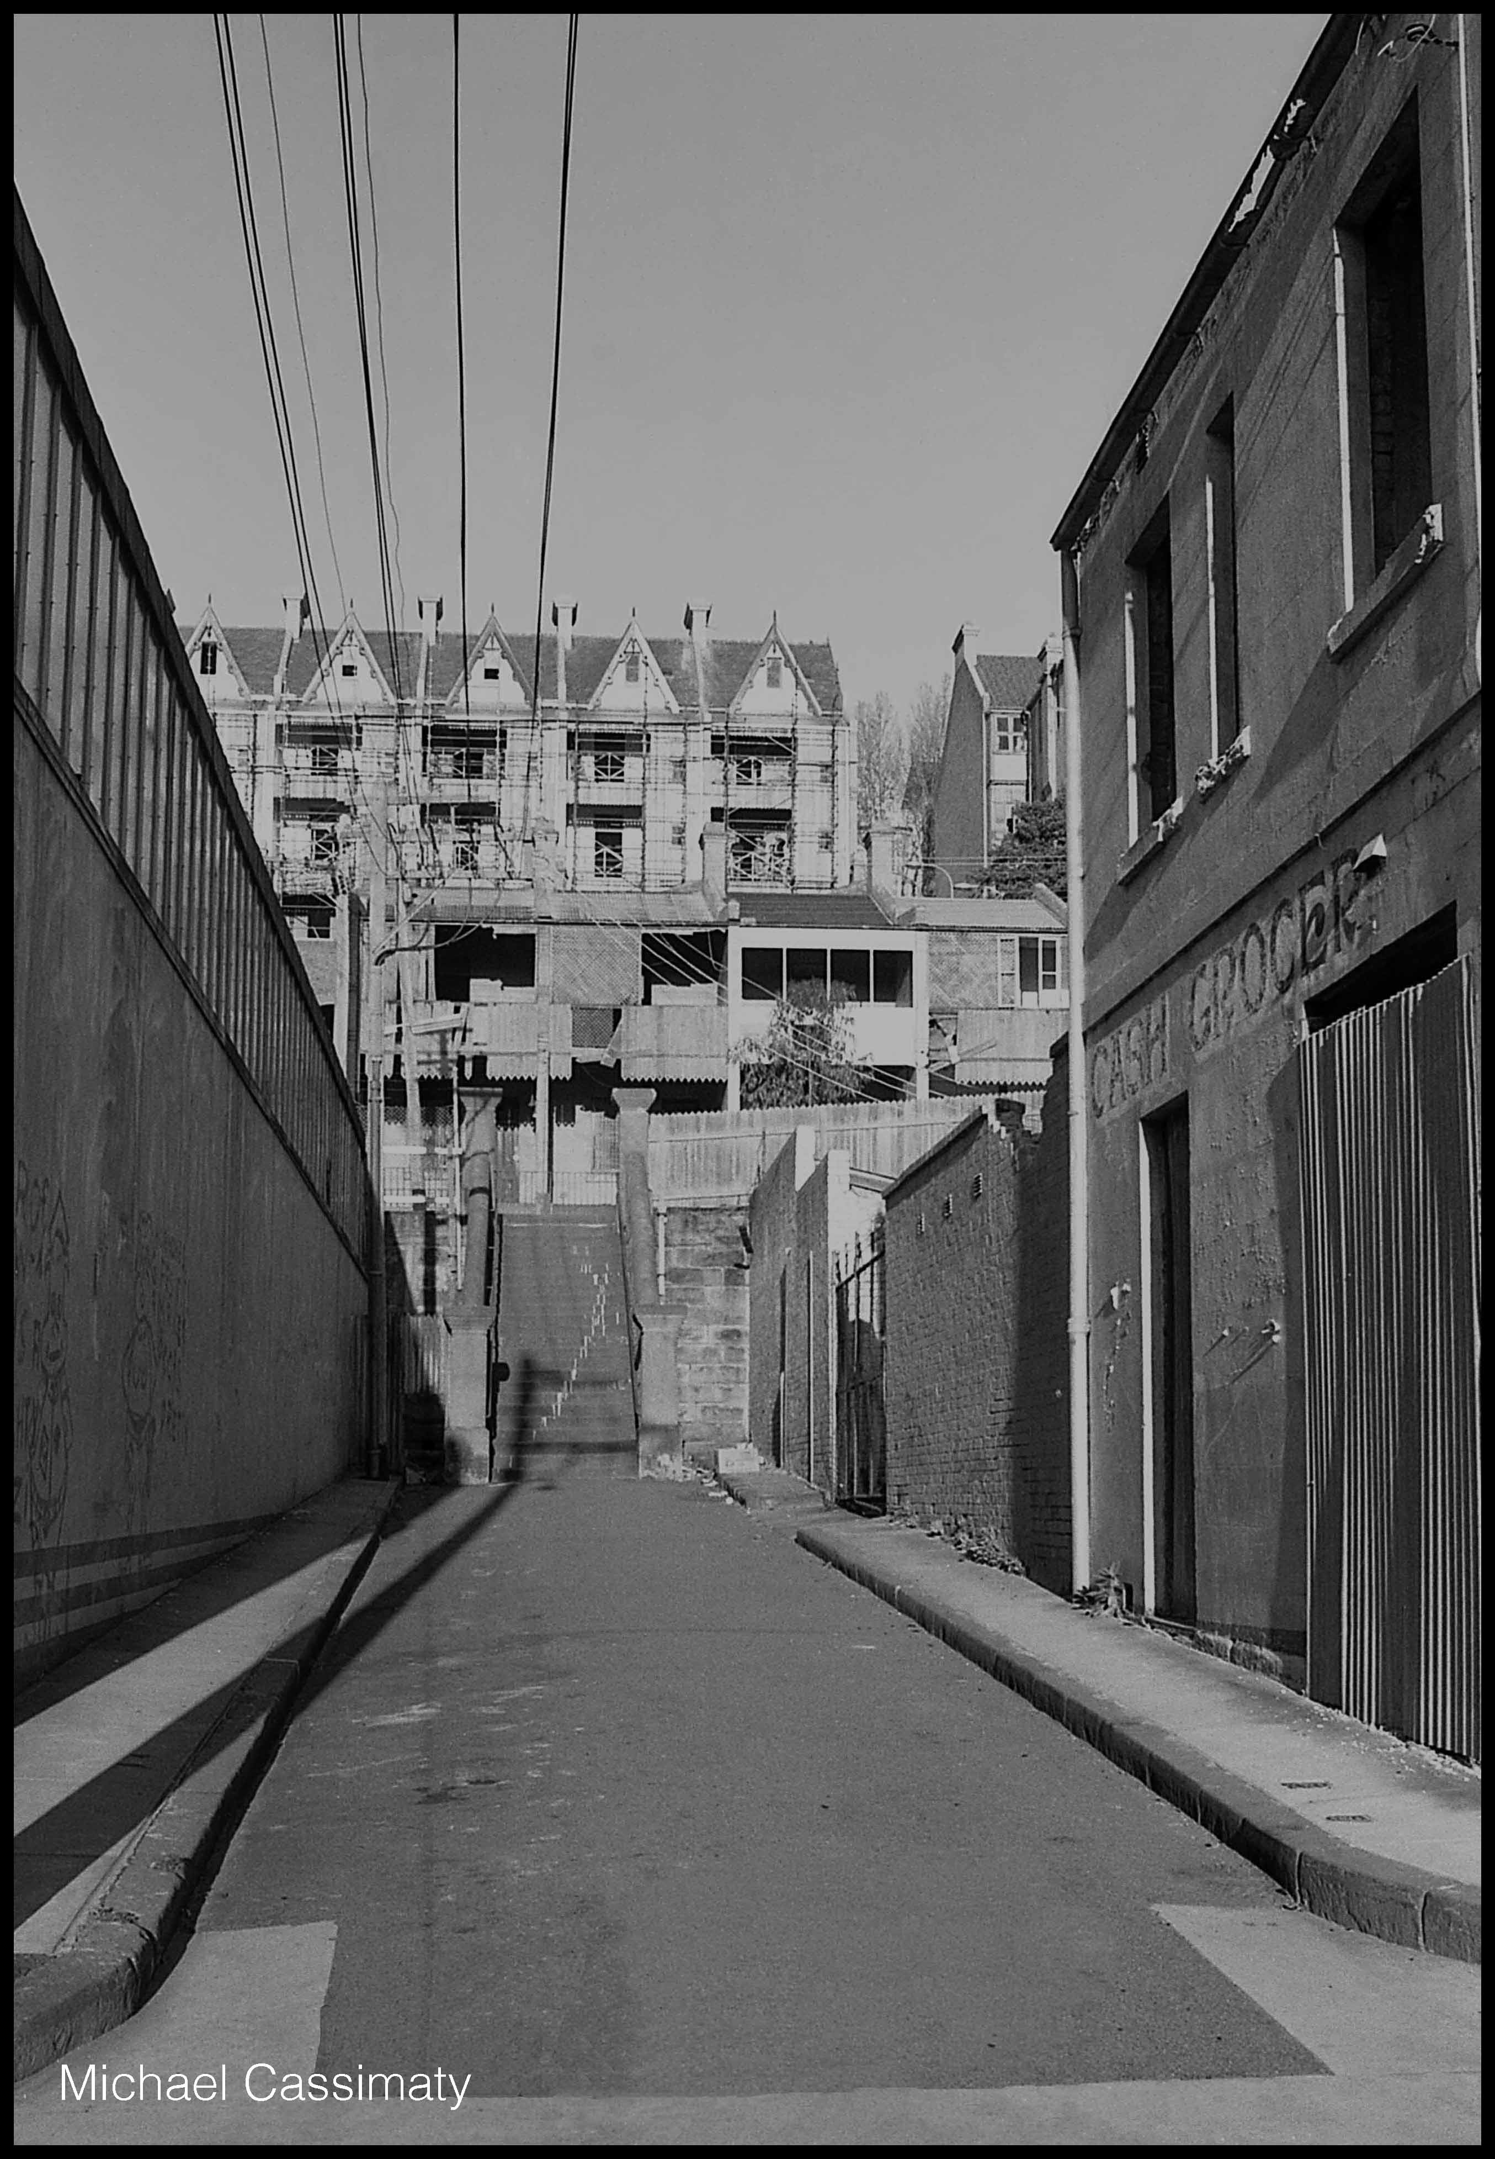
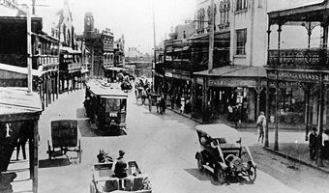
Ted Elias was born in Sydney in 1918
King Street, Newtown, 1920s
The Newtown Project
Vic Solomon Collection, Tramways Museum
Woolloomooloo
Wikimedia Commons
Royal Australian Historical Society, 30685319846

Slide 14
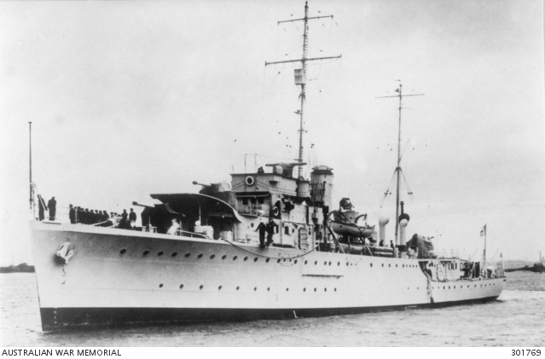
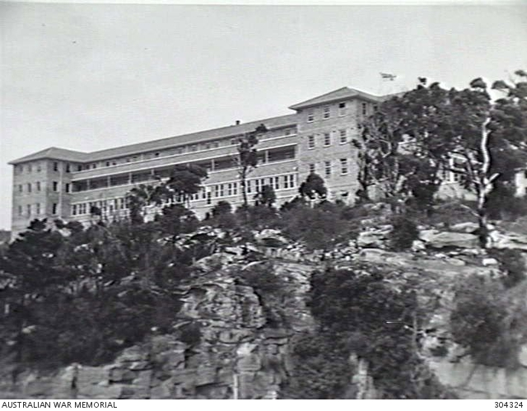
Ted Elias served on HMAS Yarra and was posted to HMAS Penguin
Sloop, HMAS Yarra
Australian War Memorial Collection, 301769
Shore Base at Balmoral, HMAS Penguin
Australian War Memorial Collection, 304324

Slide 15
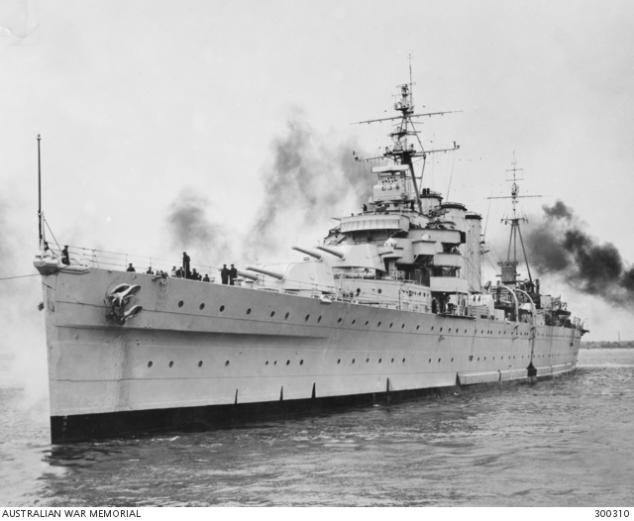
The three stokers meet on HMAS Australia in mid-1939
HMAS Australia
Australian War Memorial Collection, 300310

Slide 16
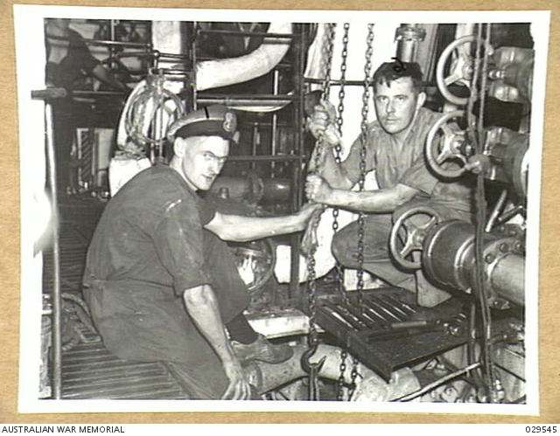
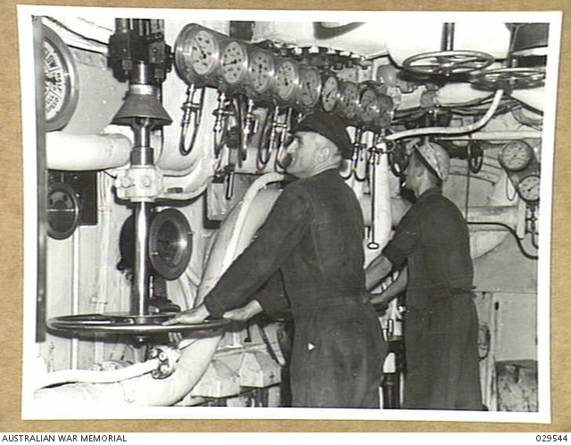
The stokers worked in the engine room
Engineers repairing a lubrication pump, HMAS Australia
Australian War Memorial Collection, 029545
The engine room, HMAS Australia
Australian War Memorial Collection, 029544

Slide 17
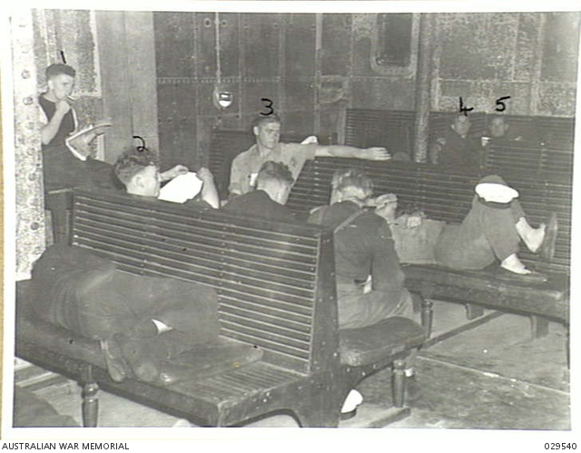
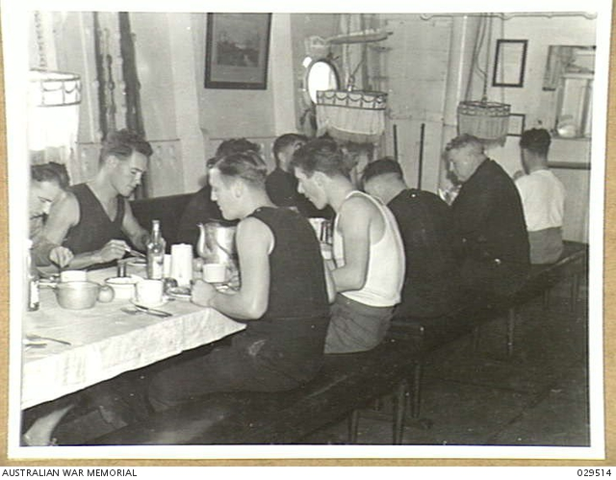
Daily life on HMAS Australia was always crowded
Artisan’s Mess Deck
HMAS Australia
Australian War Memorial Collection, 029540
Seaman’s recreation room
HMAS Australia
Australian War Memorial Collection, 029540

Slide 18
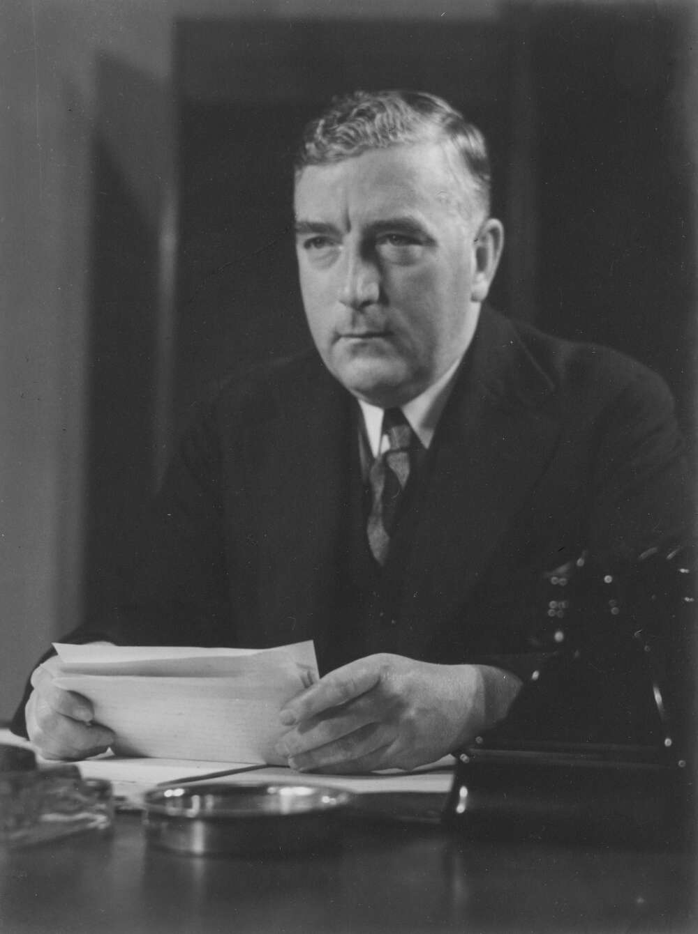
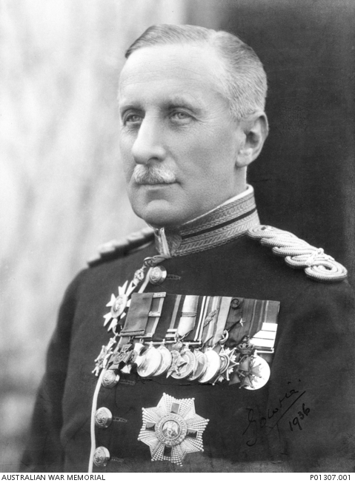
HMAS Australia was transferred to the Royal Navy at the start of the war
Robert Menzies
Prime Minister 1939-41
Declaration of War
National Library of Australia, 136636422
Alexander Hore-Ruthven
1st Earl of Gowrie
Governor General
Australian War Memorial Collection, P01307.001

Slide 19
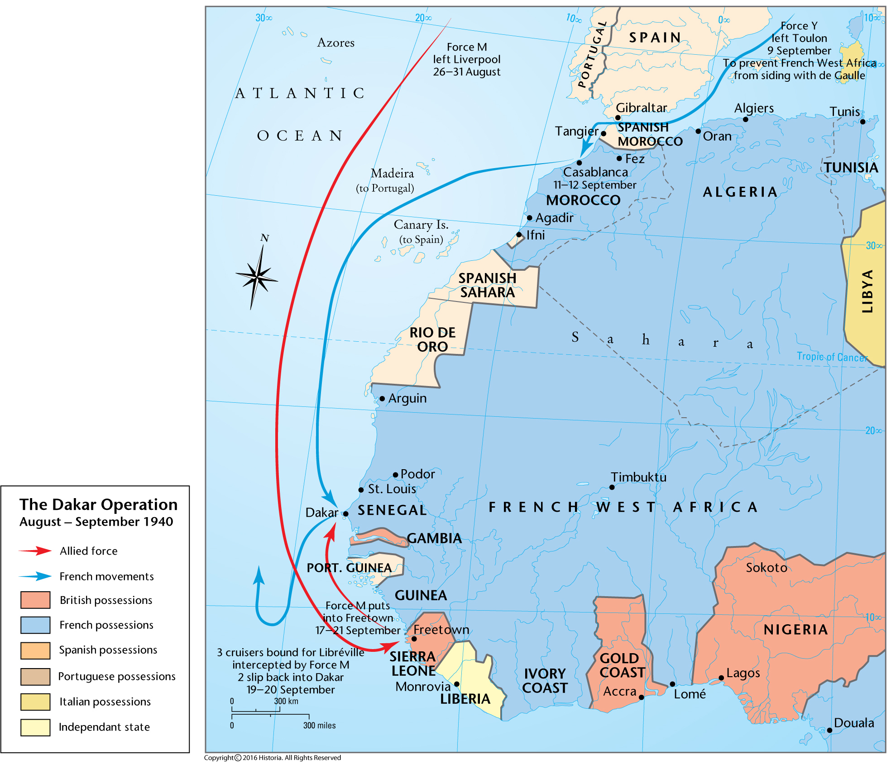
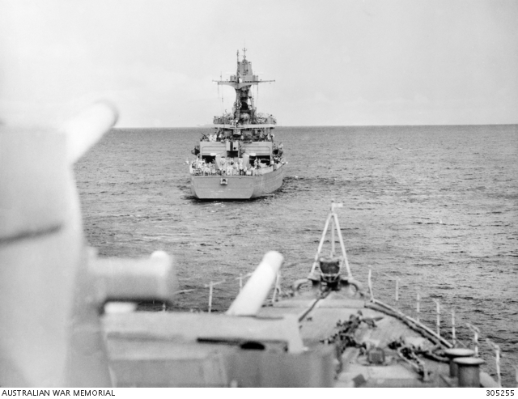
The Admiralty ordered HMAS Australia to West Africa in 1940
HMAS Australia escorts the Vichy French cruiser Gloire
to Casablanca
Australian War Memorial Collection, 305255
The Dakar Operation,
August-September 1940
The Map Archive, Ax00277

Slide 20
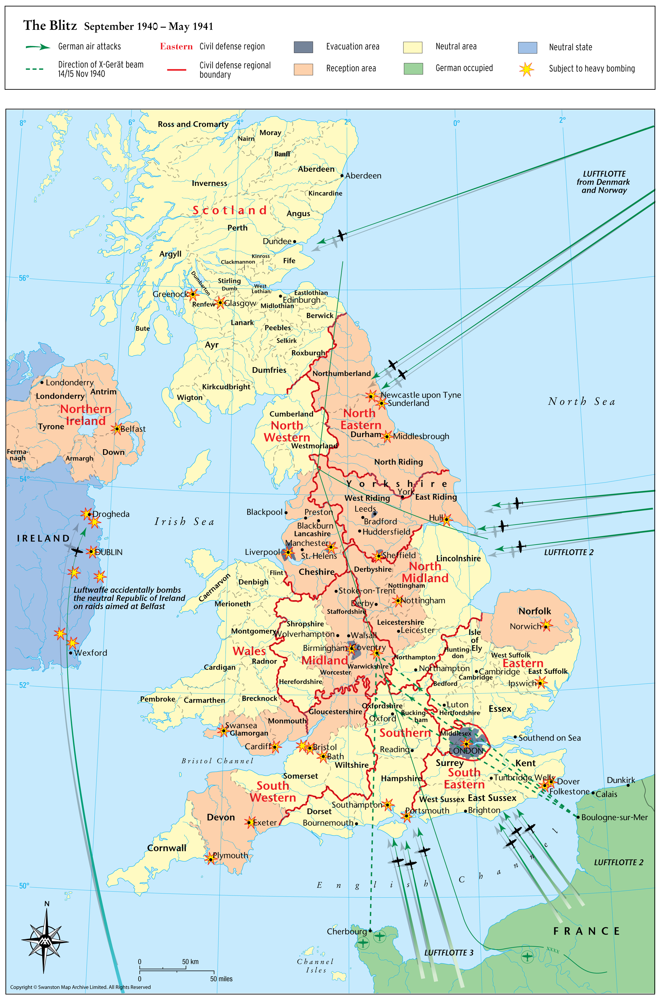
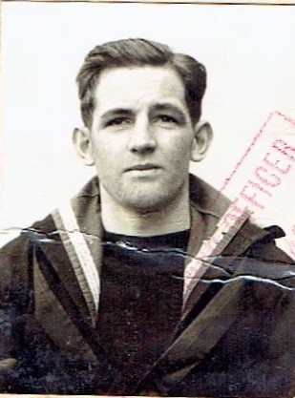
HMAS Australia then patrolled the Atlantic in 1941
The Blitz September 1940-May 1941
The Map Archive, Ax00843
Jack Riley UK pass photo
Carol Woods Collection

Slide 21
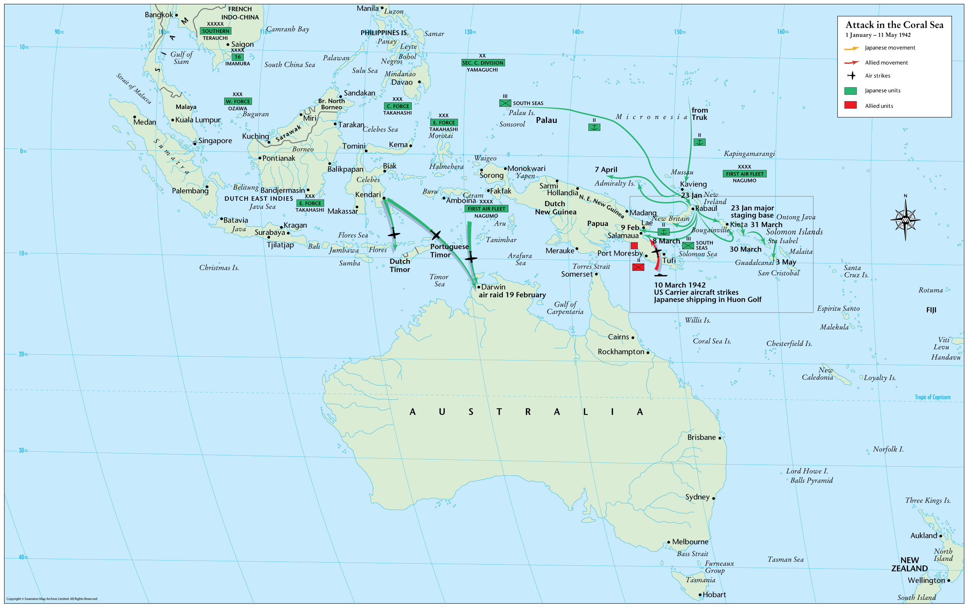
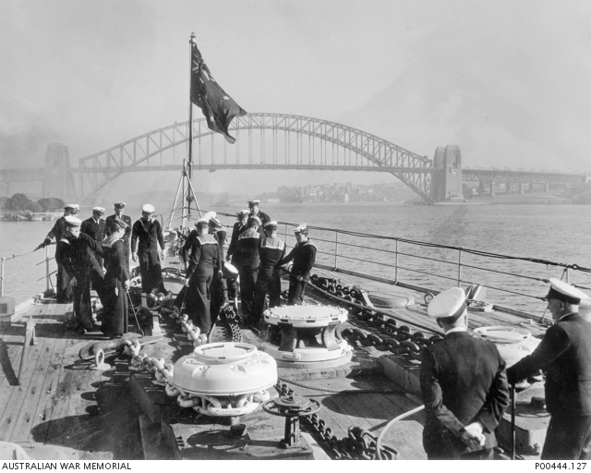
The Japanese advance forced HMAS Australia home in 1942
HMAS Australia enters
Sydney Harbour
Australian War Memorial
Naval Historical Collection, P00444.127
Attack in the Coral Sea, 1942
The Map Archive, Ax00314

Slide 22
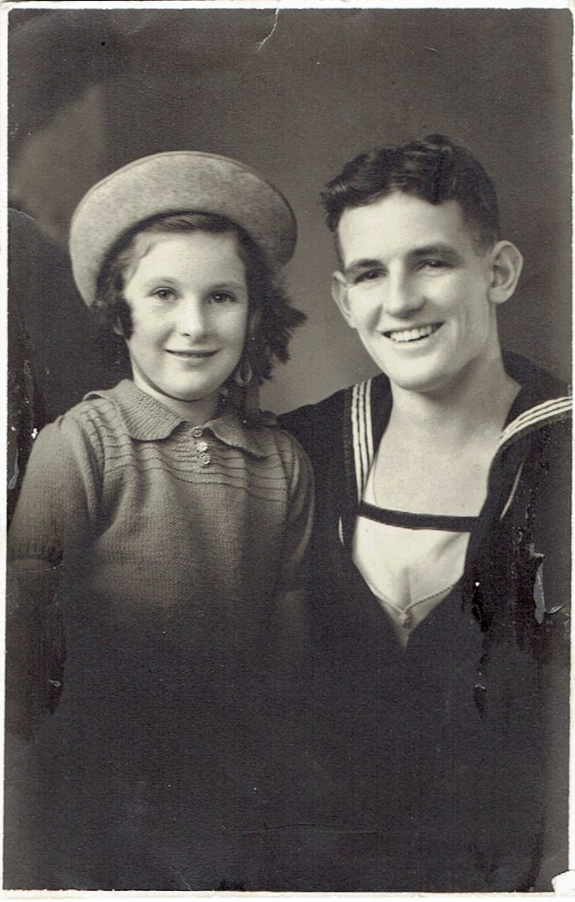
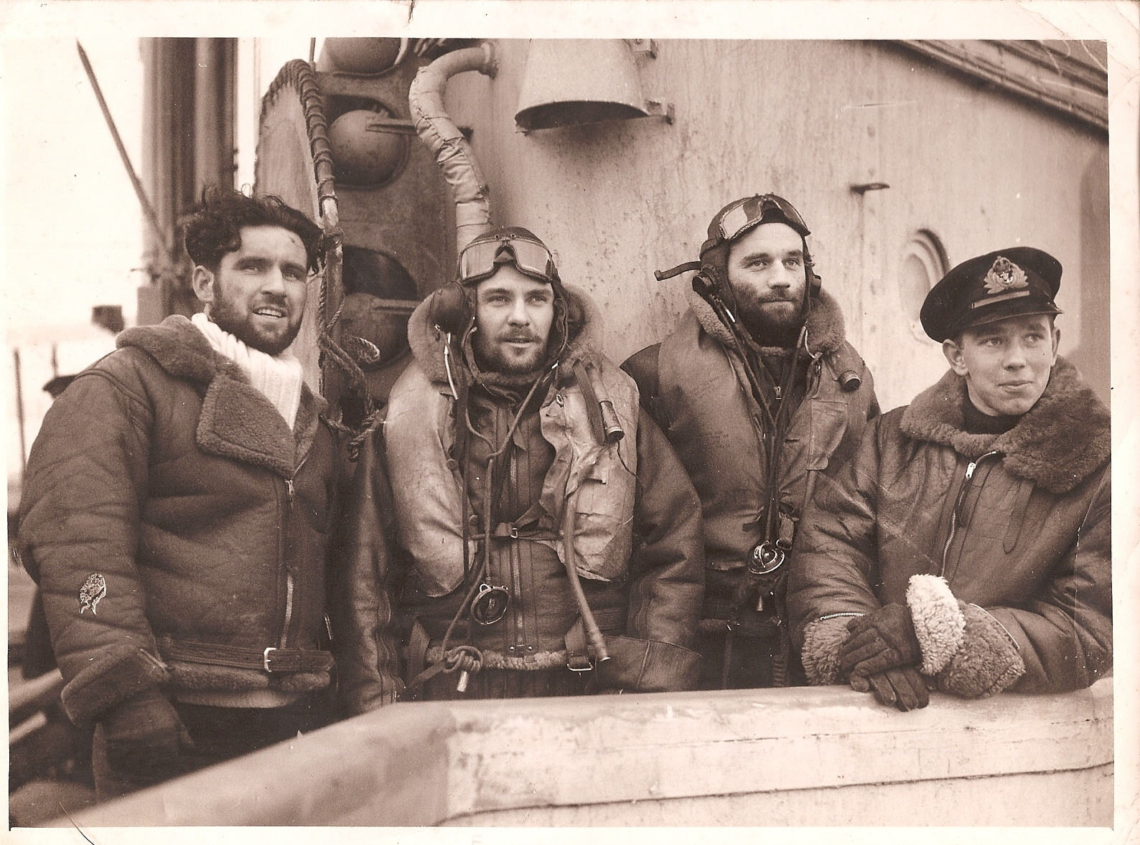
Jack Riley went home on sick leave and Ron Gordon’s brother was MIA
Frank Gordon (second from left) joined the Fleet Air Arm and was missing in action from HMS Victorious while searching for the German battleship, Tirpitz
Giles Yates Collection, ancestry.com.au
Jack and Judith Riley while on sick leave in Bellerive in 1942
Carol Woods Collection

Slide 23
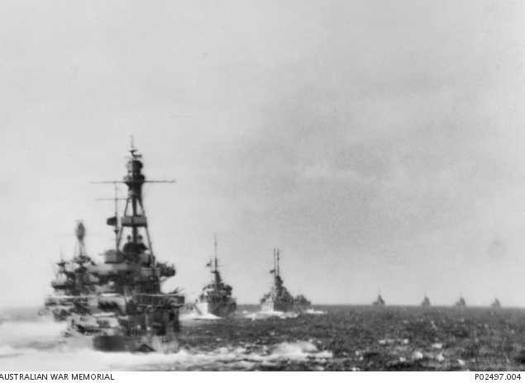
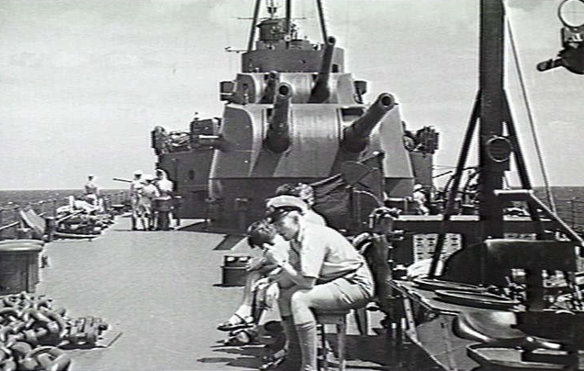
HMAS Australia led Taskforce 44 into the Coral Sea
HMAS Australia with Taskforce 44 into the Coral Sea, 1942
Australian War Memorial Collection, P02497.004
Seaman at 2nd degree readiness on HMAS Australia in the Coral Sea, 1942
Australian War Memorial Collection, 305217

Slide 24
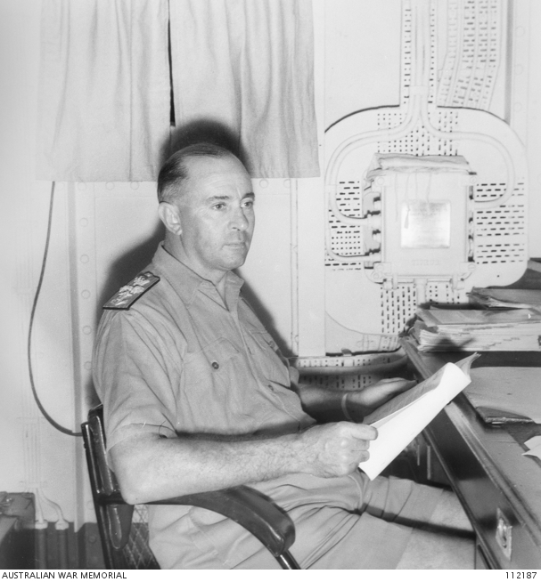
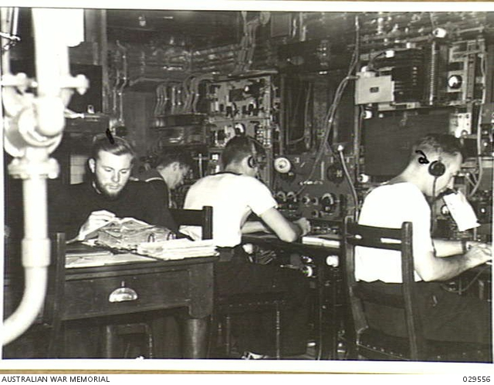
The night of the attack on Jack Riley Thursday, 12 March 1942
Captain Harold Farncomb
in his day cabin
Australian War Memorial Collection, 112187
Wireless Room on HMAS Australia
Australian War Memorial Collection, 029556

Slide 25
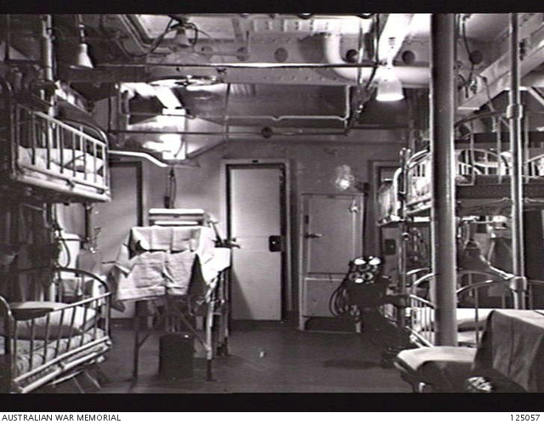
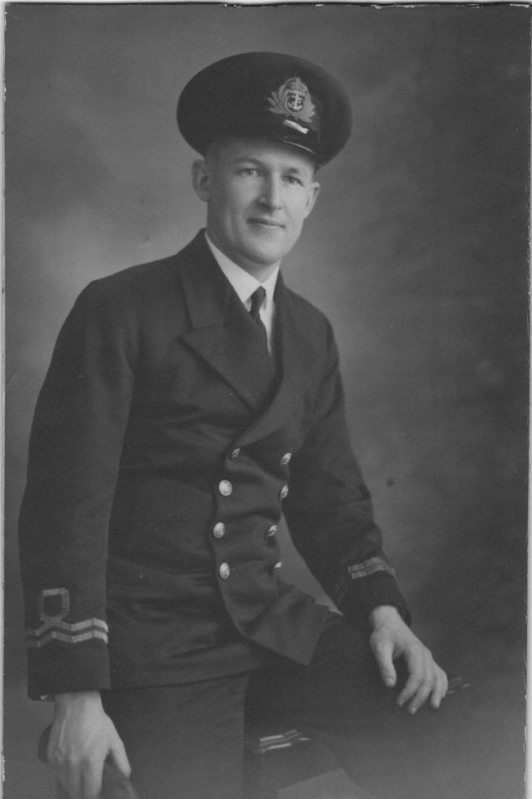
Malcolm Stening strives to save Riley Jack on Friday, 13 March 1942
Operating table in the sick bay
Australian war Memorial Collection, 125057
Surgeon Lieutenant, Malcolm Stening
Obituary, Sydney Morning Herald, 9 March 2015, Rod Lyons

Slide 26
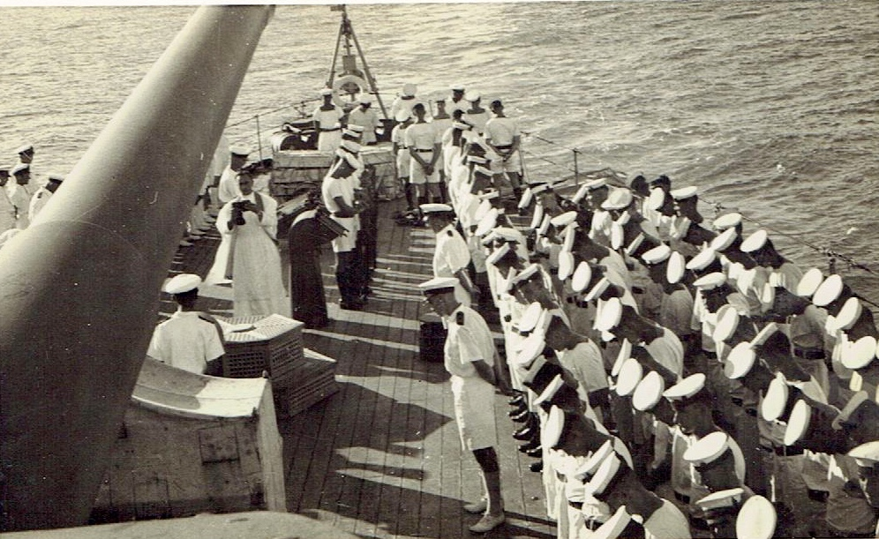
Jack Riley’s burial at sea Saturday, 14 March 1942
Burial at sea of Jack Riley, 17:00, 14 March 1942
Photograph sent to Blanche Riley by Anglican Reverend Frank Oliver, Carol Woods Collection

Slide 27
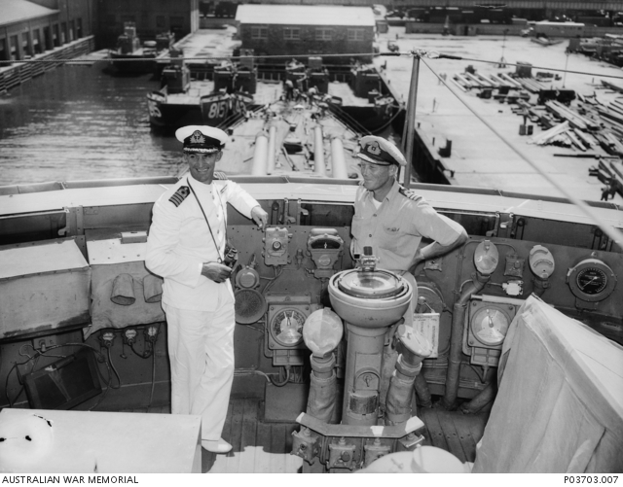
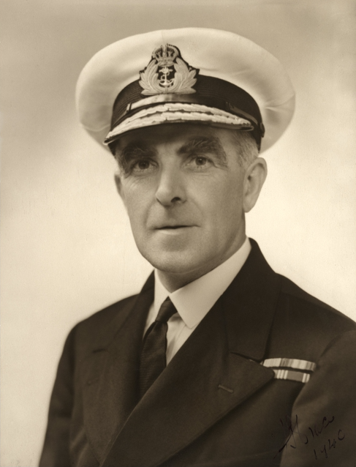
‘Third degree’ investigation finds a ‘nest of immorality’ on HMAS Australia
Commander John ‘Black Jack’ Armstrong, Executive Officer of HMAS Australia
(on left) who undertook the
murder investigation
Australian War Memorial Collection, P03703.007
Rear Admiral John ‘Jack’ Crace, Squadron Commander on HMAS Australia
Australian War Memorial, 305285

Slide 28
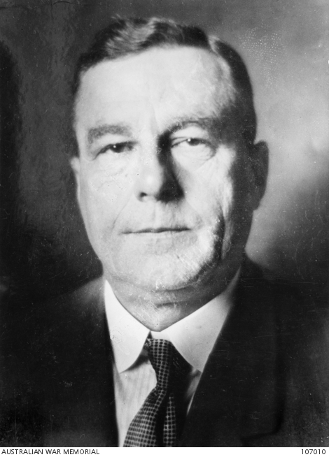
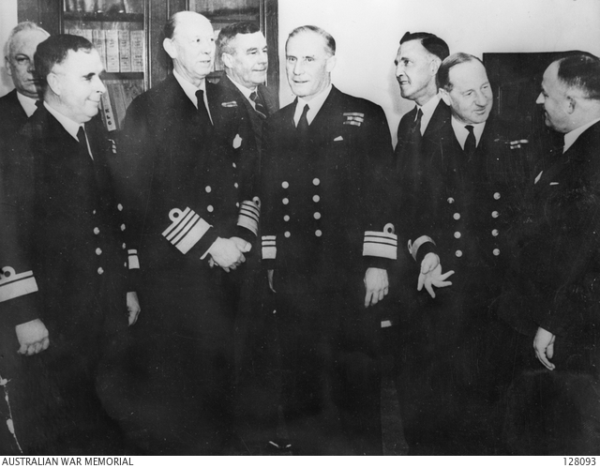
The ACNB in Melbourne are advised of the murder & approve court martial
George Macandie
Secretary to the
Naval Board
Australian War Memorial Collection, 107010
The Australian Commonwealth Naval Board
Australian War Memorial Collection, 128093

Slide 29
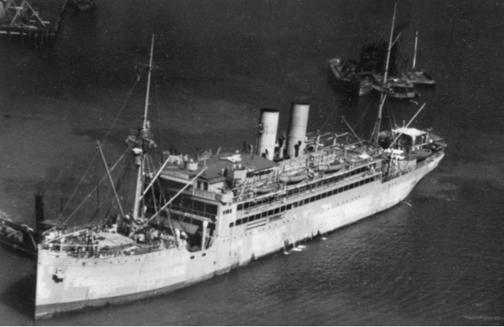
Trevor Rapke ordered from Darwin to Noumea to defend Gordon and Elias
HMAS Merkur
Australian War Memorial Collection, 301049
Paymaster Lieutenant, Trevor Rapke
Jeremy Rapke Collection

Slide 30
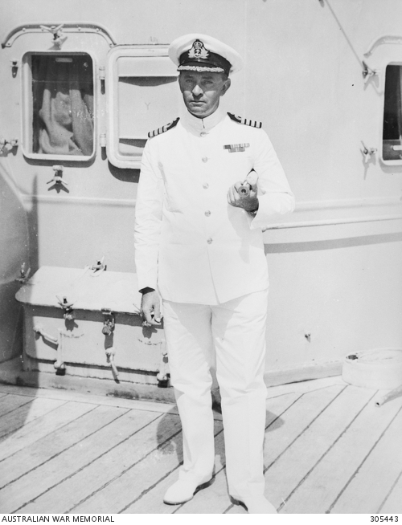
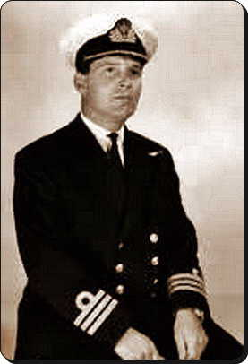
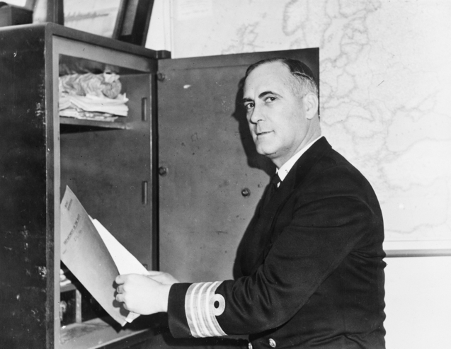
The Court Martial verdict: the death penalty for Gordon and Elias
Captain Harold Farncomb, acted as prosecutor during the Court Martial
Australian War Memorial Collection, 305443
Paymaster Commander, Patrick Perry, secretary to Rear Admiral Crace, was appointed Deputy Judge Advocate to advise the Panel
Australian War Memorial Collection, 017727
Royal Navy Captain
Robert Bevan of HMNZS Leander, served as President of the Court Martial panel
Unithistories.com

Slide 31
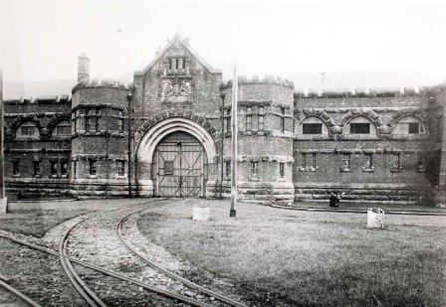
Gordon and Riley return to Australia and are held in Long Bay Penitentiary
Long Bay Penitentiary
Wikipedia Commons
Randwick Library Local Studies Collection, H00/H00030

Slide 32
Navy Minister, Norman Makin stays the death penalty
Navy Minister, Norman Makin, 1941-46, and Vice-Admiral Sir Guy Royle, Chief of Australian Naval Staff, 1941-45
Australian War Memorial Collection, 011636

Slide 33
The Labor Government was under pressure to ban capital punishment
HPRL flyer sent to Norman Makin
NAA: MT1214/1, 445/201/230

Slide 34
Legal experts came to the aid of Ron Gordon and Ted Elias
Dr Frank Luoat
President of the Constitutional Association of NSW
Trove: Sydney Morning Herald, Page 17, Thursday, 4 May 1933
David Hall, former Attorney General of NSW
and Federal MP
National Library of Australia
T Humphrey & Co., PIC/6459/13 LOC B221

Slide 35
The High Court Appeal 4 May 1942
Sir Edward McTiernan
hcourt.gov.au
Sir George Rich, PC, KCMG, KC
hcourt.gov.au
Sir Dudley Williams
hcourt.gov.au
Sir Hayden Starke, KCMG
hcourt.gov.au

Slide 36
Christina Byrnes starts her campaign to free Ted and Ron
Mrs Christina Byrnes, mother of Ted Elias
Trove: The Daily Telegraph, Page 2, Thursday, 23 July 1942
Mervyn Finlay with magistrate and future NSW Premier and Governor General, William McKell
Fairfax Archives
National Library of Australia, 157582036

Slide 37
Sonita Francis monitored by security services after supporting Ron Gordon
Secret Service surveillance photograph
believed to be Sonita Francis and Christina Byrnes
National Archives of Australia: Doris May Francis
C123, 17421

Slide 38
Bert Evatt orders his advisers to find a solution
Allan Dalziel (on right), chief of staff to Bert Evatt
Fairfax Media Archives, FXT107139
Sir George Shaw Knowles
Solicitor General, 1932-46
Office of the Parliamentary Counsel

Slide 39
A diplomatic stand-off with Whitehall
Clement Atlee, Deputy Prime Minister, 1942-45 and Secretary of State for Dominion Affairs, 1942-43,
Wikimedia Commons
Flinders University, 31560859694
Robert Gascoyne-Cecil,
Viscount Cranborne,
Secretary of State for the Colonies
Wikimedia Commons
Yousuf Karsh, Dutch National Archives, 902-2081

Slide 40
King George VI commutes the death sentences to life imprisonment
H. M. King George VI of England
Wikimedia Commons
Matson (G Eric and Edith) Photograph collection
US Library of Congress, 04464

Slide 41
Ron Gordon and Ted Elias transferred to Goulburn Reformatory
Goulburn Reformatory
Archives Office of NSW, 720

Slide 42
Evatt’s gamble – adopting the Statute of Westminster, October 1942
Opposition Leader, Robert Menzies
National Library of Australia, 136264652
Bert Evatt listening to debate
State Library of NSW, 110316141

Slide 43
Senior clergyman campaign to free Ron Gordon and Ted Elias
The Anglican Bishop of Goulburn, Dr Ernest Burgmann
Anglican Diocese of Canberra and Goulburn
Catholic Cardinal of Sydney
Norman Gilroy
Find a Grave, Eman Bonnici

Slide 44
Maxwell Inquiry in February 1944 recommends lesser gaol terms
Percy Spender, KC
Minister for the Navy, 1940
Australian War Memorial Collection, C24162
Justice Alan Maxwell Snr
(on right)
Fairfax Media Archives

Slide 45
Battle between Navy and Attorney Generals delays prisoners release
Alfred Nankervis, Secretary of the Department of the Navy
Australian War Memorial Collection, 107011
Sir George Shaw Knowles,
Secretary of the
Attorney Generals Department
Office of the Parliamentary Counsel

Slide 46
Judge Rainbow and Sir Kenneth Bailey achieve legal breakthrough in 1949
Judge Alfred Rainbow,
President,
Prisoner’s Aid Association
Lynn Rainbow Collection
Sir Kenneth Bailey,
Secretary,
Attorney General’s Department
1946-64
National Library of Australia, 137110966

Slide 47
Ted Elias (AKA Ellis) married one week after leaving gaol in September 1950
Ted Elias marriage to Jean Harrison (on right)
with Ron Gordon and unnamed bridesmaid (on left)
Giles Yates Collection: ancestry.com.au

Slide 48
Ron Gordon married later in life
Ron Gordon marriage to Maureen Nancy Pitt Mullis
With Judith Crosland and Giles Yates
Giles Yates Collection, ancestry.com.au

Slide 49
Memorials to Jack Riley
The Australian War Memorial
Wikipedia, Capital photographer
Plymouth Naval Memorial
Wikimedia Commons, Partonez

